Slide 1


Can you come to my party?
新目标八年级上册
SA 1a—2c
The first day

Slide 2

Warm up
Peel three bananas .
Cut up the bananas.
Put the bananas in the blender.
Pour the milk into the blender.
Turn on the blender
Drink the milk shake.

Slide 3
Phonetics
//
//
pepper
yogurt
cheese
//
//
spoon
//
serve

Slide 4
Revision
1.Pour hot water into the blender .(改为否定句）
_____ _____ hot water into the blender.
2.This pair of shoes is 150 yuan(划线提问）
_____ ______ ____ this pair of shoes ?
3.There is some water in the bottle .(一般）
_____ ______ _____ water in the bottle ?
4.You must drink coffee.(改为祈使句）
______ _______ coffee .
5.Mary studies English by listening to tapes.(划线）
______ ______ Mary ______ English ？
Don’t
pour
How
much
is
Is
there
any
Don’t
drink
How
does
study

Slide 5

Revision
1. In 50 years there ___ more robots in people’s homes.
A. were B. will have C. will be D. have
2.Will people live to be 300 years old ?--_____
A. No, they aren’t. B. No, they won’t .
C. No, they don’t . D. No, they aren’t .
3.They _____ any classes next week .
A. will have B. won’t have C. have D. had
4.What _____ the students _____ tomorrow ?
---- They will clean the classroom .
A. do ; do B. did ; do C. will; do D. is doing

Slide 6
Revision
comes
1.I ’m going to call him up when he _____
(come) here tomorrow .
2. The old man wants _____ (go) to Hainan
for a vacation this winter.
3.Do you enjoy ______(play)soccer in the park ?
4.Yesterday our scho0l _______ (have)a sports
meeting on the playground.
5.Every girl in our university wants to exercise
and keep ____ (fit)
to go
playing
had
fit

Slide 7

Lead in

Slide 8
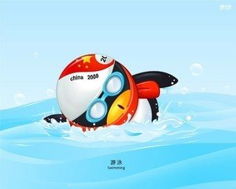


Can you swim ?
Yes . I can.
No, I can’t.

Slide 9
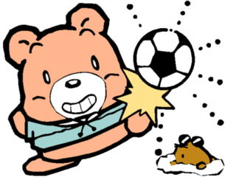
Can you play soccer ?
Yes . I can.
No, I can’t.

Slide 10


Can you come to my party ?
提出邀请
May 5
Sure , I ’d love to.

Slide 11


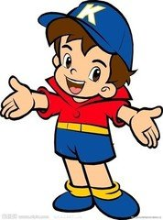
Can you come to my party?
Sure, I’d love to.

Slide 12
Can you come to my party?
Of course, I’d love to.

Slide 13
Can you come to my party?
Yes , I’d love to.

Slide 14
Notes
Can you come to my party ?
你能来我的聚会吗？
can除了表示能力之外，还可以表示邀
请，常用一般疑问句形式
接受邀请可以回答 ：
Sure, I’d love to.
Of course, I’d love to.
Yes , I’d love to.

Slide 15
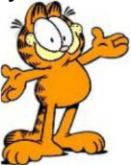
Exercise
1. Can you watch TV with me? (肯定回答)
____ , _____ ____ to.
Sure I’d love
2.Can you come to my house.
3. Can you go to the movies tomorrow
night?
A. Sure , I ’m busy. B. Sure, I’d love to .
C. Sorry , I’d love to. D. I ’m sorry I can .
____ _______, ____ _____ to.
Of course I’d love

Slide 16

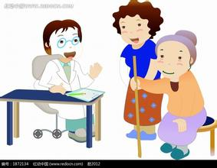
Look at the pictures and guess the meaning.
prepare for an exam
help my parents
go to the doctor

Slide 17
Can you come to my party?
Sorry, I have to
prepare for an exam.

Slide 18
Can you come to my party?
Sorry, I have to
help my parents.

Slide 19
Can you come to my party?
Sorry, I have to
go to the doctor.

Slide 20
Notes
Can you come to my party ?
你能来我的聚会吗？
can除了表示能力之外，还可以表示邀
请，常用一般疑问句形式
拒绝接受邀请可以回答 ：
Sorry , I ’m not available.对不起我没空
I ’m sorry. I have to +原因
I’d love to .but I’m afraid I can’t .I have to +原因…
我很乐意。但是我恐怕不能。我不得不…

Slide 21
Exercise
Sorry, I have to…
have to表示“被动”“客观”的必须做
单三has to 过去式had to
must表示“主动”“主观”的必须做
Lily ______play the guitar every day .
Lily ______play the guitar yesterday .
A. have to B . has to C . had to
Lily _____(must) play the guitar.
B
C
must

Slide 22
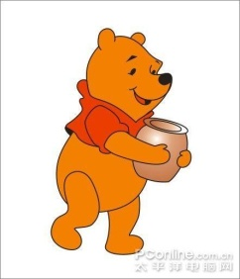
Exercise
1.Can you _____ over to my house to watch CDs?
--Yes, I’d love to.
come B. comes C. coming D. to come
2. --Can they play basketball with us?
--No, they are not ___. They have to meet friends.
busy B. free C. angry D. time
3. --____ you turn down your radio, please?
--Yes, I can.
A. May B. Need C. Must D. Can

Slide 23
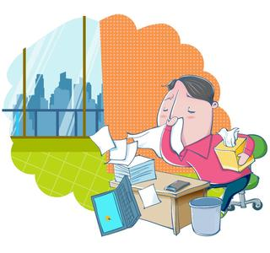
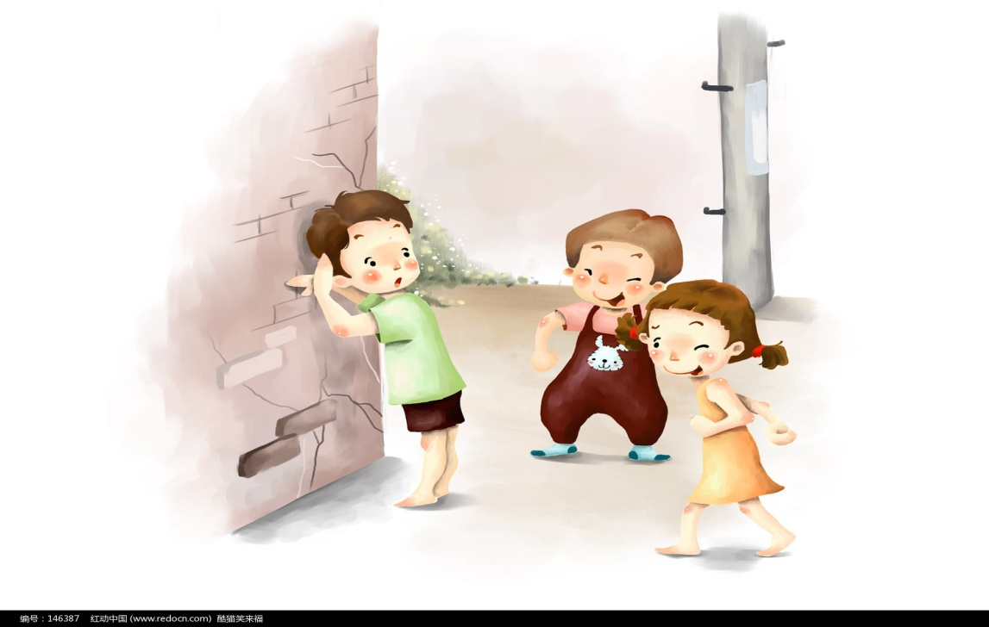
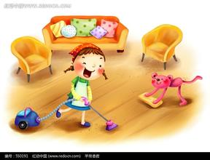
Look at these picture s, repeat the
phrases as quickly as you can .

Slide 24
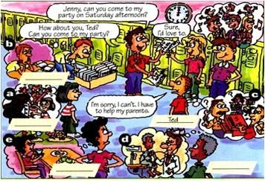
1a. Match the words with the pictures.
a
b
1. prepare for an exam ____ 4 . meet my friend ____
2. help my parents____ 5. have the flu ____
3. go to the doctor ____
e
c
d

Slide 25
Notes
1. prepare for an exam 为考试做准备
★prepare 不及物动词 使做好准备；把……准备好
★preparation n. 准备，准备工作
★prepare for 为……做准备
★ prepare to do sth 准备做某事
She has to ____________ (prepare) her exam
I _________(prepare)________(read) a book.
prepare for
prepare
to read

Slide 26
Notes
2. have the flu 患感冒
have a cold 感冒
=catch a cold
--What’s the matter with you, Tom ?
--Oh, I _____.
A. have flu B. has the flu C. have the flu

Slide 27

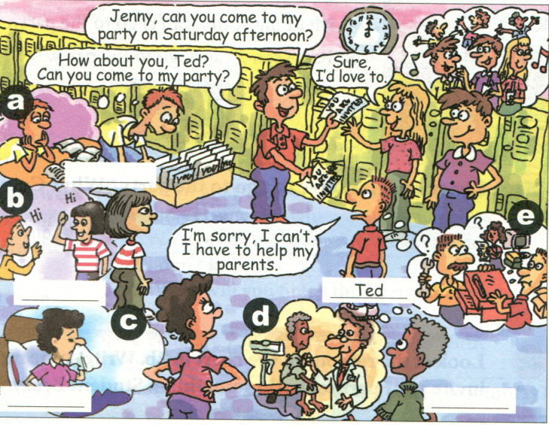
1b. Listen and write the names.
Tim
Anna
Ted
Kay
Wilson

Slide 28
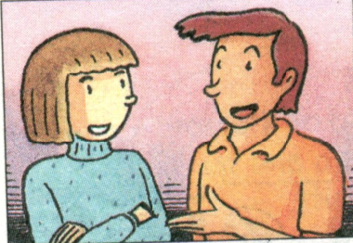
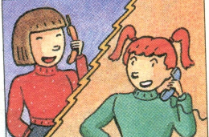
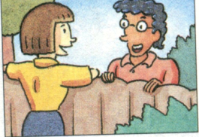
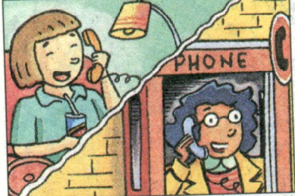
2a. Listen and circle “can” or “can’t”.
1.Jeff can/can’t come to the party.
2.Mary can/can’t come to the party.
3.May can/can’t come to the party.
4. Claudia can/can’t come to the party.
5. Paul can/can’t come to the party.

Slide 29
2b. Listen again. Who can’t go to the
party? Why ? Complete the chart.
Names
Reasons
He isn’t free. He might have to
meet his friends on Saturday.
Jeff
May
She has the flu.
Mei Ling
She must study for a math test.

Slide 30
2c Look at the reasons in the chart in 2b. Write
some more. Then, Student A, invite your
partner to do something. Student B, say you
can’t go and why.
A:Hey, Dave. Can you go
to the movies on Saturday?
B: I’m sorry. I’m not
available. I have too much
homework this weekend.
A: That’s too bad. Maybe
another time.
B: Sure, Joe. Thanks for
asking.
1. too much homework
2. _______________
3. _______________
4. _______________
to meet my friend
the flu
to go to the doctor

Slide 31
Notes
1. too much homework
too much +名不
too many +名复
much too + 形容词
1.I have ____homework to do.
2.He has _____ friends.
3.Eric is _____ thin.
A. much too B . too much C. too many
B
C
A

Slide 32
Notes
2.Maybe another time.
3.Thanks for +doing
helping
(1) Thanks for _______(help) me.
help
(2) Thanks for your _______(help).
B
(3) Thanks for ___ me.
A. to ask B. asking C. asks

Slide 33
Exercise
Thank you for ___(invite) me, but I can’t go to Lily’s party with you.
Paul has to study _ (at/ for) the English test tonight.
I have too __ (much/ many) water to drink.
Can you come to my party _ (at/ on) Sunday night?
5. Sorry ,I ’m so busy .______(Maybe/May be) another time!
inviting
for
much
on
Maybe

Slide 34
Exercise
1. I can come to your party. (变一般疑问句)
_____ you _____ to ______ party?
2. He has to go to see the doctor. (变否定句)
He ______ ______ ____ go to see the doctor.
3. She has to stay at home and do her homework.
(对划线部分提问)
______ ______ she ______ to ______?
4. Thanks for helping me today. (同义句)
Thanks for ______ _______ today.
5. Can you go shopping with me. (肯定回答)
____ ___ ______
Can come my
doesn’t have to
What does have do
your help
Yes , I can .

Slide 35
Exercise
come
1. Can you _____ (come) to my birthday party?
2. We _________ (have) a piano lesson now.
3. They had two English _______ (lesson)
yesterday morning.
4. Do you often help your mother _____ (do )
housework?
5. She ______ (can not) go with you.
are having
lessons
do
can’t

