Slide 1
How do you make a banana milk shake?
新目标八年级上册
Unit 8

Slide 2
Warm up

Slide 3
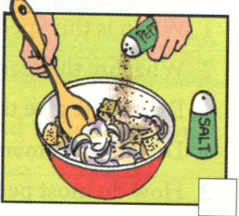
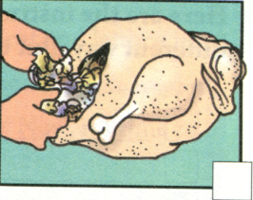
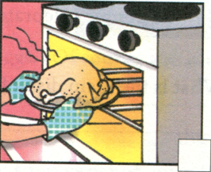
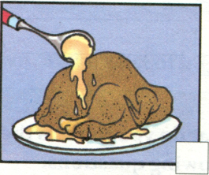
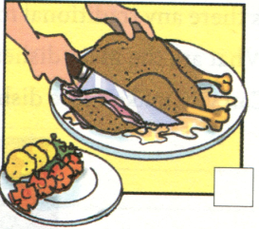
How do you make a turkey dinner?

Slide 4
Phonetics

Slide 5
/  /

Slide 6
/ ɜ /

Slide 7
/  /

Slide 8
/  /

Slide 9
/ /

Slide 10
England

Slide 11
celebrate

Slide 12
pepper

Slide 13
gravy

Slide 14
cover

Slide 15
Revision

Slide 16
Fill in the blanks with the words.
1. _____ was a man’s name long ago, but it’s a
kind of food now.
2. Bring me two ____ of bread. I’d like to make a
sandwich.
3. American families usually eat a big _____ on
Thanksgiving Day.
4. ____ is a kind of vegetable. Do you like it?
5. Western people like to eat bread with _____ .
lettuce, butter, sandwich, turkey, piece
Sandwich
pieces
turkey
Lettuce
butter

Slide 17
Choose the right answers.
Wow! Ten students in our class will celebrate their
fourteenth birthdays October!
A. in B. on C. at D. to
2. Thanksgiving is a time to give ____ for food in the
autumn.
A. goodbye B. thanks C. help D. sorry
3. My father asked us to the box these books.
A. add; to B. fill; to C. add; with D. fill; with
4. Here is a way to make turkey a Thanksgiving
dinner.
A. on B. to C. of D. for

Slide 18
Fill in the blanks。
1. Every year hundreds of ___ (travel) come to my
town on holiday.
2. Thanksgiving is always on the _____ (four)
Thursday in November.
3. Here are some ways _____ (improve) your
English.
4. You can put some turkey ______ (piece) on the
sandwich.
5. Please buy some ____ (potato) this afternoon.
travelers
fourth
to improve
pieces
potatoes

Slide 19
Fill in the blanks.
1. Zhou Danhua is going to ___ (英格兰)next week.
2. I like ___ (秋天)best. Because the weather is
cool.
3. We had a party to ____ (庆祝)her birthday last
night.
4. Tom, add some salt and ___ (甜椒)in the pot.
5. We often eat _____ (传统的)food like dumplings
during the Spring Festival.
England
autumn
celebrate
pepper
traditional

Slide 20
Lead in

Slide 21
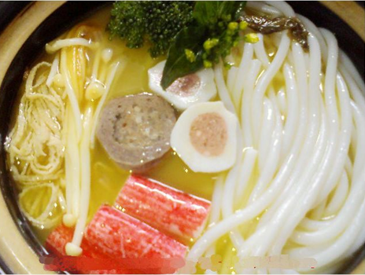
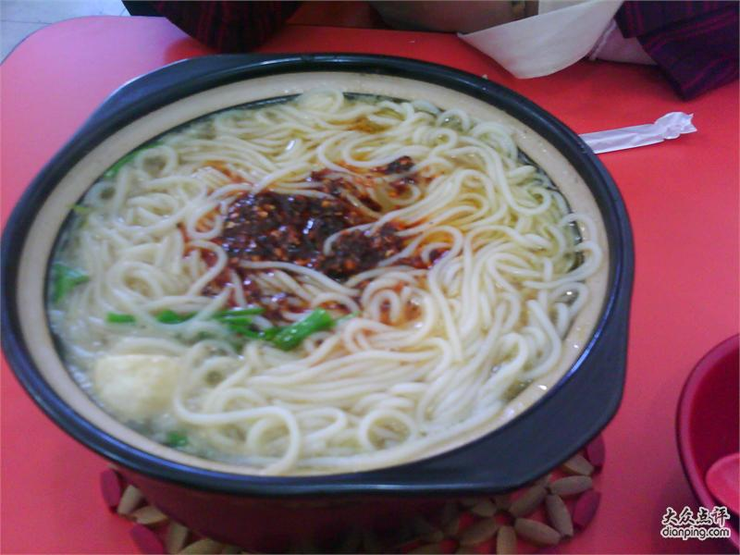
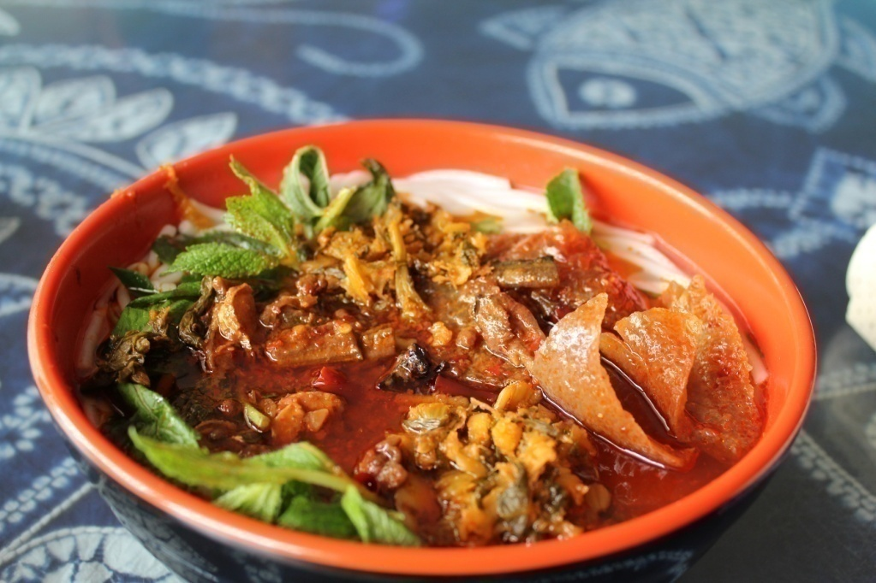
Do you know it?
Yunnan Rice Noodles

Slide 22
3a. Read the recipe below and fill in the blanks with the
words in the box.
cook next wash finally have enjoy first cut
Yunnan Rice Noodles
In Yunnan, many people eat rice noodles for breakfast, and even for lunch and dinner. To make this special food, you need to_______ rice noodles, chicken, lettuce and eggs, (Of course, you can also have other things like
have

Slide 23
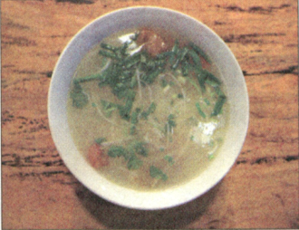
fish and different vegetables.) _______, _______the lettuce and cut it up._______, _______the chicken into pieces. Then , make the chicken soup very hot, over 100 ℃ . Then,______ the eggs, meat and lettuce in the pot of hot soup, one by one.______ , put the rice noodles into the soup. Now , it’s time to ____ the rice noodles!
First
wash
Next
cut
cook
Finally
enjoy

Slide 24
Grammar in 3a:
1. to make this special food
目的状语
______(catch) the early bus, Bob has to get up early.
To catch
2.
make sb. do / make sb. adj.
She often makes her mother _______(laugh).
laugh
My sister always makes me ________(happily).
happy
3. over
超过= more than

Slide 25
Grammar in 3a:
I have over 60 story books. (=)
I have more than 60 story books.
4.the pot of
Don’t touch the p____of hot water.
ot
5. one by one
一个接一个读。
Read it one by one.

Slide 26
Grammar in 3a:
6.it’s time to
=It’s time for
It’s time _______(eat) lunch.
=
to eat
It’s time for lunch.

Slide 27
3b. Think of a favorite food in your hometown. Make a
list of ingredients.
_____________________________________
____________________________________
____________________________________
Tomato and beef noodles
noodles
tomatoes
beef
green onion
some relish(just like salt , sauce and pepper)

Slide 28
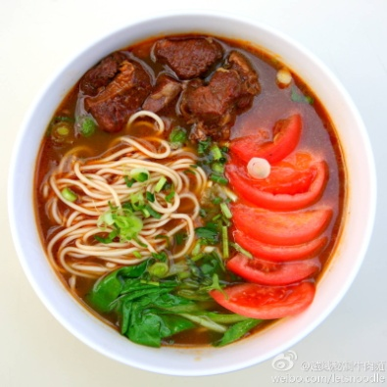
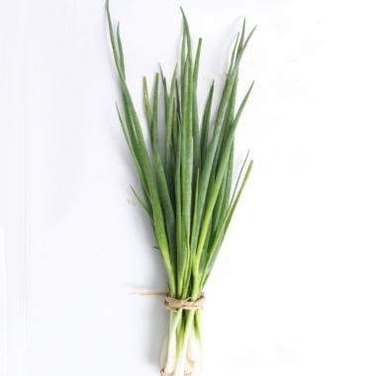
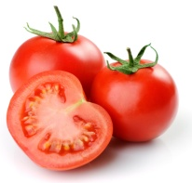
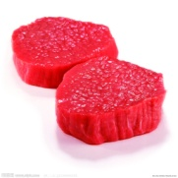
Writing exercise:
Tomota and beef noodles
In my hometown, most people like to eat tomoto and beef noodles.To make the noodles, you need to have tomatoes , beef, and some green onions . First, wash the tomatoes and green onions . Cut them up. Then cut the beef into pieces. Put the noodle into the pot of hot water for a few minutes. Then put the ingredients into the noodles.Finally ,enjoy the noodles.

Slide 29
Self check:
Number these instructions for making tomato and
egg soup in the correct order. Then complete the instructions with the words in the box.
Finally
______,mix everything together and serve it.
______,cook for five minutes and add two eggs.
______, cut up three tomatoes and put them into the
pot.
______, add some water,sugar and salt.
4
2
Next
1
First
3
Then

Slide 30
2. Write questions and answer using the words in brackets.
Q；________________________________
( how many / eggs/ we/ need/make/ cake)
A:_________________________________
( two)
How many eggs do we need to make a cake?
Two .
2. Q；________________________________
(how much/ milk / we / need)
A:_________________________________
(three cups)
How much milk do we need?
Three cups.

Slide 31
Do we have to add any sugar or honey?
3. Q；________________________________
(we /have to / add/ sugar or honey)
A:_________________________________
(yes/can/add/two spoons/honey)
Yes, we can add two spoons of honey.

Slide 32
Fill the blanks with the first letters.
1. You must cook it at very high t _____ for
a long time.
2. Please place the turkey on a large p __ .
3. First, m __ together some bread pieces,
onions, salt and pepper.
4. Could you s ___ him some tea?
5. People in E ___ often talk about weather
when they meet.
emperature
late
ix
erve
ngland

Slide 33
Fill the blanks.
1. They often wear beautiful clothes special
holidays.
2. She studies math asking the teacher for
help.
3. What is the main dish the Thanksgiving
meal?
4. They will give thanks life and food in
their new home tomorrow.
5. Next, fill the turkey the bread mix.
on
by
of
for
with

Slide 34
1. Teachers’ Day is on September 10th.
__ __ Teachers’ Day?
2. People celebrate it by having a big meal at home
__ _ people _______ it?
3. Last night I served my classmates delicious turkey.(=)
Last night I _ delicious turkey my classmates.
4. The box is filled with books.(=)
The box __ __ __ books.
5. I think the most special day in China is Spring Festival
is the most special day in China?
When
is
How
do
celebrate
served
to
is
full
of
What
do
you
think

