Slide 1
How do you make a banana milk shake?
新目标八年级上册
Unit 8

Slide 2
Warm up

Slide 3
Anna: Sam, I want to _____ ______ soup ___a party
___Saturday . Can you ____ me ____?
Sam: ____. First, ____ some beef , one cabbage, four
carrots, three potatoes, five tomatoes and one
onion . Then, ____ ____the vegetables.
Anna: What’s ____?
Sam: Next, ____ the beef, carrots and potatoes____a
pot and ____some water. After that, ____ them
___ 30 minutes.Then, ___the cabbage, tomatoes
and onion and cook ____ ______10 minutes.
Anna: OK, _____ ____?
Sam: No, ___ _____thing. Finally, don’t ____to ___
some ______.
make
Russian
for
on
tell
how
Sure
buy
cut
up
next
put
into
add
cook
for
add
for
another
that’s
it
one
more
forget
add
salt

Slide 4
Revision

Slide 5
Exercisre:
Fill in the blanks
1. --- do you make a sandwich?
--- I don’t know. Please ask mom. She can make it.
2. Please pour some milk into the glass.(×)
Please milk into the glass.
3. Tim ate three bananas yesterday.
bananas did Tim yesterday?
4. We need two spoons of honey.
honey do you need?
5. 妈妈让我向汤里面添加一些盐。(汉译英)
Mother asks me to some the soup.
How
don’t
pour
any
How
many
eat
How
much
add
salt
to

Slide 6
Correct the sentences.
1. Cut up the turkey and put them in the bowl. ( )
A B C D
2. Two spoon of sugar are enough. ( )
A B C D
3. There are some butter on the bread. ( )
A B C D
4. How many salad would you like? ( )
A B C D
5. Do you like eating tomato? ( )
A B C D
C it
A spoons
A is
A much
D tomatoes

Slide 7
Choose the right answers.
–How many ____ do we need to make fruit salad?
-- Two should be enough.
A. cabbage B. potatoes C. bananas D. lemon
2. – Do you like the lettuce in sandwich?
--____.
A. Yes, I am. B. Yes, I do. C. No, I do. D. No, I’m not.
3.---How do you make fruit salad?
---____ cut up three bananas and a watermelon. Next put them in a bowl.
A. First B. Next C. Then D.Finally
4. Turn on the blender ______ about two minutes.
A. for B. in C. to D. at

Slide 8
Lead in

Slide 9
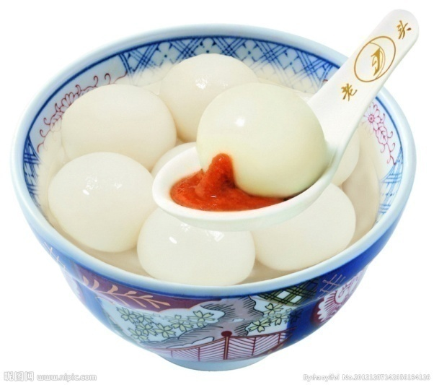
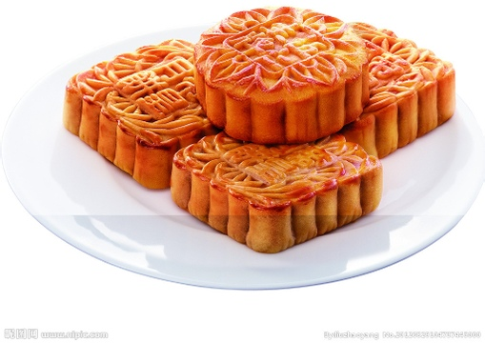
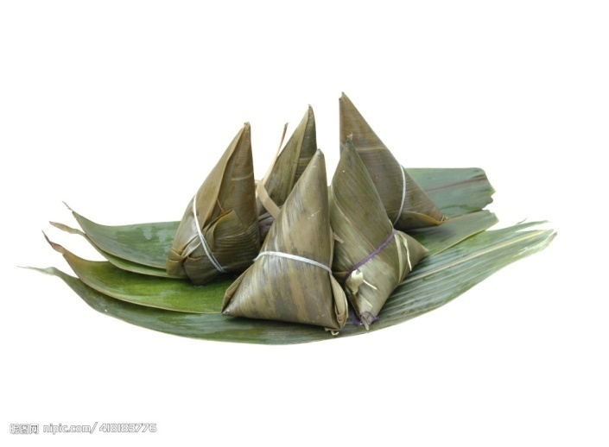
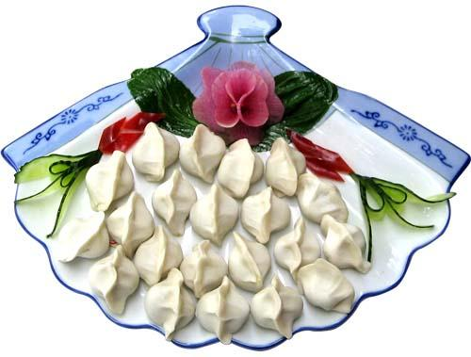
/  /
What kind of traditional food do people eat on special holidays in China?

Slide 10
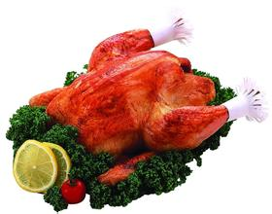
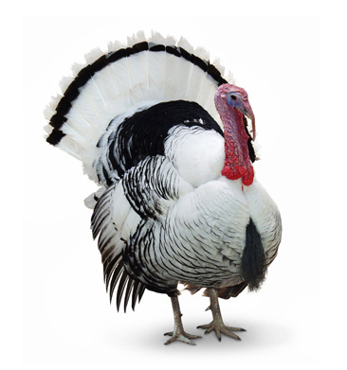
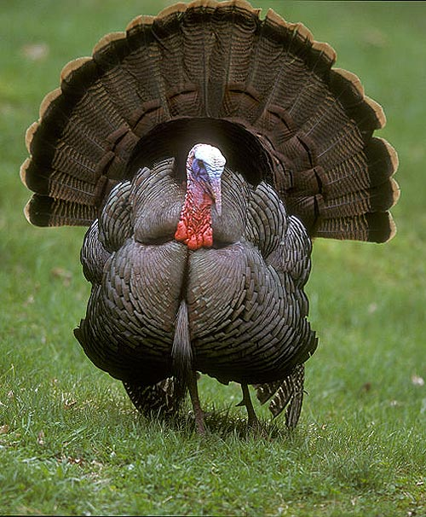
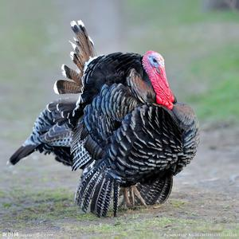
What animals are they?
When do we eat them?

Slide 11
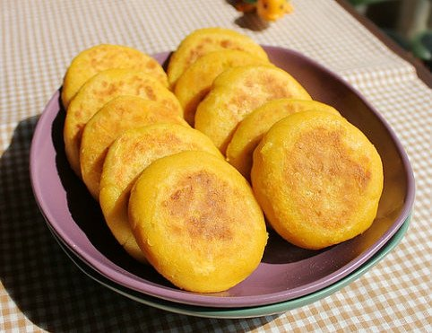
感恩节（Thanksgiving Day）是美国和加拿大共有的节日，由美国人民独创，原意是为了感谢上天赐予的好收成、感谢印第安人的帮助。在美国，自1941年起，感恩节是在每年11月的第四个星期四，并从这一天起将休假两天；加拿大的感恩节则起始于1879年，是在每年10月第二个星期一，与美国的哥伦布日相同。近年来，众多国内学者倡议设立“中华感恩节”，以弘扬传统文化。

Slide 12
Grammar in 2b:
1. Thanksgiving in the United States
美国的感恩节
Thanksgiving = Thanksgiving Day
2. in most countries
在大多数的国家
Most ______(student) in our class are boys.
students
3.eat tradional food
吃传统的食物

Slide 13
Grammar in 2b:
Spring Festival is a ________(tradition) festival in China.
traditional
4.on special holidays
在特殊的节日时
holiday (假期） = vacation
What do you usually do on special _______(holiday)?
holidays
你准备去哪度假？
Where are you going on your holiday?

Slide 14
Grammar in 2b:
5. on the fourth Thursday in November
在11月的第四个星期四
on 具体日 ，星期 in 月、 年，
She was born ____1990.
Bob will leave here ___Jan. 25th.
in
on
6.it’ s a time to
一个….的时候
to go
It’s a good time __________(go ) there.

Slide 15
Grammar in 2b:
7. give thanks for…
对…表示感谢
+v.ing
让我们感谢我们的国家。
Let’s give thanks for our country.
8. in the autumn
在秋天
秋天树叶都变黄了。
The leaves turn yellow in autumn.
We give thanks for the food ___ ____ ________. (秋天）
in
the
autumn

Slide 16
Grammar in 2b:
9. at this time
在这个时候
10. also /too/either
She ____wants to go with us.
I like swimming ,______.
Mary doesn’t want anything ,_________.
also
too
either
11.remember to do / remember doing
I remember ______(clean) my room.
My mum remembers _______(post) the letter.
to clean
posting

Slide 17
Grammar in 2b:
12. the first travelers from England
来自英国的第一批旅行者
v.travel travel to travel all over the world
I want to be a _______(travel) when I grow up.
traveler
13. come to
来（到）…
Do you come ________(study) with me?
to study
14. many of
许多 + 可名复

Slide 18
Grammar in 2b:
Many of ______(travel) are from Japan.
travelers
15. died
die的过去式
n. death
adj. dead
That poor man ______(die) yesterday.
Most people are afraid of _______(die).
We always see some ______ mice on the street.
died
death
dead
16.in the next autumn
在下一个秋天
17. these days
如今

Slide 19
Grammar in 2b:
18. this idea of
…的意愿、想法
Most Americans still celebrate this idea of _______(give) thanks for the food.
giving
19.by+v.ing
通过…方式
Most Chinese people study English by _______
(read) the textbooks.
reading
20. have a big meal
吃一顿大餐

Slide 20
Grammar in 2b:
21. The main dish of the meal
这一餐的主菜
The m______ dish of the meal is chicken.
ain
22.here is /are
这是
Here _____(be)the photo of my sister.
is
Here _____(be)students from America.
are
23.one way to…
一个….方法/方式
It’s one way _______(make) fruit salad.
to make

Slide 21
Grammar in 2b:
24. fill …with…
用….填满….
be full of = be filled with 装满
Don’t fill the box ______(介) the books.
with
--The box is too heavy to carry. What’s in it?
-- Oh, it is ____books.
A. filled with B. covered with
C. used for D. asked for

Slide 22
Grammar in 2b:
瓶子里装满了水。
The bottle is full of water.
= The bottle is filled with water.
25.put…in…
把…放进…
=put …into…
Put your toys ______ the box.
in/ into
26. for a few hours
（持续）几个小时
for +段时间 划线提问用 how long

Slide 23
Grammar in 2b:
She’s going to stay there _____two months.
for
How long is she going to stay there?
27. place the turkey on a large plate
把火鸡放在一个大盘子上
Sam, don’t p______the food on the table.
lace

Slide 24
Grammar in 2b:
28.cover …with…
用…把…. 盖上
Don’t worry. C ______the cut _____(介) the clean cloth.
over
with
29.cut…into..
把…切成…
First, you should cut the chicken _____the pieces.
into
30. eat the meat with vegetables like carrots and
potatoes
和（像）胡萝卜和土豆这样的蔬菜一起吃肉

Slide 25
It’s a big house _____ (介) a beautiful garden.
I want to eat a sandwich ________ some salad.
with
with

Slide 26
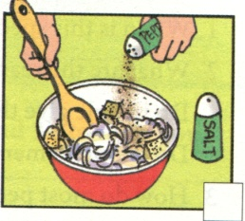
Exercise :
How do you make a turkey dinner?
First, ____ _____some bread pieces, onions, salt and
pepper.
mix
together

Slide 27
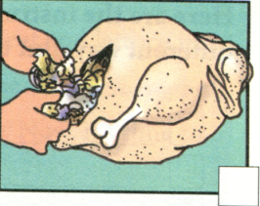
How do you make a turkey dinner?
Next, ____the turkey ______this bread mix.
fill
with

Slide 28
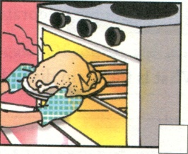
How do you make a turkey dinner?
Then, ____ the turkey ____a hot_____and cook it ____a few hours.
put
in
oven
for

Slide 29
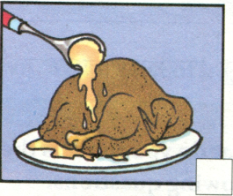
How do you make a turkey dinner?
When it is _____, _____ the turkey____a large _____and _____ it ______ gravy.
ready
place
on
plate
cover
with

Slide 30
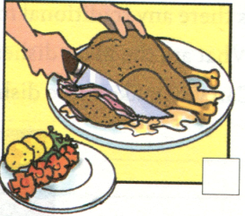
How do you make a turkey dinner?
Finally, ____the turkey ______ thin ______and eat
the meat ______vegetables ____ carrots and potatoes.
cut
into
pieces
with
like

Slide 31
2c. Read the article again and answer the following
questions.
Where do people celebrate Thanksgiving?
____________________________________
2. When do people celebrate?
___________________________________
3. Why do people celebrate it?
__________________________________
4. How do people celebrate it now?
__________________________________
5. What is the main dish of the Thanksgiving meal?
_____________________________________
In the United States.
On the fourth Thursday in November.
To give thanks for food in the autumn.
By having a big meal at home with their family.
Turkey .

Slide 32
2d. Here are the instructions for making a turkey
dinner written in a different way. Put them in
order.write First, Next, Then and Finally.
______,serve it to your friends with some vegetables.
______,put this into the bird.
______, cook it at a very high temperature for a
long time.
______, put everything you need together in a large
bowl.
serve sth. to sb.
我们应该为那些贫困的人提供一些食物。
We should serve some food to the poor people.

Slide 33
2d. Here are the instructions for making a turkey
dinner written in a different way. Put them in
order.write First, Next, Then and Finally.
at a very high temperature 用一个高的温度
take one’s temperature 量某人的体温
______,serve it to your friends with some vegetables.
______,put this into the bird.
______, cook it at a very high temperature for a
long time.
______, put everything you need together in a large
bowl.
First , cook it ____(介) a very high t_________.
at
emperature
The doctor asks me to _____ the temperature.
take

Slide 34
2d. Here are the instructions for making a turkey
dinner written in a different way. Put them in
order.write First, Next, Then and Finally.
Finally
______,serve it to your friends with some vegetables.
______,put this into the bird.
______, cook it at a very high temperature for a
long time.
______, put everything you need together in a large
bowl.
4
2
Next
3
Then
1
First

Slide 35
Fill in the blanks with the words.
1. _____ was a man’s name long ago, but it’s a
kind of food now.
2. Bring me two ____ of bread. I’d like to make a
sandwich.
3. American families usually eat a big _____ on
Thanksgiving Day.
4. ____ is a kind of vegetable. Do you like it?
5. Western people like to eat bread with _____ .
lettuce, butter, sandwich, turkey, piece
Sandwich
pieces
turkey
Lettuce
butter

Slide 36
Choose the right answers.
Wow! Ten students in our class will celebrate their
fourteenth birthdays October!
A. in B. on C. at D. to
2. Thanksgiving is a time to give ____ for food in the
autumn.
A. goodbye B. thanks C. help D. sorry
3. My father asked us to the box these books.
A. add; to B. fill; to C. add; with D. fill; with
4. Here is a way to make turkey a Thanksgiving
dinner.
A. on B. to C. of D. for

Slide 37
Fill in the blanks。
1. Every year hundreds of ___ (travel) come to my
town on holiday.
2. Thanksgiving is always on the _____ (four)
Thursday in November.
3. Here are some ways _____ (improve) your
English.
4. You can put some turkey ______ (piece) on the
sandwich.
5. Please buy some ____ (potato) this afternoon.
travelers
fourth
to improve
pieces
potatoes

Slide 38
Fill in the blanks.
1. Zhou Danhua is going to ___ (英格兰)next week.
2. I like ___ (秋天)best. Because the weather is
cool.
3. We had a party to ____ (庆祝)her birthday last
night.
4. Tom, add some salt and ___ (甜椒)in the pot.
5. We often eat _____ (传统的)food like dumplings
during the Spring Festival.
England
autumn
celebrate
pepper
traditional

