Slide 1
How do you make a banana milk shake?
新目标八年级上册
Unit 8

Slide 2
Warm up

Slide 3
Nick : What are you ______, Jill?
Jill: It’s a_____about the ______.
Nick: ______ cool. So what will the future ___ ____?
Jill: Well, cities will be ____ _______and ______.
_____ _____ ____fewer trees and the
environment will be ___ _____ _________.
Nick: That sounds ____! _____we have to _____
___other _______?
Jill: Maybe . But I want to ____ ____the _____.
Nick: Me, too. Then what ____ we ____?
Jill: We can ___ ____ _____ and plant _____ trees .
_______should ____ __ _____in ______ the
earth.
reading
about
future
Sounds
be
like
more
crowded
polluted
There
will
be
in
great
danger
bad
Will
move
to
planets
live
on
earth
can
do
use
less
water
more
Everyone
play
a
part
saving

Slide 4
Phonetics

Slide 5
side

Slide 6
shape

Slide 7
shake

Slide 8
peace

Slide 9
peel

Slide 10
piece

Slide 11
/speIs/

Slide 12
/bVtE/

Slide 13
/spu:n/

Slide 14
/pXt/

Slide 15
/dIg/

Slide 16
/fIl/

Slide 17
Revision

Slide 18
Translate the phrases into English:
1.在将来
2.用钱
3. 通过电脑
4.活到200岁
5.100年以后
6.空闲时间
7.更多的人
8.反反复复
in the future
use money
on computers
live to be 200 years old
in 100 years
free time
more people
over and over again

Slide 19
Fill in the blanks.
There is a tall ________(build) in front of the post
office.
2.I think there will be _____(little) pollution in the future.
3.I ______(be) able to climb the tree last year, but now I can’t.
4.It will ________(probable) rain.
5.He ______(fall) from a tall tree. Lucily he didn’t hurt badly.
6.We saw many different kind of _____(robot) in Beijing last week.
buildings
less
was
probably
fell
robots

Slide 20
Change the sentences.
1.There will be more people in our country. (× )
_____ ______ _____ more people in our country.
2. I will live in Shanghai in ten years.
_____ ____ you live in ten years?
3. I think he can finish doing the work on time.(=)
I think he _____ _____ _____ finish doing the
work on time.
4. Sally played football yesterday. ( simple future tense)
Sally _____ ____ ______ tomorrow.
5. Li Na practices singing a song again and again.(=)
Li Na practices singing a song ____ ____ _____
______.
There
won’t
be
Where
will
is
able
to
will
play
football
over
and
over
again

Slide 21
Lead in

Slide 22
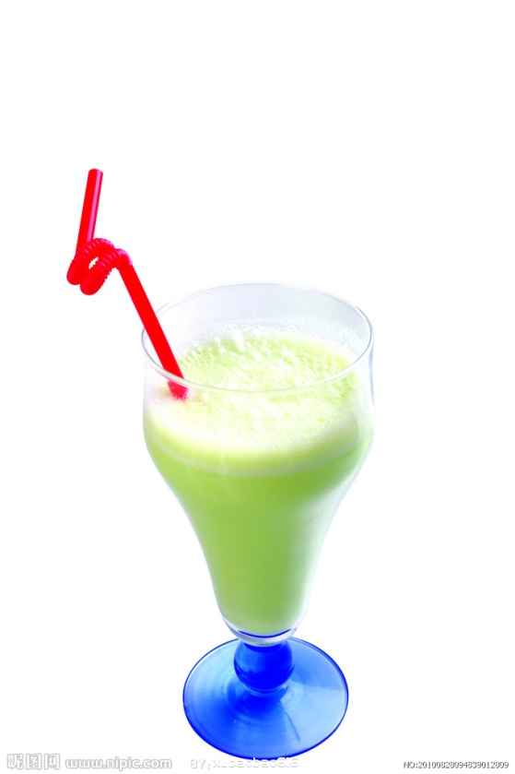
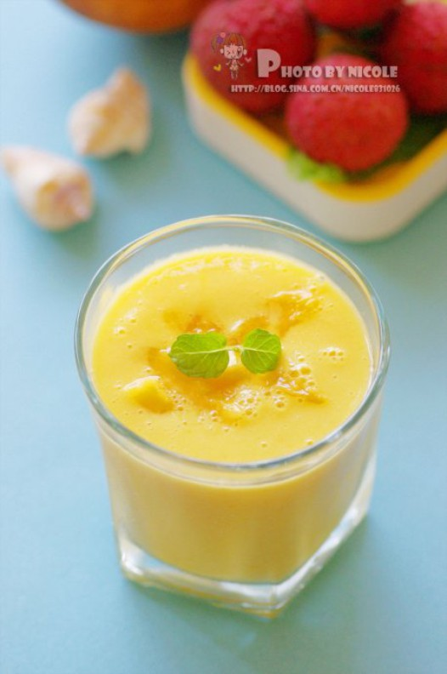
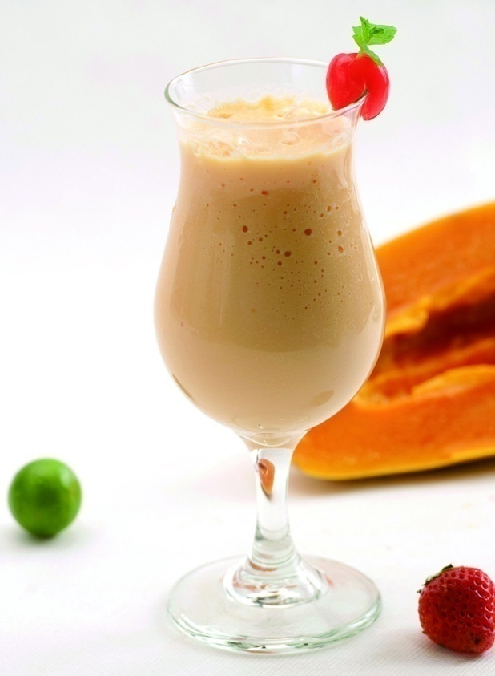
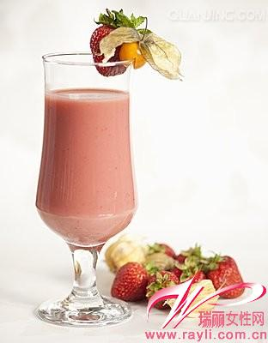
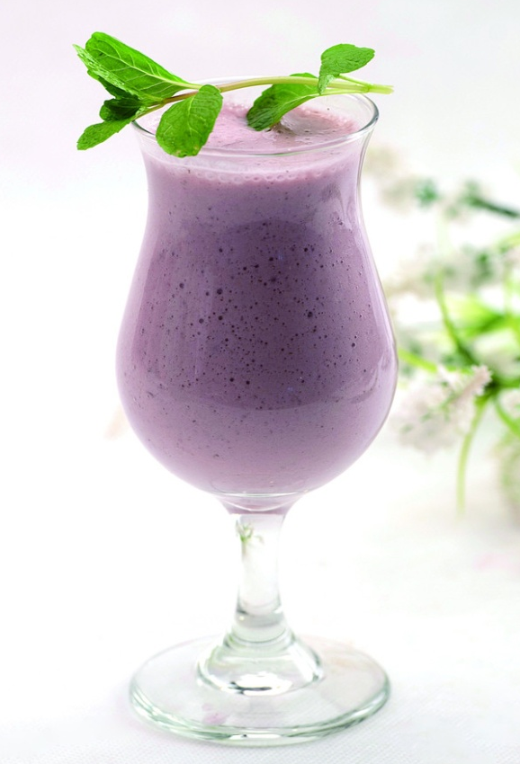
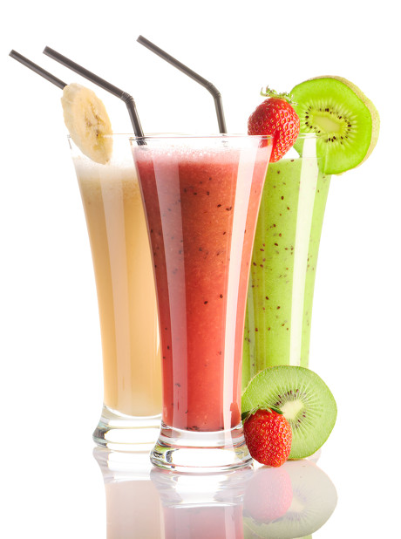
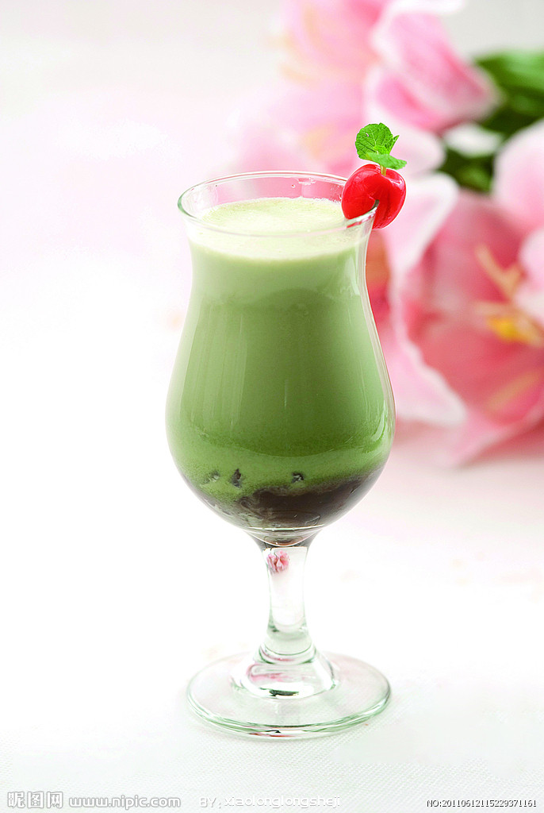
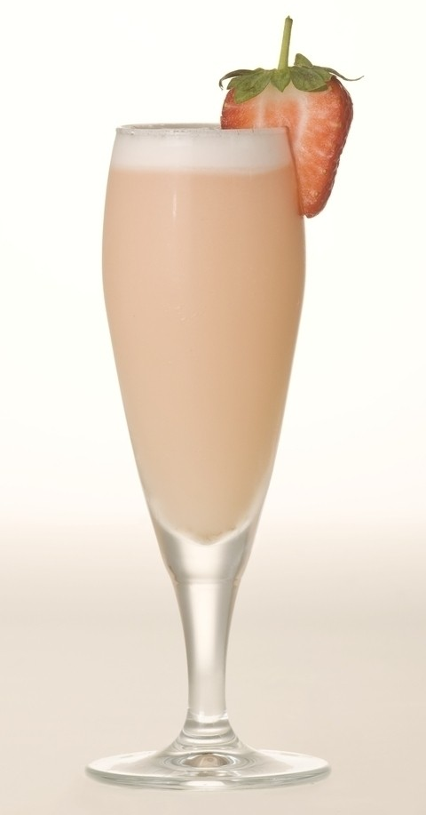
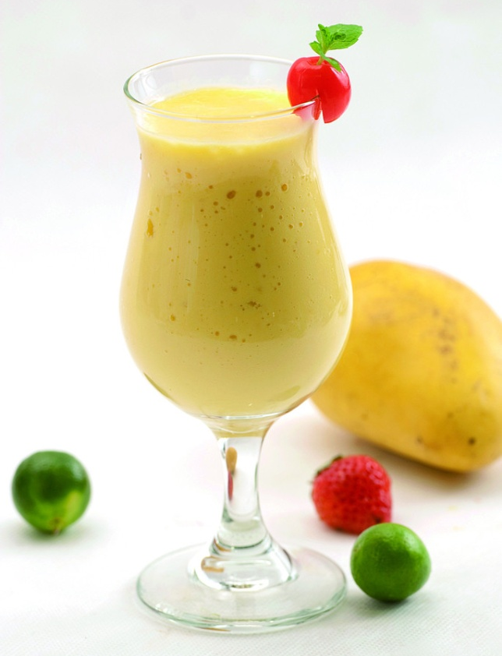
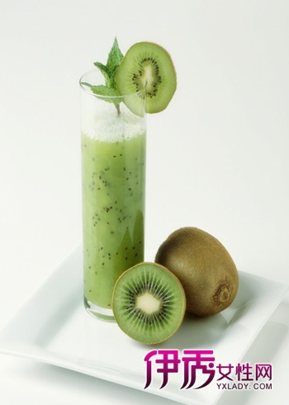
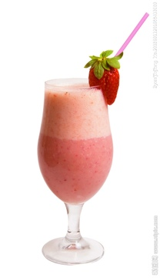
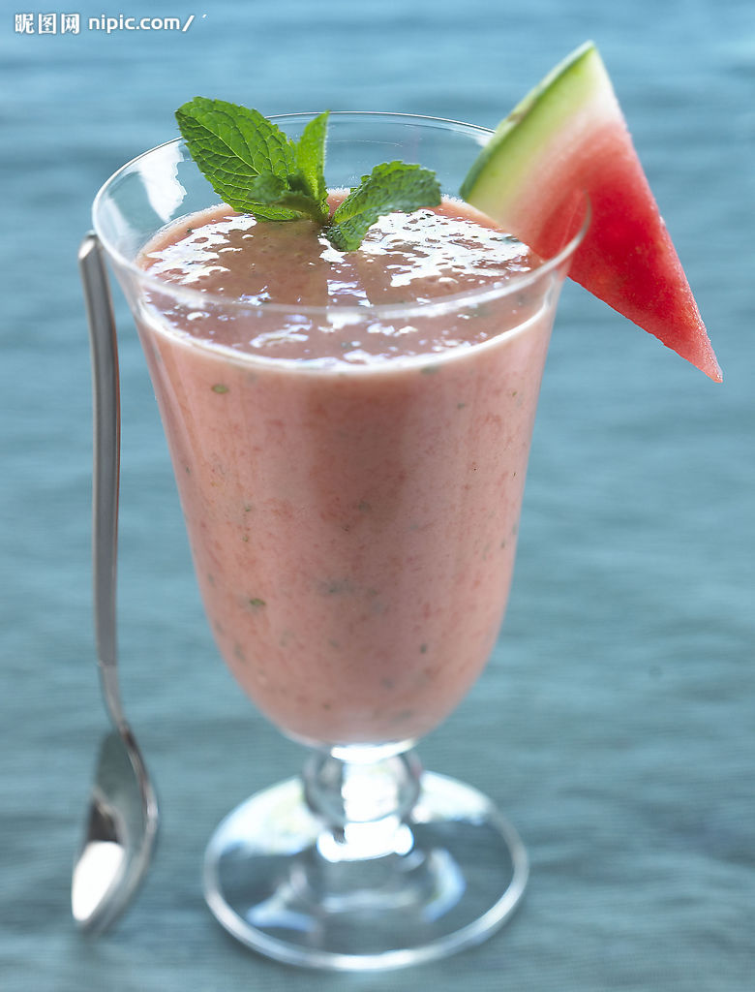
Do you know them?

Slide 23
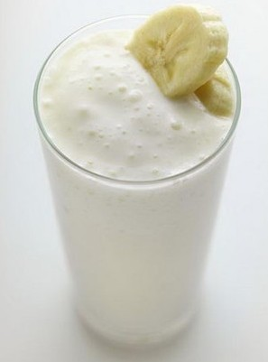
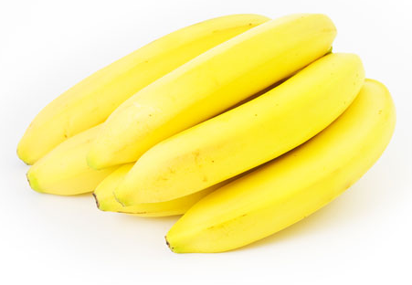
How do you
make a
banana
milk shake
/SeIk/

Slide 24
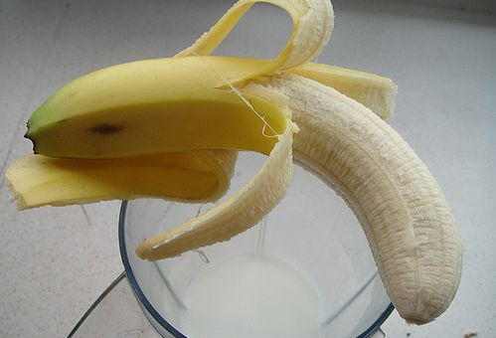
First
peel the bananas
You need to p_____three apples.
eel
/pi:l/

Slide 25
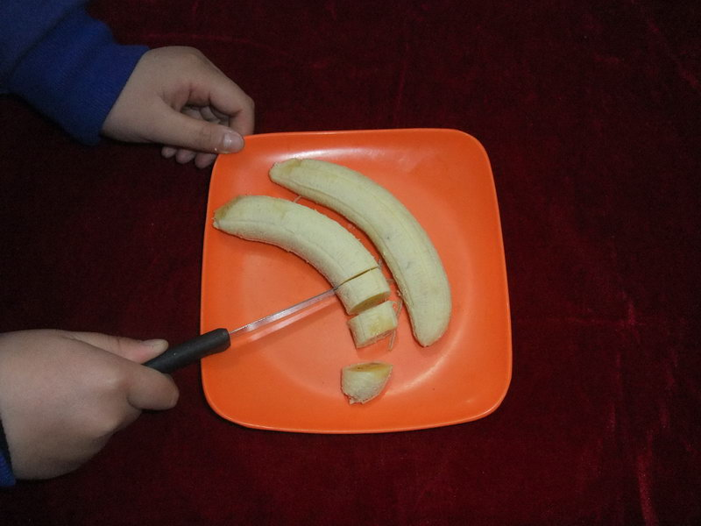
你应该把西红柿切碎。
and
cut up the bananas
You should ______ _____ the tomatoes.
cut
up
把它切碎
cut up it
cut it up
/kVt/
把它们切碎
cut up them
cut them up

Slide 26
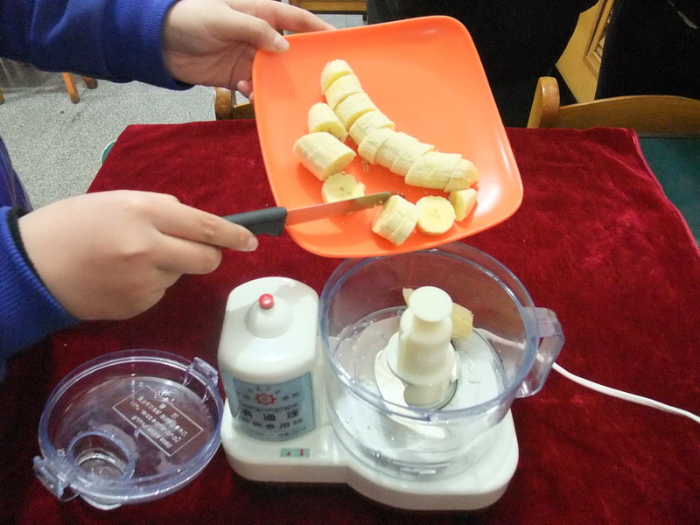
Next
把香蕉和冰激凌放进搅拌机里。
______the______ and ice-cream _______the __________.
Put
bananas
put the bananas in the blender
in
blender
/blendE/

Slide 27
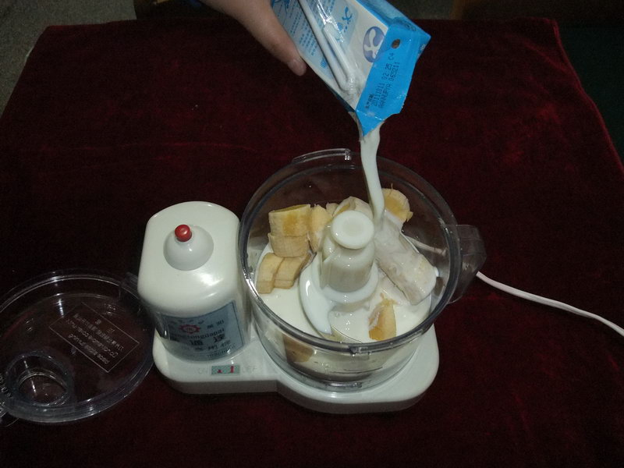
Then
把牛奶倒进水里。
pour the milk into the blender
______some milk _______the water.
Pour
into
/pO:/

Slide 28
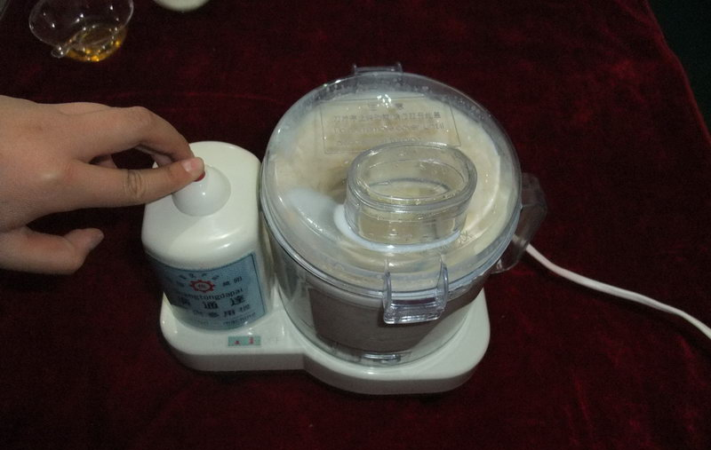
Finally
= at last
= in the end
turn on the blender
turn off 关掉 turn down 调低 turn up 调高

Slide 29
Exercise
The room was dark, so she asked me to_____
the lights.
A. turn up B. turn down
C. turn off D.turn on
2. The baby is sleeping. Could you please _____
the music?
A. turn up B. turn down
C. turn off D. turn on

Slide 30
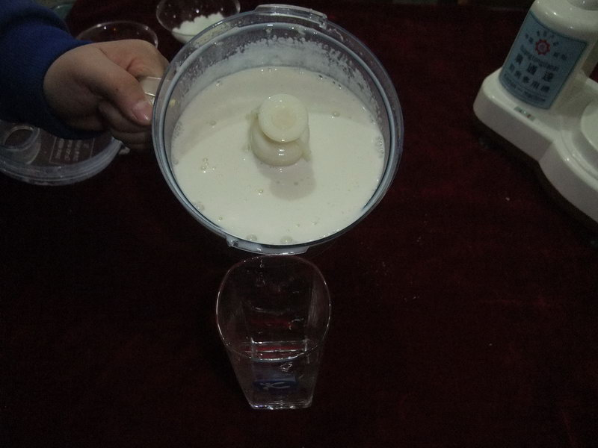
And
pour the milk shake into a glass and drink it.

Slide 31
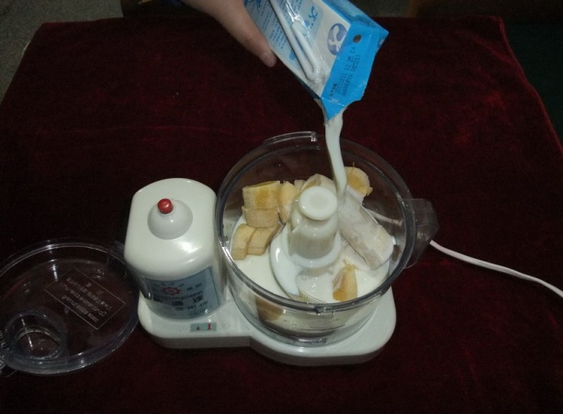
Let’s make a banana milk shake.

Slide 32
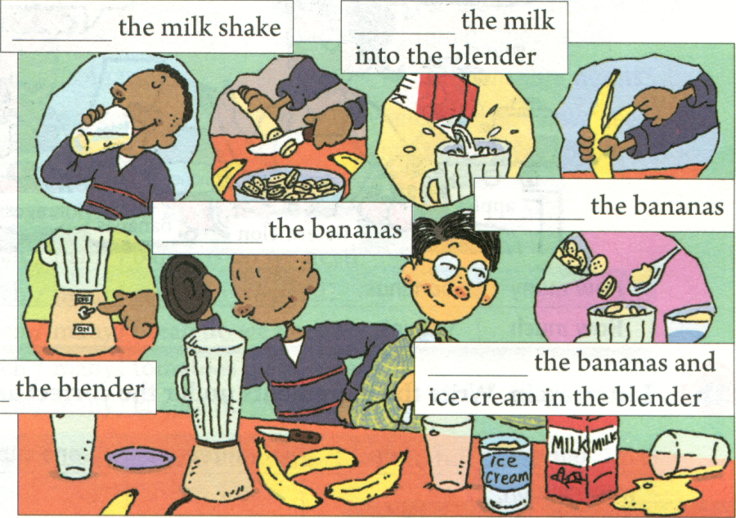
1a. Write these words in the blanks in the picture above.
Drink
Pour
Peel
Cut up
Turn on
Put

Slide 33
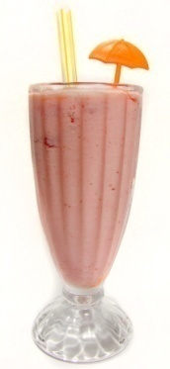
1b.Listen and put the instructions in the correct order.
___Turn on the blender. ___ Cut up the bananas. ___ Drink the milk shake. ___ Pour the milk into the blender. ___ Put the bananas and yogurt into
the blender.
___ Peel three bananas.
5
2
6
4
3
1

Slide 34
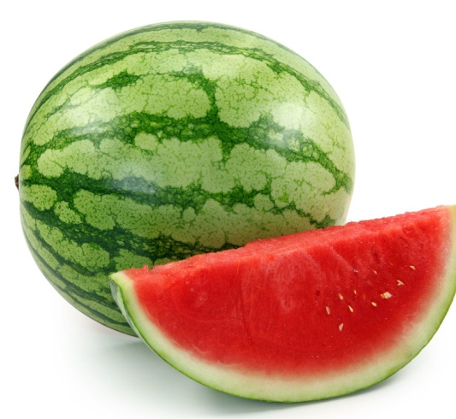
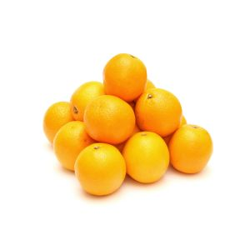
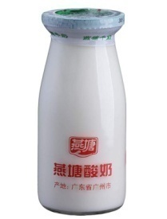
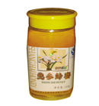
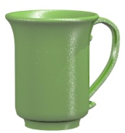
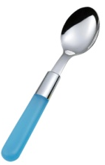
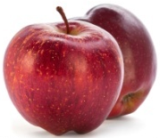
What are these?
honey
/hVni/
cup
/kVp/
spoon
watemelon
yogurt
/spu:n/
/wO:tEmelEn/
/jEƱgErt/

Slide 35
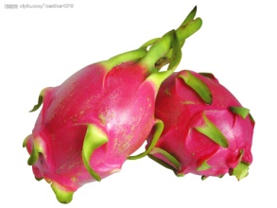
Which one is missing?

Slide 36
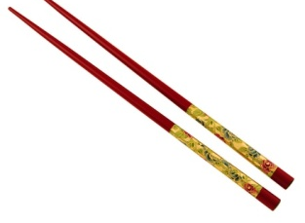
Which one is missing?

Slide 37
Which one is missing?

Slide 38
Which one is missing?

Slide 39
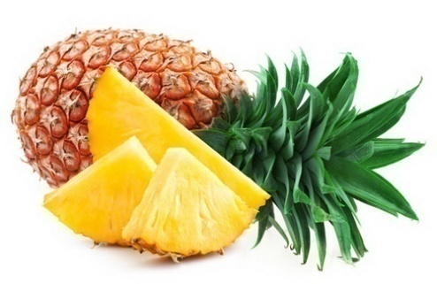
Which one is missing?

Slide 40
Which one is missing?
honey
banana
spoon
apple
apple
watermelon
orange
yogurt

Slide 41
Which one is missing?
honey
banana
spoon
apple
apple
watermelon
orange
cup

Slide 42
Which one is missing?
honey
banana
spoon
apple
apple
yogurt
orange
cup

Slide 43
Which one is missing?
honey
banana
watermelon
apple
apple
yogurt
orange
cup

Slide 44
Grammar :
我有两个西瓜。
I have two watermelons.
对数量提问： how many+ 可名复
how much + 不可名
How many watermelons do you have?

Slide 45
Grammar :
我需要一些酸奶。
I need some yogurt.
How much yogurt do you need?
一杯：
a cup of
两杯：
two cups of
我需要两杯酸奶。
I need two cups of yogurt.
How much yogurt do you need?

Slide 46
Grammar :
I need two cups of yogurt.
How many cups of yogurt do you need?
一勺：
a spoon of
两勺：
two spoons of
我想要三勺蜂蜜。
I want three spoons of honey.
How much honey do you want?
How many spoons of honey do you want?

Slide 47
Exercise :
How many milk should I put into the blender?
A
B
C
(A.) How many --- How much
This hat is ten dollars.
How much is this hat?

Slide 48
Exercise :
How ____ yogurt do you need?
A. many B. a little C. Much D. few
You should put three cups of yogurt in the bowl.
_____ ______ yogurt should I pu in the bowl?
How
much
I want to buy three bottles of orange.
______ ______ orange do you want to buy?
How
much

Slide 49
Fill in the blanks with How many or How much.
1. -- __ _ eggs do you need for dinner? -- Only one.
2. -- ___ bread can you eat? -- Three pieces.
3. -- ____ glasses of yogurt does Mary drink every
day? --Two.
4. -- ___ students went to the party? --About fifty.
5. -- ____ cheese does he eat every morning?
--Only one piece.
How many
How much
How many
How many
How much

Slide 50
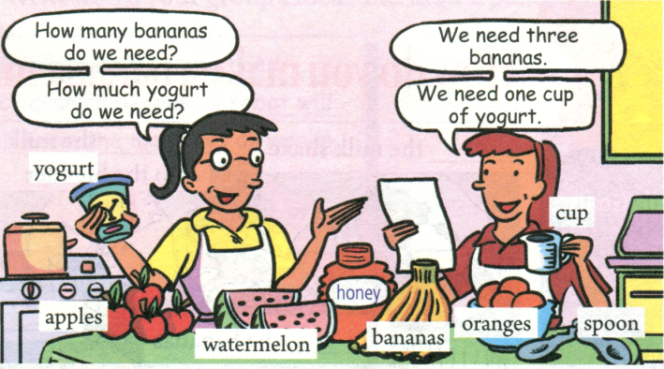
2a. Listen and complete the chart.
How many
How much
bananas
apples
watermelons
oranges
yogurt
honey

Slide 51
2b. Listen again. Write the ingredients under the
correct amount in the chart.
one
two
three
one cup
two spoons
watermelon
orange
apples
bananas
yogurt
honey

Slide 52
Grammar in 2c:
1. let sb.v.原
Let’s _____(d0) it together.
do
2. make fruit salad
--让我们来做水果沙拉吧。--- 好主意。
--Let’s _____ _____ ______.
--_______ _______.
make
fruit
salad
Good
idea

Slide 53
Sum up:
1. cut up
切碎
2. put …in…
把…放到…里
3. pour … into
把…倒到…里
4.a cup of
一杯…
5. how many
多少，对数量提问 ，修饰可名复
6.how much
多少， 修饰不可名，也对钱提问

Slide 54
Sum up:
7. let +v.原
让…做某事
8. make a banana
milk shake
做香蕉奶昔
9. make fruit salad
做水果沙拉
10. Let me think.
让我想想

Slide 55
Exercise ：
The steps of making a banana milk shake.
1. three bananas.
2. the bananas.
3. the bananas and ice cream the
blender.
4. the milk the blender.
5. the blender.
Peel
Cut
up
Put
in
Pour
into
Turn
on

Slide 56
Exercise ：
Choose the right answers.
1. First, we should cut all the apples and bananas.
A. on B. up C. off
2. Please some water into the blender.
A. peel B. bring C. pour
3. --- do you make an apple milk shake?
---First we need some apples…
A. Where B. How C. When
4. When you leave the reading room, you should
remember to the lights.
A. turn on B. turn down C. turn off

Slide 57
Exercise ：
Fill in the blanks with the first letters.
1. Please give me a c ___ of tea to drink.
2. Let’s t __ on the TV and watch our favorite
programs.
3. Wash an apple and then c __ it into four parts,
please.
4. Do you need a __ ten minutes?
5. I walked for a long time. F __ , I got there.
up
urn
ut
nother
inally

