Slide 1
新目标八上
Unit 7
Will people have robots?

Slide 2
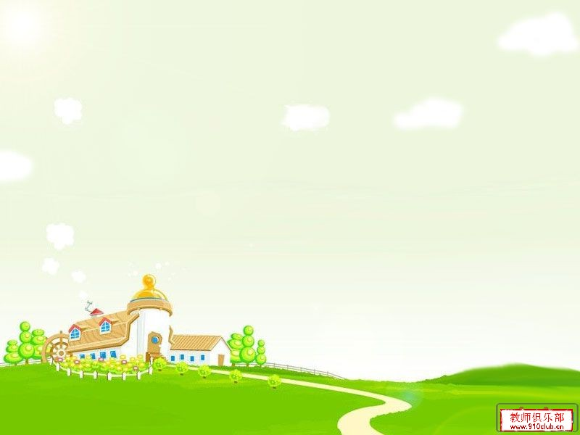
Greetings
Hello, everyone.
Nice to meet you.
What will our life be in
future?
Can you imagine?

Slide 3
Read it
Nick: What are you reading , Jill ?
Jill: It’s a book about the future.
Nick : Sounds cool. So what will the future be like ?
Jill: Well , cities will be more crowded and polluted . There will be fewer trees and the environment will be in
great danger.
Nick: That sounds bad ! Will we have to move to other planets ?
Jill: Maybe. But I want to live on the earth.
Nick : Me, too .Then what can we do ?
Jill : We can use less water and plant more trees.
Everyone should play a part in saving the earth.

Slide 4
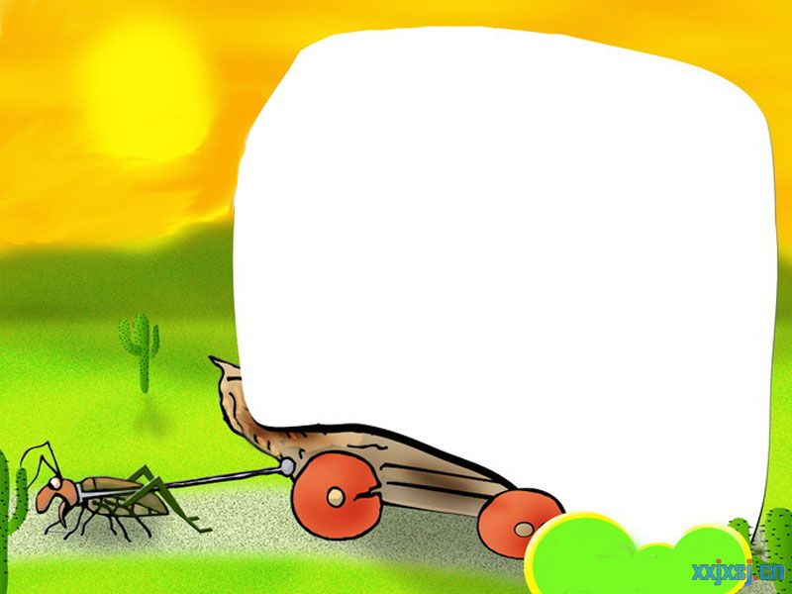
Phonetics :
['deɪndʒə]
['peɪpə]
['fjuːtʃə]
environment
['plænɪt]
on earth
crowded
[plɑːnt]
fewer
less
earth

Slide 5
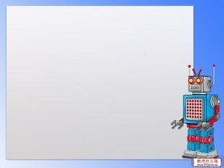
一般将来时口诀
一般将来时,形式有三变：
be +doing表计划，be going to +动原
还有一种更简单，will,shall 加动原
变疑问 be 提前，
will,shall 也提前，
否定be后加not,
will否定变won’t,shall否定变shan’t,
切记there be存在句
将来时是there will be.

Slide 6
标志性时间状语
明天和后天
in+段时间
今天下午和今晚
下周，下月和明年
当我长大，在未来
还有soon记心间。
tomorrow
the day after tomorrow
在…以后
this afternoon
this evening/tonight
next week, next month
next year
when I grow up
in the future

Slide 7
Exercises
用所给词的适当形式填空
1.I think there will be ______(few) trees in the future.
2.There will be more tall buildings on the ____(earth).
3.Tom was surprised by all the ________(pollute) on
the beach.
4. I think the kids in the future will study at home on
________(computer).
5. I think there will be more _____(plant) in the future.
fewer
earth
pollution
computers
plants

Slide 8
Exercises
单项选择
1. It’s ___ for them to swim in the river. They should
leave at home.
A. safe B. dangerous C. simple D. happy
2.We can see many stars in the ___. It will be a sunny
day tomorrow.
A. earth B. river C. sky D. hole
3.Mr.Green went to see his family in Shanghai. He ___
back in six days.
A. is B. was C. is being D. will be
4.Let’s play a part ____the housework.
A. to do B. doing C. do D. in doing

Slide 9
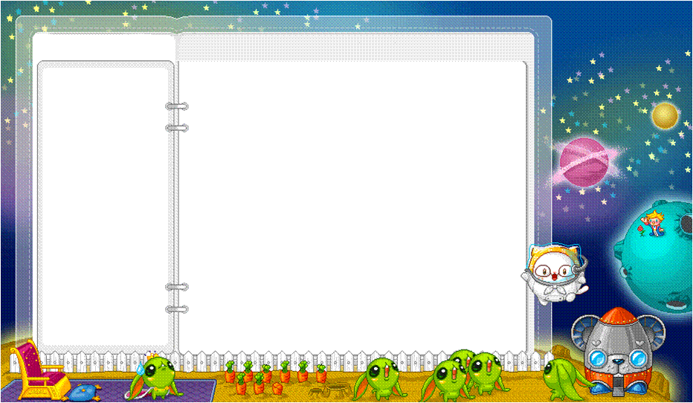
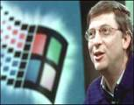
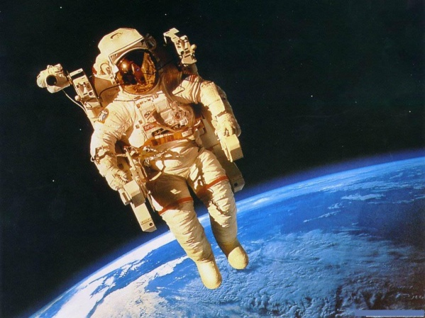
Lead-in
computer programmer
/prʊgrm/
电脑程序设计师 ,程序师
astronaut ['æstrənɔːt]
宇航员

Slide 10
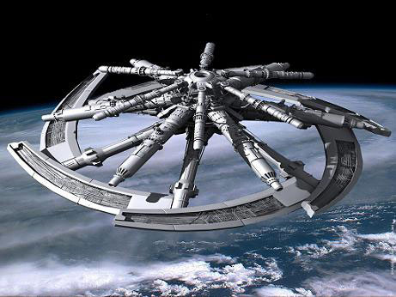
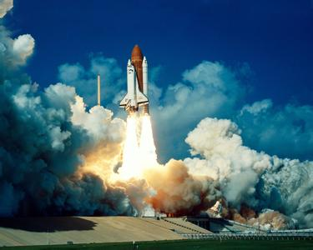
Lead-in
astronaut ['æstrənɔːt]
宇航员
space station
宇宙空间站
rocket [‘rɒkɪt]火箭

Slide 11
1a
Write each word in the correct column below.
/QstrEnO:t/ n.宇航员
/EpA:tmEnt/ n.公寓套房
astronaut house apartment train
rocket space station computer programmer
/RXkIt/ n.
火箭
/speIs/ n.太空,空间
Jobs
Transportation
Places to live
astronaut
computer
programmer
house
apartment
space station
train
rocket
1b
Think of other words and write them in the chart in 1a.

Slide 12
1c
Listen to Alexis and Joe. Number the pictures
[1---3] .
2
3
1

Slide 13
Listen again. Fill in the blanks with the correct
verbs in the box.
1d
I ______ in an apartment across the street from here.
I ______ near here.
I ______ a computer programmer.
We ________ in a house in the country.
I _______ the train to school.
I _______ an astronaut.
I ____________ rockets to the moon.
I __________ on a space station.
live
work
am live work lived took
will be
will live
will fly
am
lived
took
will be
will fly
will live

Slide 15
1e
Student A is Alexis and Student B is Joe. Talk about
Joe’s life now , 10 years ago and 10 years from now.
A: Where do you live ?
B: I live in an apartment.

Slide 16
Exercises
句型转换
There will be more people in our country.(否定句)
____ ____ ____ more people in our country.
I will live in Shanghai in ten years.(划线提问)
_____ ____ you live in ten years ?
Sally played football yesterday. (改为一般将来时)
Sally ______ _____ ______ tomorrow.
连词成句
less, in ,will, years, there, pollution , be, 100
______________________________.
won’t , be, any , there, money, paper
_______________________________.
There won’t be
Where will
will play football
There will be less pollution in 100 years
There won’t be any paper money

Slide 17
Exercises
单项选择
1.We are glad to hear that the Greens ___ to a new flat
next week.
A. move B. moved C. will move D. have moved
2. Have you washed the clothes ?
--Not yet. But I ___ them in half an hour.
A. washed B. have washed C. will wash D. wash
3.Simon is happy that he __in a big apartment in 2013.
A. live B. lives C. will live D. will living
4.The plane will take off ___three hours. I must get to
the airport right now.
A. in B. for C. on D. on

Slide 19
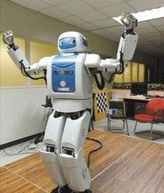
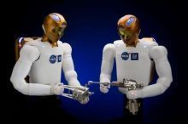
2a
What do the robots look like?
Tell your partner what you know about robots.
What do they look like
and what can they do ?
humans
They look like _________.
human /hju:mEn/ adj. 人的 n. 人

Slide 20
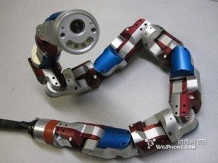
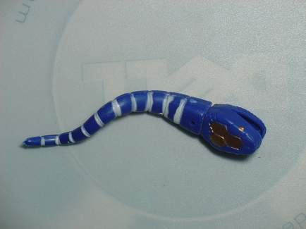
What do the robots look like?
snakes
They look like _________.

Slide 21
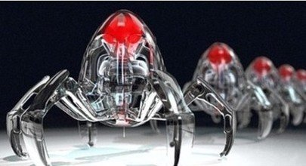
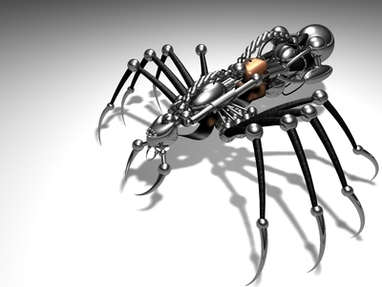
What do the robots look like?
spiders
They look like _________.

Slide 22
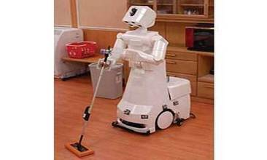
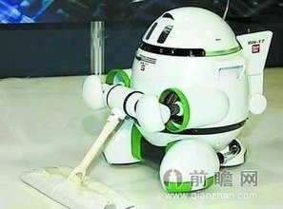
What can the robots do ?
They can ________________.
do the housework

Slide 23
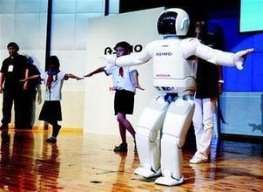
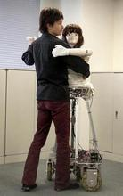
What can the robots do ?
dance
They can __________.

Slide 24
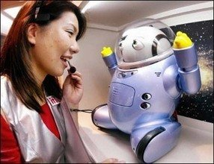
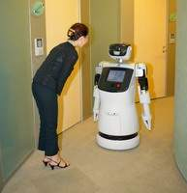
What can the robots do ?
talk
They can __________.

Slide 25
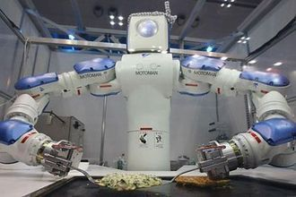
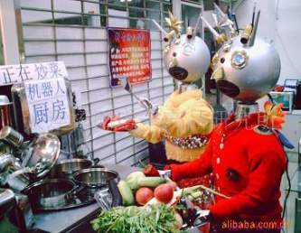
What can the robots do ?
cook
They can __________.

Slide 26
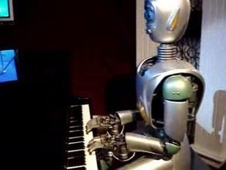
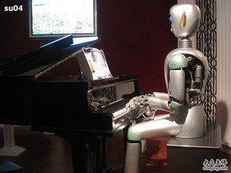
What can the robots do ?
play the piano
They can _____________.

Slide 27
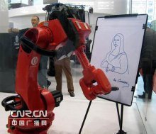
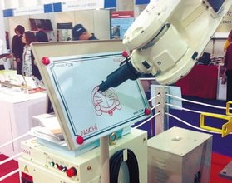
What can the robots do ?
draw
They can _____________.

Slide 28
2b
Listen to the article and match each paragraph with
the question it discusses.
Paragraph 1 Will robots think like humans in the future ?
Paragraph 2 What will robots be like in the future ?
Paragraph 3 What can robots do today ?
Paragraph 4 What are robots like in movies?

Slide 29
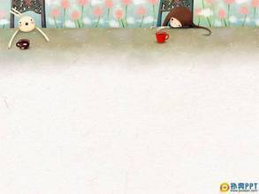
Do You Think You Will Have Your Own Robot ?
1. When we watch movies about the future, we
sometimes see robots. They are usually like
human servants. They help with the housework
and do jobs like working in dirty or dangerous
places.
/s3:vEnt/ n. 仆人
帮助做家务
/deIndZErEs/
adj. 危险的

Slide 30
Notes
1. They are usually like human servants.
它们通常就像人类的仆人一样。
辨析 human, person, person 和 man
指包括男人,女人,孩子的“人,人类”
human
无性别之分,常用于数目不大而且数目
比较精确的场合，可数名词
person
泛指“人们”集合名词 表示复数
people
a man 可指一个人,也可指一个男人
复数men
man

Slide 31
Do You Think You Will Have Your Own Robot ?
/O:LRedi/ adv. 已经,早已
2. Today there are already robots working in
factories . Some can help to build cars, and
they do simple jobs over and over again .Fewer
people will do such jobs in the future because
they are boring,but robots will never get bored.
多次,反复地
做简单工作
such +n. 如此……
factory /fQktri/ n. 工厂
感到厌倦

Slide 32
Notes
2. Today there are already robots working in factories.
今天，已经有机器人在工厂工作了。
①already adv. 早已，已经
多用于肯定句句中，否定疑问要变yet,放句末
eg. He has _____ left.
Has he finished the work ____ ?
already
yet
②There be + n. +doing sth.
有某人/某物正在做某事
eg. There are some girls ______(sing).
singing

Slide 33
Notes
3. Some can help to build cars , and they do simple
jobs over and over again .
有些可以帮助制造小汽车,它们可以反复地做一些
简单的工作。
①simple adj. 简单的,简易的
同义词 easy
反义词 hard / difficult
②over and over again
反复地, 一遍又一遍地
=again and again
eg. Li Na practices singing again and again.
=
over and over again
Li Na practices singing ___ ___ ___ ____.

Slide 34
believe /bIli:v/ v. 相信
disagree /dIsEgri:/
v. 不同意
even /i:vn/ adv. 甚至
Do You Think You Will Have Your Own Robot ?
3. Scientists are now trying to make robots look like
humans and do the same things as we do .Some robots
in Japan can walk and dance. They are fun to watch.
However, some scientists believe that although we can
make robots move like people, it will be difficult to
make them really think like a human. For example ,
scientist James White thinks that robots will never be
able to wake up and know where they are. But many
scientists disagree with Mr.White . They think that
robots will even be able to talk like humans in 25 to 50
years.

Slide 35
Notes
4. Scientists are now trying to make robots look like
humans and do the same things as we do.
科学家现在正尽力制造一些看上去像人类一样，
并且能像我们一样做事情的机器人。
①try to do sth. 尽力做某事
eg. I try ________(speak) English.
to speak
②look like 看起来像
③do the same things as…
像……一样做事情

Slide 36
Notes
5. They are fun to watch.
他们看着很有趣。
①be fun to do sth. 做某事有趣
eg. The boys are fun ______(play).
to play
6. However, some scientists believe that
although we can make robots move like
people. 然而,一些科学家认为虽然我们
能使机器人像人们一样移动。
① make sb. do sth. 使某人做某事
make sb. +adj. 使某人……

Slide 37
Notes
7. However, some scientists believe that
although we can make robots move like
people. 然而,一些科学家认为虽然我们
能使机器人像人们一样移动。
① believe v. 相信 , 认为
(和think用法一样)
② believe sb. 相信某人 (所说的话是真的)
③ believe in sb. 信任某人
eg. I believe him, but I can’t believe in him.
我相信他说的话是真的,但我不能信任他。

Slide 38
Notes
8. It will be difficult to make them really think
like a human.
使它们真正像人类一样 思考将是困难的。
① It is +adj. (for sb.) + to do sth.
做某事对某人来说……的。
C
eg. It will be difficult for a robot ___ the
same things ___ a person.
A. doing ; like B. do ; from
C. to do ; as D. does ; as

Slide 39
Notes
9. For example, scientist James White thinks
that robots will never be able to wake up
and know where they are.
例如,科学家詹姆斯怀特认为机器人将永远
不能醒来并知道它们在哪里。
① wake up 醒来
wake sb. up 把某人唤醒, 代词放中间。
eg. His mother often wakes ____(he)
up at 5:00 in the morning.
him

Slide 40
Notes
辨析 be able to 和 can
可用多种时态,表示经
过努力而有能力做成
某事
有人称和
数的变化
be able to
只有现在时(can)和过去时
(could),can 可以表示请求,
允许,推测,be able to 没有此
用法。
can
没有人称
和数的变化
eg. He ___(be) able to do great things.
Mary can’t ____(be) in Paris.
is
be

Slide 41
Notes
10. But many scientists disagree with Mr.White.
但是许多科学家不同意怀特先生。
① disagree v. 不同意
反义词：agree
② agree/disagree with sb.
同意/不同意某人
eg. I think people here are friendly.
Do you agree ___ me ?
A. with B. to C. on D. from
A

Slide 42
Notes
11. They think that robots will even be able to
talk like humans in 25 to 50 years.
他们认为在25到50年之后机器人甚至能
像人类一样进行交谈。
① even adv. 甚至,更 ,
用来加强语气,也修饰比较级。
②in 25 to 50 years 在25到50年之后

Slide 43
Thank you!

