Slide 1


新目标八上
Unit 7
Will people have robots?

Slide 2
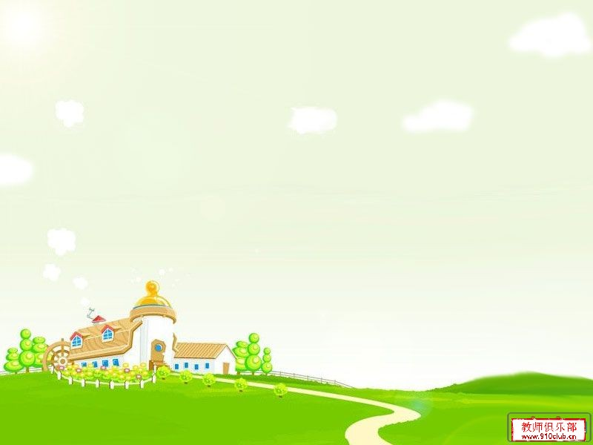
Greetings
Hello, everyone.
Nice to meet you.
What will our life be in
future?
Can you imagine?

Slide 3


Warm up

Slide 4

Autobots

Slide 5
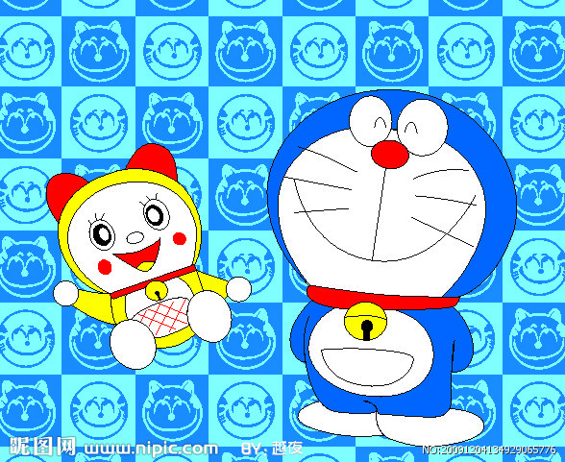
Doreamon

Slide 6
Read it
Nick: What are you reading , Jill ?
Jill: It’s a book about the future.
Nick : Sounds cool. So what will the future be like ?
Jill: Well , cities will be more crowded and polluted . There will be fewer trees and the environment will be in
great danger.
Nick: That sounds bad ! Will we have to move to other planets ?
Jill: Maybe. But I want to live on the earth.
Nick : Me, too .Then what can we do ?
Jill : We can use less water and plant more trees.
Everyone should play a part in saving the earth.

Slide 7
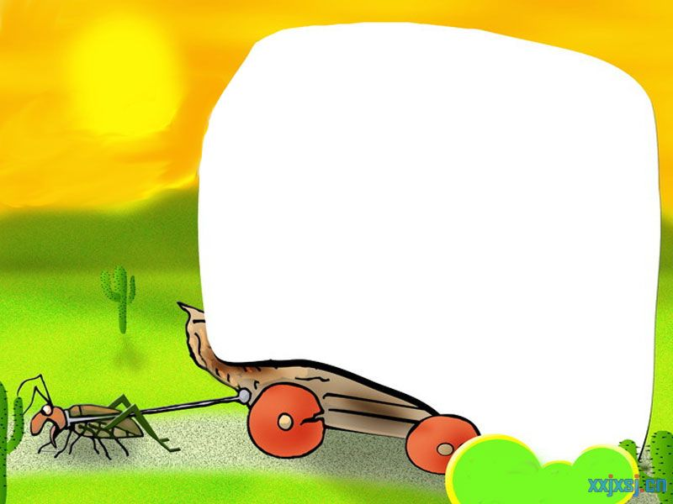
Phonetics :
['hɒbɪ]
[plɑːnt]
['plænɪt]
['peɪpə]
['wiːklɪ]
[ə'griː]
resolution
able
environmet
college
take up
earth

Slide 8


Phonetics :
找出画线部分发音不同的一项.
1. A. pilot B. doctor C . college D . hobby
2. A. paper B. driver C. term D. cooker
3. A. simple B. engineer C. rich D. article
4. A. cartoon B. cook C. good D. foot
5. A. hobby B. army C. dry D. dirty

Slide 9
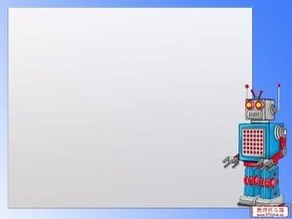
一般将来时口诀
一般将来时,形式有三变：
be +doing表计划，be going to +动原
还有一种更简单，will,shall 加动原
变疑问 be 提前，
will,shall 也提前，
否定be后加not,
will否定变won’t,shall否定变shan’t,
切记there be存在句
将来时是there will be.

Slide 10
标志性时间状语
明天和后天
in+段时间
今天下午和今晚
下周，下月和明年
当我长大，在未来
还有soon记心间。
tomorrow
the day after tomorrow
在…以后
this afternoon
this evening/tonight
next week, next month
next year
when I grow up
in the future

Slide 11
Exercises
根据句意及首字母提示,补全单词
1.Look at the s_____. Can you see any kites ?
2.Take out a piece of p_____ and write down your
dreams on it .
3.Can you show me how to u____ the computer ?
4.We can see there is much p_______ around us.
Our environment is getting worse and worse.
5. In the f_______ , there will be more buildings and
fewer trees.
ky
aper
se
ollution
uture

Slide 12
Exercises
用所给词的适当形式填空
1.I think there will be ______(few) trees in the future.
2.There will be more tall buildings on the ____(earth).
3.Tom was surprised by all the ________(pollute) on
the beach.
4. I think the kids in the future will study at home on
________(computer).
5. I think there will be more _____(plant) in the future.
fewer
earth
pollution
computers
plants

Slide 13
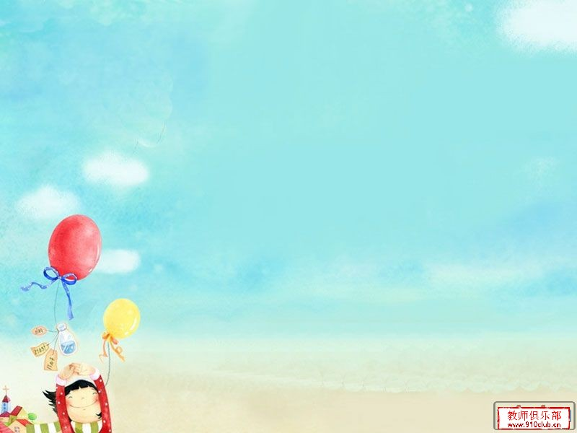
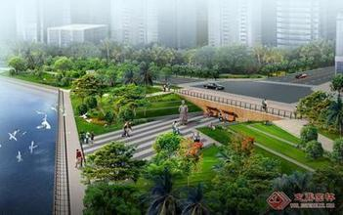
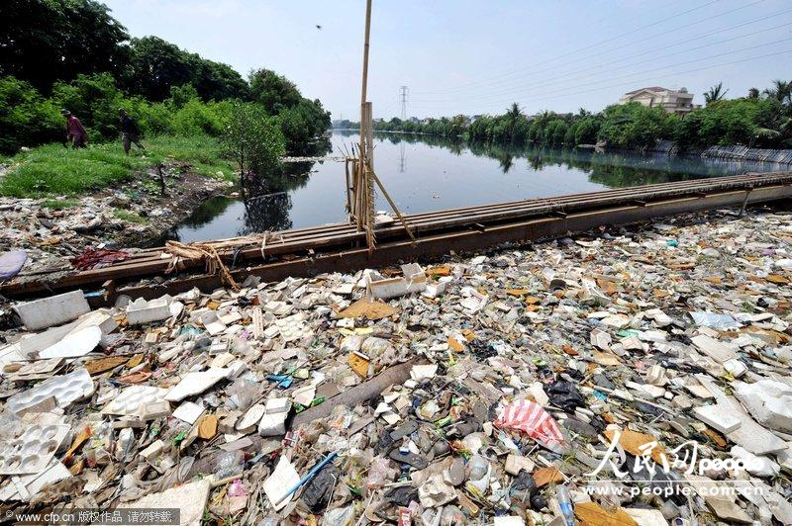
Look at two cities.
Which one do you like ?
Why ?

Slide 14
Read it quickly !
Nick: What are you reading , Jill ?
Jill: It’s a book about the future.
Nick : Sounds cool. So what will the future be like ?
Jill: Well , cities will be more crowded and polluted . There will be fewer trees and the environment will be in
great danger.
Nick: That sounds bad ! Will we have to move to other planets ?
Jill: Maybe. But I want to live on the earth.
Nick : Me, too .Then what can we do ?
Jill : We can use less water and plant more trees.
Everyone should play a part in saving the earth.
planet /plQnIt/n.行星
/3:(R)T/n.地球
/PLA:nt/v.种植 n.植物
/PA:t/ n.参加,部分

Slide 15
Notes
It’s a book about the future.
它是关于未来方面的一本书。
① about prep. 关于,对于,有关
辨析 about 和 on (关于)
about
常用在口语中,表示的内容较普通,
不太正式。
常用在书面语中,表示严肃的或学术性的
问题。
on
eg. She has a lot of books on the history of
China.

Slide 16
Notes
2. So what will the future be like ?
那么,未来将会是什么样子？
① What’s … like ? ……是怎么样 ？
② What’s sb. like ? 某人怎么样 ？
常用来询问某人的相貌,性格,品质
eg. 天气怎么样 ？
Tom 怎么样？--他滑稽有趣。
你的父亲长得怎么样 ？.
What’s the weather like ?
What’s Tom like ?—He is funny.
What’s your father like ?

Slide 17
Notes
3. There will be fewer trees and the environment
will be in great danger.
将会有更少的树,环境将会处于极度危险之中。
① in danger 处于险境,在危险中
② 反义短语：out of danger 脱险
③ danger n.---dangerous adj. 危险的
eg. It’s ________(danger) to play on
the road.
He is in great ________(dangerous).
dangerous
danger

Slide 18
Notes
4. Will we have to move to other planets ?
我们将不得不搬到其他星球上吗？
不得不have to 单三 has to
过去 had to 后面加动原
疑问否定别忘do , does,did来帮忙
eg. Mary ____(have) to do the laundry herself.
____ Mary ____(have) to do the laundry
herself?
Mary __________(have ) to do the laundry
herself.
has
Does
have
doesn’t have

Slide 19
Notes
辨析 have to 和 must
①主观必须must 客观不得不have to
② have to 有人称,数和时态变化,疑问否定
要用do , does, did.
must 情态动词 没有人称数变化
must 问,肯定回答must
否定回答needn’t.
eg. My mother has to get up early .(否定句)
My mother ____ ____ ____get up early.
Must you go now ? (肯定/否定回答)
Yes, I _____. / No , I _____.
doesn’t have to
must
needn’t

Slide 20
Notes
5. But I want to live on the earth.
但是我想住在地球上。
辨析 on the earth 和 on earth
地点状语
位于句首或句末
在地球上
on the earth
究竟,到底
用于疑问词后,加强语气
on earth
eg. What on earth do you mean ?
你究竟什么意思？

Slide 21
Notes
6. We can use less water and plant more trees.
我们可以少用水,多栽树。
辨析 plant和 grow
“种植”,一般指栽入土中,强调种植动作.
plant
“种植”,包括种下及以后培育过程,
强调种植过程 .
grow
eg. Don’t ____ the flowers before mid-April.
My uncle’s job is to ____ flowers.
plant
grow

Slide 22
Notes
7. Everyone should play a part in saving the earth.
每个人都应该参与到拯救地球的行列当中去。
①play a part in +n./pron./doing
参与某事; 在……方面起作用
eg. Let’s play a part ____ the room.
---That sounds great !
A. clean B. cleaning
C. to clean D. in cleaning
D

Slide 23
Practice the conversation.
Nick: What are you reading , Jill ?
Jill: It’s a book about the future.
Nick : Sounds cool. So what will the future be like ?
Jill: Well , cities will be more crowded and polluted . There will be fewer trees and the environment will be in
great danger.
Nick: That sounds bad ! Will we have to move to other planets ?
Jill: Maybe. But I want to live on the earth.
Nick : Me, too .Then what can we do ?
Jill : We can use less water and plant more trees.
Everyone should play a part in saving the earth.

Slide 24
Grammar
Focus
more polluted
Cities will be ____________
(polluted).And there will be
______(few) trees.
What
like
____ will the future be ____?
fewer
use
won’t
Will people _____(use) money
In 100 years ?
No, they _____. Everything
will be free.
Will there be world peace ?
Yes, I hope so.
study
won’t
Kids will ______(study) at
home on computers.
They _______(will not) go to
school.
Peace /pi:s/n.和平
peaceful adj.和平的

Slide 25
Grammar
Focus
Countable nouns
Uncountable nouns
There will be more people.
There will be more pollution.
There will be fewer trees.
There will be less free time.
ˊll=will
won’t = will not

Slide 26
3a
Fill in the blanks with more, less or fewer.
less
In the future , there will be ______ fresh water because
there will be ______ pollution in the sea.
2. In 100 years, there will be _____ cars because there will
be ______ people in the cities.
There will be _____ jobs for people because _____ robots
will do the same jobs as people.
I think there will be _____ cities because people will build
_____ buildings in the country.
In 50 years , people will have ______ free time because
there will be ______ things to do .
more
/si:/n.海洋,海
more
more
fewer
more
more
more
less
more

Slide 27
Notes
8. There will be fewer jobs for people because more
robots will do the same jobs as people.
对人们来说将会有更少的工作,因为更多的机器
人将会像人们一样做工作。
①the same…as 和……一样
②be different from 和……不同
eg. Is William’s lifestyle ___ David’s ?
A. the same B. same as
C. same to D. the same as
D

Slide 28
3b
Complete the predictions with what you think
will happen.
sky /skaI/ n.天空,可数名词
sky-skies
Kids study at school now.
In 100 years, ______________________________.
I sometimes see blue skies in my city , but in the future
________________________________________ .
People now usually live to be about 70 –80 years old ,but
in the future _______________________________
________________________________________ .
Families usually spend time together on weekends , but
maybe in 200 years _________________________
________________________________________ .

Slide 29
Notes
9. Families usually spend time together on weekends.
周末，全家人通常在一起度过时光。
①spend +time/ money (in) doing sth .
②spend +time /money on sth .
eg. She spends the whole morning
_______(help) her mother clean
the house.
helping

Slide 30
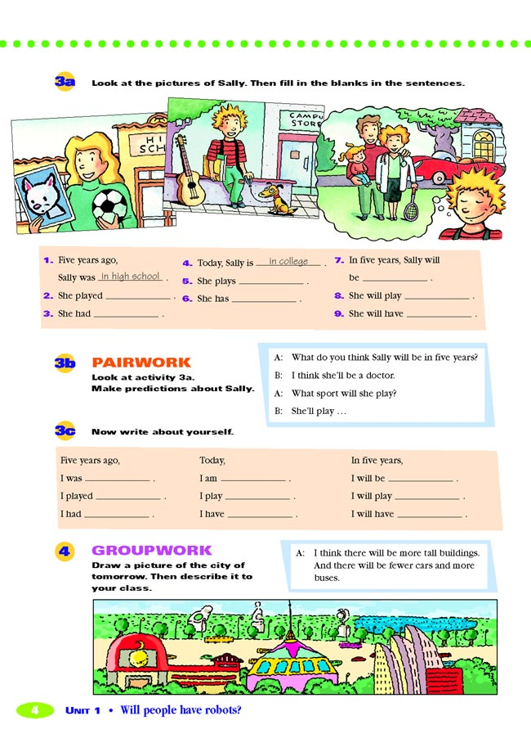
3c
Draw a picture of what you think a city in
the future will be like . Then describe it to
the class.
I think there will be more tall buildings, and there will be fewer
cars and more buses.

Slide 31
Exercises
单项选择
1. It’s ___ for them to swim in the river. They should
leave at home.
A. safe B. dangerous C. simple D. happy
2.We can see many stars in the ___. It will be a sunny
day tomorrow.
A. earth B. river C. sky D. hole
3.Mr.Green went to see his family in Shanghai. He ___
back in six days.
A. is B. was C. is being D. will be
4.Let’s play a part ____the housework.
A. to do B. doing C. do D. in doing

Slide 32

Thank you!

