Slide 1
新目标八上
Unit 7
Will people have robots?

Slide 2
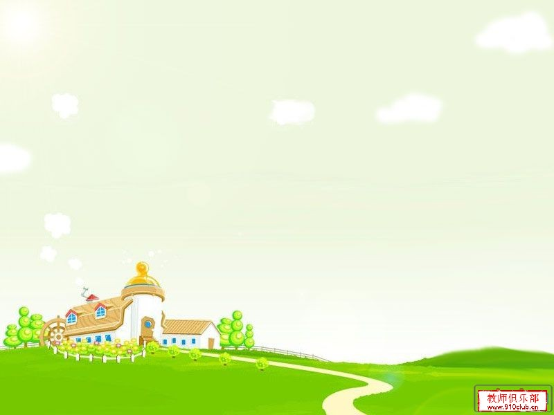
Greetings
Hello, everyone.
Nice to meet you.
Do you like robots?
Do you know some names about robots?

Slide 3
Warm up

Slide 4
Autobots

Slide 5
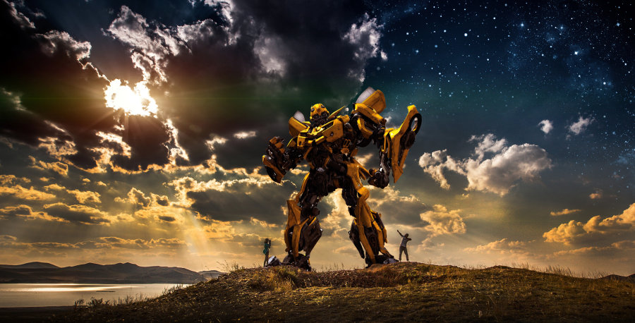
Big bee

Slide 6
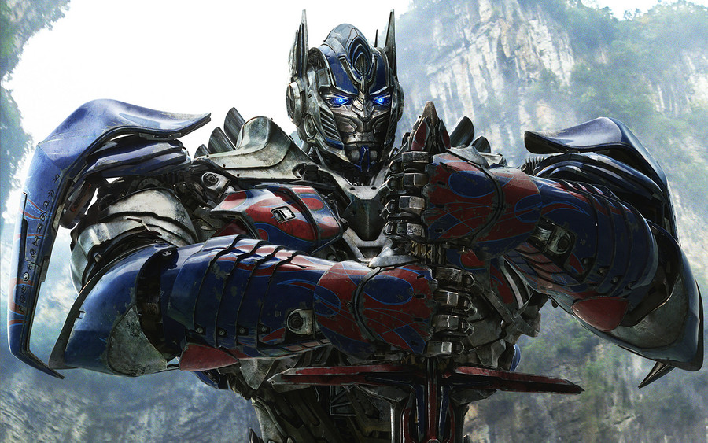
Optimus Prime

Slide 7
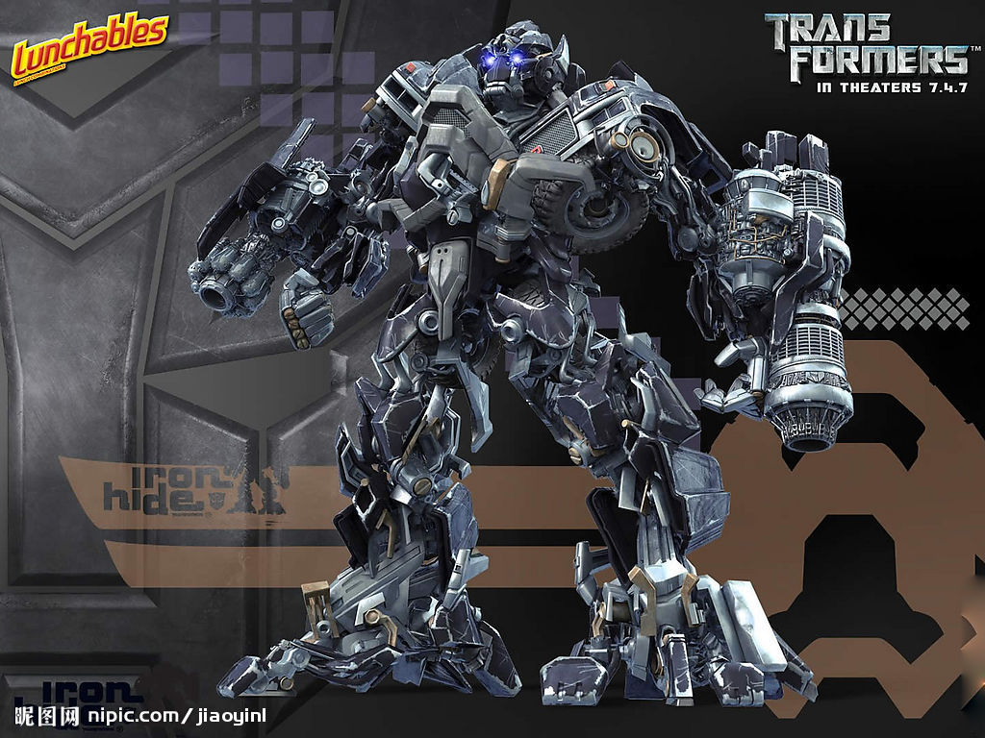
Ironhide

Slide 8
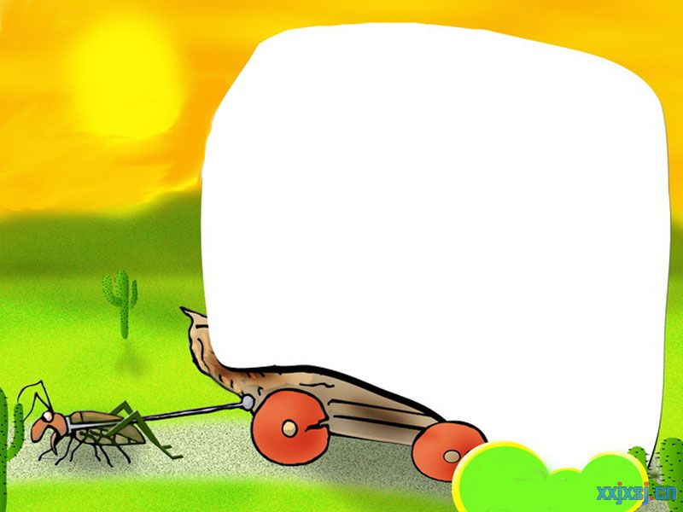
Phonetics :
['hɒbɪ]
future
relationship
['peɪpə]
['wiːklɪ]
[ə'griː]
resolution
discuss
[ɜːɵ]
able
college
take up
plant

Slide 9
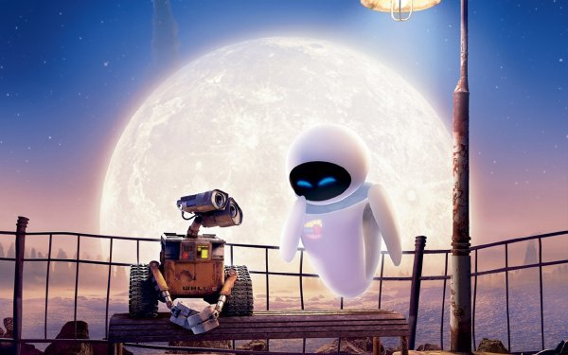
Will people have robots in
the future?
will …
将要

Slide 10
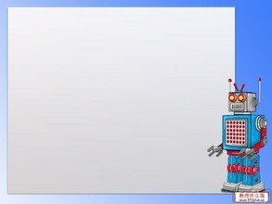
一般将来时口诀
一般将来时,形式有三变：
be +doing表计划，be going to +动原
还有一种更简单，will,shall 加动原
变疑问 be 提前，
will,shall 也提前，
否定be后加not,
will否定变won’t,shall否定变shan’t,
切记there be存在句
将来时是there will be.

Slide 11
标志性时间状语
明天和后天
in+段时间
今天下午和今晚
下周，下月和明年
当我长大，在未来
还有soon记心间。
tomorrow
the day after tomorrow
在…以后
this afternoon
this evening/tonight
next week, next month
next year
when I grow up
in the future

Slide 12
Exercises
1.Please pass me two ____ .
A. pieces of paper B. pieces of papers
C. pieces paper D. piece papers
2.Where is your brother ?
--He has gone to Beijing. He ___back in three days.
A. will come B. comes C. has come D. came
3.Some people ride bikes to work instead of driving in
order to reduce ____ pollution.
A. water B. air C. soil D. white

Slide 13
Exercises
4. I think English is ____ French.
---I don’t agree with you .
A. less popular than B. the most popular
C. so popular as D. as more popular as
5.He went to have a meeting on May 5th,2013 in
Shenzhen .He ___ back in 3 days.
A. is B. was C. is being D. will be
6.I hear there ____ a meeting tomorrow afternoon.
A. will have B. have C will be D. will

Slide 14
Notes
Will people use money in 100 years ?
100 年以后人们还使用钱吗 ？
① in 1oo years 在100年以后
② in +时间段 在……之后 用于一般将来时
③ in +时间段 how soon来提问
辨析 in 和 after
用来表示以现在为起点的将来某一段时间之后，后接时间段
in
将来时
既可接时间点有可接时间段
将来时或
过去时
after

Slide 15
Notes
eg. He will be back _____ two days.
He will be back ______ three o’clock.
He started on Sunday and arrived in Beijing _____ three days. A. in B . after
A
B
B
eg. My mother will finish cooking dinner in an hour.
____ _____ ____ your mother finish cooking
dinner ?
How soon will

Slide 16
2a
Listen and circle the words you hear.
1.There will be (more/less/fewer)people.
2.There will be (more/less/fewer free time.
3.There will be (more/less/fewer) cars.
4.There will be (more/less/fewer) pollution.
5.Ther will be (more/less/fewer) trees.
/PElu:Sn/n.污染

Slide 17
2b
Listen again .Check (✓) the predictions you hear.
__1.There will be fewer people.
__2.There will be less free time.
__3.People will use the subways less.
__4.There will be more pollution.
__5.Cities will be very big and crowded.
✓
✓

Slide 18
Notes
There will be (more/less /fewer) people.
many
① more 是_____和 _____的比较级,更多的
much
little
② less 是____ 的比较级，较少的,更少的
③ fewer 是______的比较级，较少的,更少的
few
more +可名复/不可名
less + 不可名
fewer + 可名复

Slide 19
Notes
eg. Ms. Smith wanted to get _____money.
(more / fewer)
There is _____ water in that glass.
(fewer/less)
I have _____ friends in that school.
(fewer/less)
more
less
fewer

Slide 20
Notes
8. There will be (more/less /fewer) pollution.
① pollution 不可数名词 “污染,污染物”
② pollute v. 污染,弄脏-polluted-polluting
③ air pollution 空气污染
noise pollution 噪音污染
eg. All these waste products are _______
(pollute) the river.
polluting

Slide 21
2c
Make conversations about the predictions in 2a and
2b.
/PrIdIKSn/n.预言,预测
A: What’s your prediction
about the future?
/fju:tSE/n.
将来,未来
A : Really ? I don’t think
so. But I think there will
be fewer trees.
B: I think there will be more
pollution.

Slide 22
Notes
What’s your prediction about the future ?
关于未来你的预言是什么?
① prediction 可数名词 复数+s
② predict v. 预测-predicted-predicting
③ future n. 将来,未来
in the future在将来,以后,特指将来的
某一时刻.
in future 从今以后的全部将来.
=from now on

Slide 23
Notes
I don’t think so . 我不这样认为.
① 表示否定对方的意见或观点
② 肯定形式 : I think so.
I hope so. 我希望是这样的.
I hope not. 我希望不是这样.
I’m afraid so. 恐怕如此.
I’m afraid not. 恐怕不是.

Slide 24
Exercises
句型转换
1.They clean the classroom every day.
(用tomorrow代替every day)
They _____ ____ the classroom tomorrow.
2.Will the flowers come out soon ? (肯定回答)
_____ , _____ _____.
3.We’ll go out for a walk with you .(否定句)
We ____ _____ out for a walk with you .
4.Nanjing will have a fine day. (一般疑问句)
____ Nanjing ____ a fine day ?
5.The students will work in the supermarket .(划线提问)
_____ ____ the students ______ ?
will clean
Yes they will
won’t go
Will have
Where will work

Slide 25
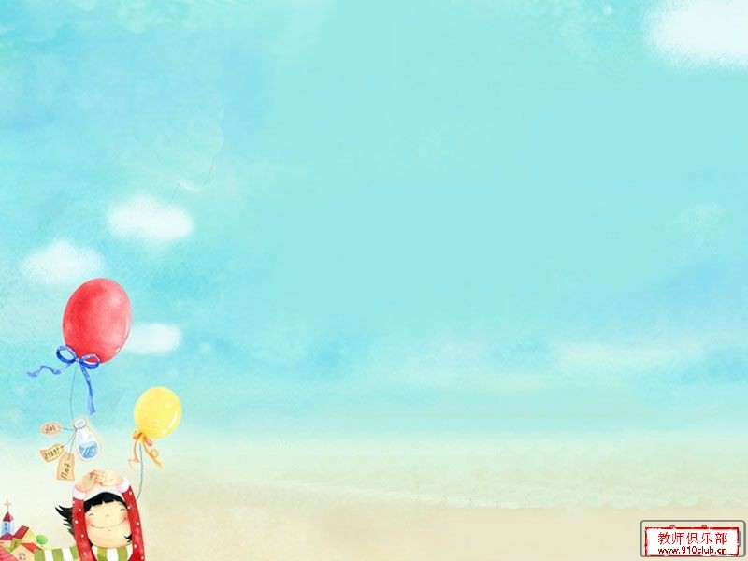
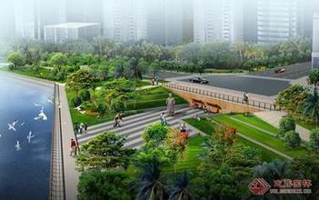
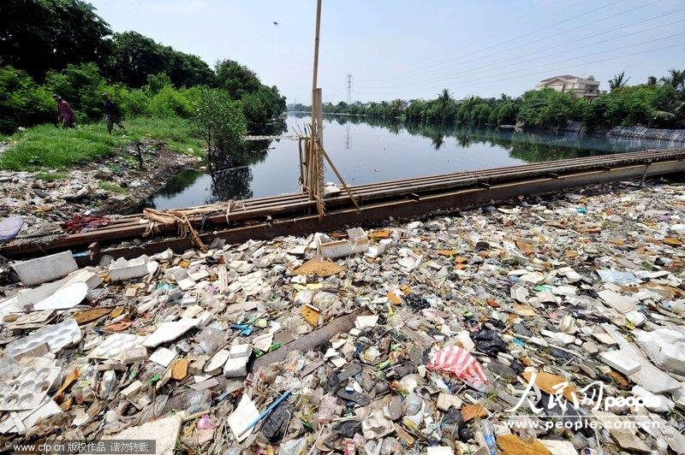
Look at two cities.
Which one do you like ?
Why ?

Slide 26
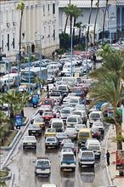
2d
Listen to the conversation and answer the
questions.
1.What will the future be like ?
①
②
③
Cities will be more crowded and polluted.
There will be fewer trees .
/InvaIrEnmEnt/n.环境
The environment will be in
great danger.

Slide 27
Listen and repeat !
Nick: What are you reading , Jill ?
Jill: It’s a book about the future.
Nick : Sounds cool. So what will the future be like ?
Jill: Well , cities will be more crowded and polluted . There will be fewer trees and the environment will be in
great danger.
Nick: That sounds bad ! Will we have to move to other planets ?
Jill: Maybe. But I want to live on the earth.
Nick : Me, too .Then what can we do ?
Jill : We can use less water and plant more trees.
Everyone should play a part in saving the earth.
planet /plQnIt/n.行星
/3:(R)T/n.地球
/PLA:nt/v.种植 n.植物
/PA:t/ n.参加,部分

Slide 28
Role –play the conversation.
Nick: What are you reading , Jill ?
Jill: It’s a book about the future.
Nick : Sounds cool. So what will the future be like ?
Jill: Well , cities will be more crowded and polluted . There will be fewer trees and the environment will be in
great danger.
Nick: That sounds bad ! Will we have to move to other planets ?
Jill: Maybe. But I want to live on the earth.
Nick : Me, too .Then what can we do ?
Jill : We can use less water and plant more trees.
Everyone should play a part in saving the earth.

Slide 29
Notes
It’s a book about the future.
它是关于未来方面的一本书。
① about prep. 关于,对于,有关
辨析 about 和 on (关于)
about
常用在口语中,表示的内容较普通,
不太正式。
常用在书面语中,表示严肃的或学术性的
问题。
on
eg. She has a lot of books on the history of
China.

Slide 30
Notes
2. So what will the future be like ?
那么,未来将会是什么样子？
① What’s … like ? ……怎么样 ？
② What’s sb. like ? 某人怎么样 ？
常用来询问某人的相貌,性格,品质
eg. 天气怎么样 ？
Tom 怎么样？--他滑稽有趣。
你的父亲长得怎么样 ？.
What’s the weather like ?
What’s Tom like ?—He is funny.
What’s your father like ?

Slide 31
Notes
3. There will be fewer trees and the environment
will be in great danger.
将会有更少的树,环境将会处于极度危险之中。
① in danger 处于险境,在危险中
② 反义短语：out of danger 脱险
③ danger n.---dangerous adj. 危险的
eg. It’s ________(danger) to play on
the road.
He is in great ________(dangerous).
dangerous
danger

Slide 33
Notes
4. Will we have to move to other planets ?
我们将不得不搬到其他星球上吗？
不得不have to 单三 has to
过去 had to 后面加动原
疑问否定别忘do , does,did来帮忙
eg. Mary ____(have) to do the laundry herself.
____ Mary ____(have) to do the laundry
herself?
Mary __________(have ) to do the laundry
herself.
has
Does
have
doesn’t have

Slide 34
Notes
辨析 have to 和 must
①主观必须must 客观不得不have to
② have to 有人称,数和时态变化,疑问否定
要用do , does, did.
must 情态动词 没有人称数变化
must 问,肯定回答must
否定回答needn’t.
eg. My mother has to get up early .(否定句)
My mother ____ ____ ____get up early.
Must you go now ? (肯定/否定回答)
Yes, I _____. / No , I _____.
doesn’t have to
must
needn’t

Slide 35
Notes
5. But I want to live on the earth.
但是我想住在地球上。
辨析 on the earth 和 on earth
地点状语
位于句首或句末
在地球上
on the earth
究竟,到底
用于疑问词后,加强语气
on earth
eg. What on earth do you mean ?
你究竟什么意思？

Slide 36
Notes
6. We can use less water and plant more trees.
我们可以少用水,多栽树。
辨析 plant和 grow
“种植”,一般指栽入土中,强调种植动作.
plant
“种植”,包括种下及以后培育过程,
强调种植过程 .
grow
eg. Don’t ____ the flowers before mid-April.
My uncle’s job is to ____ flowers.
plant
grow

Slide 37
Notes
7. Everyone should play a part in saving the earth.
每个人都应该参与到拯救地球的行列当中去。
①play a part in +n./pron./doing
参与某事; 在……方面起作用
eg. Let’s play a part ____ the room.
---That sounds great !
A. clean B. cleaning
C. to clean D. in cleaning
D

Slide 38
Practice the conversation.
Nick: What are you reading , Jill ?
Jill: It’s a book about the future.
Nick : Sounds cool. So what will the future be like ?
Jill: Well , cities will be more crowded and polluted . There will be fewer trees and the environment will be in
great danger.
Nick: That sounds bad ! Will we have to move to other planets ?
Jill: Maybe. But I want to live on the earth.
Nick : Me, too .Then what can we do ?
Jill : We can use less water and plant more trees.
Everyone should play a part in saving the earth.

Slide 39
Grammar
Focus
more polluted
Cities will be ____________
(polluted).And there will be
______(few) trees.
What
like
____ will the future be ____?
fewer
use
won’t
Will people _____(use) money
In 100 years ?
No, they _____. Everything
will be free.
Will there be world peace ?
Yes, I hope so.
study
won’t
Kids will ______(study) at
home on computers.
They _______(will not) go to
school.
Peace /pi:s/n.和平
peaceful adj.和平的

Slide 40
Grammar
Focus
Countable nouns
Uncountable nouns
There will be more people.
There will be more pollution.
There will be fewer trees.
There will be less free time.
ˊll=will
won’t = will not

Slide 41
3a
Fill in the blanks with more, less or fewer.
less
In the future , there will be ______ fresh water because
there will be ______ pollution in the sea.
2. In 100 years, there will be _____ cars because there will
be ______ people in the cities.
There will be _____ jobs for people because _____ robots
will do the same jobs as people.
I think there will be _____ cities because people will build
_____ buildings in the country.
In 50 years , people will have ______ free time because
there will be ______ things to do .
more
/si:/n.海洋,海
more
more
fewer
more
more
more
less
more

Slide 42
Notes
8. There will be fewer jobs for people because more
robots will do the same jobs as people.
对人们来说将会有更少的工作,因为更多的机器
人将会像人们一样做工作。
①the same…as 和……一样
②be different from 和……不同
eg. Is William’s lifestyle ___ David’s ?
A. the same B. same as
C. same to D. the same as
D

Slide 43
3b
Complete the predictions with what you think
will happen.
sky /skaI/ n.天空,可数名词
sky-skies
Kids study at school now.
In 100 years, ______________________________.
I sometimes see blue skies in my city , but in the future
________________________________________ .
People now usually live to be about 70 –80 years old ,but
in the future _______________________________
________________________________________ .
Families usually spend time together on weekends , but
maybe in 200 years _________________________
________________________________________ .

Slide 44
Notes
9. Families usually spend time together on weekends.
周末，全家人通常在一起度过时光。
①spend +time/ money (in) doing sth .
②spend +time /money on sth .
eg. She spends the whole morning
_______(help) her mother clean
the house.
helping

Slide 45
3c
Draw a picture of what you think a city in
the future will be like . Then describe it to
the class.
I think there will be more tall buildings, and there will be fewer
cars and more buses.

Slide 46
Exercises
根据句意及首字母提示,补全单词
1.Look at the s_____. Can you see any kites ?
2.Take out a piece of p_____ and write down your
dreams on it .
3.Can you show me how to u____ the computer ?
4.We can see there is much p_______ around us.
Our environment is getting worse and worse.
5. In the f_______ , there will be more buildings and
fewer trees.
ky
aper
se
ollution
uture

Slide 47
Exercises
用所给词的适当形式填空
1.I think there will be ______(few) trees in the future.
2.There will be more tall buildings on the ____(earth).
3.Tom was surprised by all the ________(pollute) on
the beach.
4. I think the kids in the future will study at home on
________(computer).
5. I think there will be more _____(plant) in the future.
fewer
earth
pollution
computers
plants

Slide 48
Exercises
单项选择
1. It’s ___ for them to swim in the river. They should
leave at home.
A. safe B. dangerous C. simple D. happy
2.We can see many stars in the ___. It will be a sunny
day tomorrow.
A. earth B. river C. sky D. hole
3.Mr.Green went to see his family in Shanghai. He ___
back in six days.
A. is B. was C. is being D. will be
4.Let’s play a part ____the housework.
A. to do B. doing C. do D. in doing

Slide 49
Thank you!

