Slide 1
新目标八上
Unit 7
Will people have robots?

Slide 2
Greetings
Hello, everyone.
Nice to meet you.
Do you know robots?
Do you know some movies about robots?

Slide 3
Warm up

Slide 4
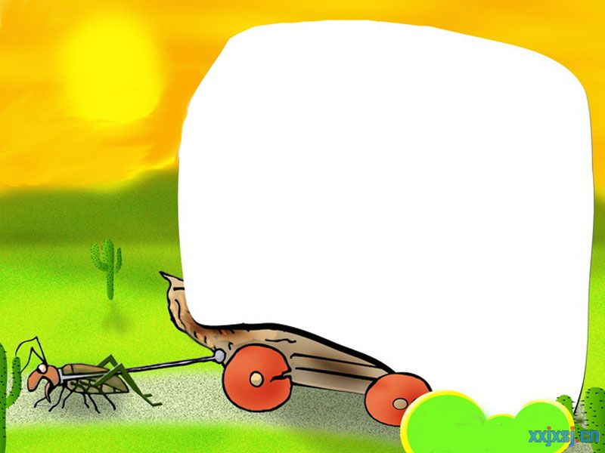
Phonetics :
['hɒbɪ]
future
relationship
['peɪpə]
['wiːklɪ]
[ə'griː]
resolution
discuss
[ɜːɵ]
able
college
take up
plant

Slide 5
//

Slide 6
//

Slide 7
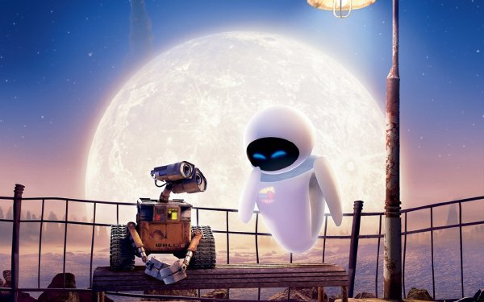
Will people have robots in
the future?
will …
将要

Slide 8
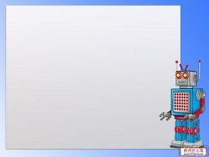
Simple Future Tense
定义：
表示将要发生的动作或情况。
be going to +动原
be doing+将来的时间
will/shall+动原
结构：
将要，打算，计划，做某事

Slide 9
标志性时间状语
明天和后天
in+段时间
今天下午和今晚
下周，下月和明年
当我长大，在未来
还有soon记心间。
tomorrow
the day after tomorrow
在…以后
this afternoon
this evening/tonight
next week, next month
next year
when I grow up
in the future

Slide 10
一般将来时口诀
一般将来时,形式有三变：
be +doing表计划，be going to +动原
还有一种更简单，will,shall 加动原
变疑问 be 提前，
will,shall 也提前，
否定be后加not,
will否定变won’t,shall否定变shan’t,
切记there be存在句
将来时是there will be.

Slide 11
1.What are you going to be when you grow up ?
---I ___ an actor.
A. am B. was C. be D. am going to be
2. Her father is an ____ in a big factory.
A. star B. engineer C. actor D. player
3. We are going to work ___this year than last year.
A. hard B. harder C. hardest D. much hard
4.___ are you going to do that ?---I’m going to practice
football every day ? A. What B. How C. Why D. When
Exercises
单项选择

Slide 12
5. What is your New Year’s ____ ?
---I am going to study harder.
A. resolution B. question C. job D. subject
6.Mr. Black ___ up early every morning.
A. gets B. is getting C. is going to get D. got
7. He ____ to save his pocket money for later use, but
he spent it on a toy soon.
A. refused B. persuaded C. promised
Exercises
单项选择

Slide 13
Do you think there
will be robots in
people’s homes?
Yes, there will.
I think every home
will have a robot.
Will kids go to
school ?
Kids won’t go
to school. They’ll
study at home on
computers.

Slide 14
Notes
1.Do you think there will be robots in people’s homes ?
你认为人们家里将会有机器人吗?
本句是一个含有宾语从句的主从复合句
Do you think 是主句,there will be … 是宾语从句
如果do you think 放在句中,则为插入语, 常放在疑问词之后.
结构为： 疑问词+do you think +主语+谓语+其他成分 ？
eg. What time do you think the train will arrive here ?
你认为火车什么时间到达这里？
宾语从句要用陈述语气。

Slide 15
Notes
A
eg.1. Do you know ____to buy some pears ?
----Sure, there’s a supermarket next to the post office.
Where I can go B. who will help me
What I should take D. when is the right time
2.Excuse me . Could you wake me up when my friend
___ here ? ---Of course. But we still don’t know
when your friend ____here.
A. comes; will come B. comes; comes
C. will come; comes D. will come; will come
A

Slide 16
Notes
2. I think every home will have a robot.
我认为每家都会有一个机器人。
本句是一个含有宾语从句的主从复合句
I think是主句,every home will have a robot是宾语从句
I think/suppose/believe 等后的宾语从句如果是否定句， 要把否定转移到主句的动词上，即“否定转移”。
eg. I don’t think he can swim.
我认为他不会游泳。
eg. I think you can go there by bus. (否定句)
I don’t think you can go there by bus.

Slide 17
Notes
3. 辨析 every 和 each
指三者或三者以上范围中的“每一个”
侧重总体，不能单独使用。
every
adj.
adj.
指两者或两者以上中的“每一个”，
侧重个体。
each
pron.
可作主语或宾语，其后可跟介词 of
eg. _____ teacher knows her .
There are lots of trees on ____side of the road.
____ of us has a dictionary.
Every
each
Each

Slide 18
Chant
every 用来表整体 ,each 用来表个体.
each 最低需是两, every最低需是三.
every做主用单数, each可单也可复 .
作主,定用单数 , 其他情况用复数 .

Slide 19
1a
How will the world be different 100 years from now? Read these predictions. Check(✓) A for agree or D for disagree.
✓
__A __D 1.People will have robots in their homes.
__A __D 2.People won’t use money . Everything
will be free.
__A __D 3.Books will only be on computers, not
on paper.
__A __D 4.Kids won’t go to school. They’ll study at
home on computers.
__A __D 5.There will be only one country.
__A __D 6.People will live to be 200 years old.
✓
免费的
✓
/PeIPE/ n. 纸,纸张
✓
在家通过电脑学习
✓
✓

Slide 20
Notes
4. Books will only be on computers , not on paper.
书只会在电脑上出现，而不会在纸上。
① paper 不可数名词 ，纸，纸张
② a piece of paper 一张纸
③ two pieces of paper 两张纸
A
eg. Please pick up the ___.Don’t keep it
on the floor.
A. paper B. boxes C. books D. bottles

Slide 21
Notes
5. People will live to be 20o years old.
人们将会活到200岁。
① live to be +基数词+year(s) old 活到……岁
② live v. 居住，生活
③ live in +地点 居住在……
④ live with +sb. 和某人住在一起
ive
eg. In the story, people will l____ to be
500 years old.
I l_____ in Beijing.
ive

Slide 22
Notes
⑤ live v. -----lives (单三)
/lIvz/
life n. 生命
-----lives (复数)
/laIvz/
eg. The doctor lives in a village.
He saved many lives.
/lIvz/
/laIvz/

Slide 23
1b
Listen and circle the predictions you hear in 1a.
1.People will have robots in their homes.
2.People won’t use money . Everything will be free.
3.Books will only be on computers, not on paper.
4.Kids won’t go to school. They’ll study at home on computers.
5.There will be only one country.
6.People will live to be 200 years old.

Slide 24
1c
Ask and answer questions about the predictions in 1a.
A:Will people use money in
100 years?
A : Yes, they will.
B: No, they won’t .Everything
will be free . Will people live to be
200 years old?

Slide 26
Notes
6. Will people use money in 100 years ?
100 年以后人们还使用钱吗 ？
① in 1oo years 在100年以后
② in +时间段 在……之后 用于一般将来时
③ in +时间段 how soon来提问
辨析 in 和 after
用来表示以现在为起点的将来某一段时间之后，后接时间段
in
将来时
既可接时间点有可接时间段
将来时或
过去时
after

Slide 27
Notes
eg. He will be back _____ two days.
He will be back ______ three o’clock.
He started on Sunday and arrived in Beijing _____ three days. A. in B . after
A
B
B
eg. My mother will finish cooking dinner in an hour.
____ _____ ____ your mother finish cooking
dinner ?
How soon will

Slide 28
2a
Listen and circle the words you hear.
1.There will be (more/less/fewer)people.
2.There will be (more/less/fewer free time.
3.There will be (more/less/fewer) cars.
4.There will be (more/less/fewer) pollution.
5.Ther will be (more/less/fewer) trees.
/PElu:Sn/n.污染

Slide 29
2b
Listen again .Check (✓) the predictions you hear.
__1.There will be fewer people.
__2.There will be less free time.
__3.People will use the subways less.
__4.There will be more pollution.
__5.Cities will be very big and crowded.
✓
✓

Slide 30
Notes
7. There will be (more/less /fewer) people.
many
① more 是_____和 _____的比较级,更多的
much
little
② less 是____ 的比较级，较少的,更少的
③ fewer 是______的比较级，较少的,更少的
few
more +可名复/不可名
less + 不可名
fewer + 可名复

Slide 31
Notes
eg. Ms. Smith wanted to get _____money.
(more / fewer)
There is _____ water in that glass.
(fewer/less)
I have _____ friends in that school.
(fewer/less)
more
less
fewer

Slide 32
Notes
8. There will be (more/less /fewer) pollution.
① pollution 不可数名词 “污染,污染物”
② pollute v. 污染,弄脏-polluted-polluting
③ air pollution 空气污染
noise pollution 噪音污染
eg. All these waste products are _______
(pollute) the river.
polluting

Slide 33
2c
Make conversations about the predictions in 2a and
2b.
/PrIdIKSn/n.预言,预测
A: What’s your prediction
about the future?
/fju:tSE/n.
将来,未来
A : Really ? I don’t think
so. But I think there will
be fewer trees.
B: I think there will be more
pollution.

Slide 34
Notes
9. What’s your prediction about the future ?
关于未来你的预言是什么?
① prediction 可数名词 复数+s
② predict v. 预测-predicted-predicting
③ future n. 将来,未来
in the future在将来,以后,特指将来的
某一时刻.
in future 从今以后的全部将来.
=from now on

Slide 35
Notes
10. I don’t think so . 我不这样认为.
① 表示否定对方的意见或观点
② 肯定形式 : I think so.
I hope so. 我希望是这样的.
I hope not. 我希望不是这样.
I’m afraid so. 恐怕如此.
I’m afraid not. 恐怕不是.

Slide 36
Exercises
1.Please pass me two ____ .
A. pieces of paper B. pieces of papers
C. pieces paper D. piece papers
2.Where is your brother ?
--He has gone to Beijing. He ___back in three days.
A. will come B. comes C. has come D. came
3.Some people ride bikes to work instead of driving in
order to reduce ____ pollution.
A. water B. air C. soil D. white

Slide 37
Exercises
4. I think English is ____ French.
---I don’t agree with you .
A. less popular than B. the most popular
C. so popular as D. as more popular as
5.He went to have a meeting on May 5th,2013 in
Shenzhen .He ___ back in 3 days.
A. is B. was C. is being D. will be
6.I hear there ____ a meeting tomorrow afternoon.
A. will have B. have C will be D. will

Slide 38
Exercises
句型转换
1.They clean the classroom every day.
(用tomorrow代替every day)
They _____ ____ the classroom tomorrow.
2.Will the flowers come out soon ? (肯定回答)
_____ , _____ _____.
3.We’ll go out for a walk with you .(否定句)
We ____ _____ out for a walk with you .
4.Nanjing will have a fine day. (一般疑问句)
____ Nanjing ____ a fine day ?
5.The students will work in the supermarket .(划线提问)
_____ ____ the students ______ ?
will clean
Yes they will
won’t go
Will have
Where will work

Slide 39
Thank you!

