Slide 1
新目标八上
Unit 7
Will people have robots?

Slide 2
Greetings
Hello, everyone.
Nice to meet you.
Do you know robots?
What can they do?

Slide 3
Warm up

Slide 4
Phonetics :
/dRaIvE/
engineer
/P3:sEnl/
/dXktE/
already
/peIpE/
shape
/Pi:s/
article

Slide 5
/peIpE/

Slide 6
/pElu:t/

Slide 7
/wi:kli/

Slide 8
Phonetics :
找出画线部分发音不同的一项.
1. A. pilot B. doctor C . college D . hobby
2. A. paper B. driver C. term D. cooker
3. A. simple B. engineer C. rich D. article
4. A. cartoon B. cook C. good D. foot
5. A. hobby B. army C. dry D. dirty

Slide 9
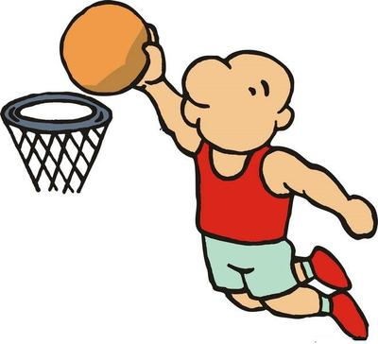
A: What do you want to be when you grow up ?
B: I want to be a basketball player .
A: How are you going to do that ?
B: I’m going to practice basketball every day.

Slide 10
Exercises
用 be going to 填空
1. He ____________(go) hiking on his field
trip next Sunday.
2. They ______________(watch) a football
match tomorrow afternoon.
3. Lin Tao _____________(study) Japanese
next term.
4. ____ you __________(have) dinner
together ?
5. When ___the children _________(meet) at
the school gate ?
6.What ___ you _______(do) next Friday ?
is going to go
are going to watch
is going to study
Are going to have
are going to meet
are going to do

Slide 11
1. I’m going to call him up when he _____(come)
here tomorrow.
2. The old man wants _______(go) to Hainan
for a vacation this winter.
3. Do you enjoy ______(play) soccer in the park?
4.Yesterday our school _____(have) a sports
meeting on the playground.
5.Every girl in our university wants to exercise
and keep _____(fit).
Exercises
适当形式填空
comes
to go
playing
had
fit

Slide 12
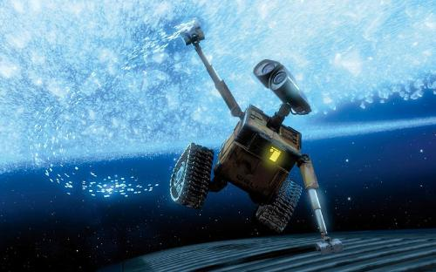
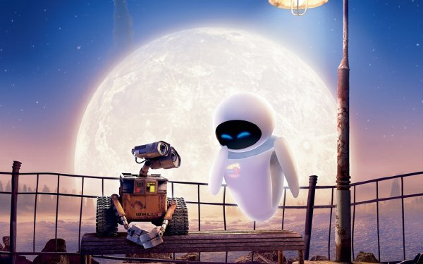
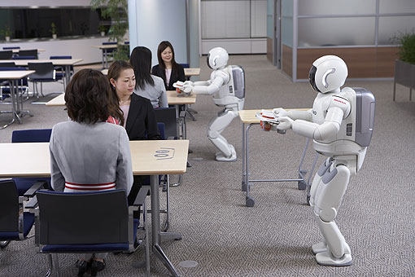
robots
['rəʊbɒt, 'rɒbət]

Slide 13
Will people have robots in
the future?
will …
将要

Slide 14
Grammar
一般将来时

Slide 15
Simple Future Tense
定义：
表示将要发生的动作或情况。
be going to +动原
be doing+将来的时间
will/shall+动原
结构：
将要，打算，计划，做某事

Slide 16
标志性时间状语
明天和后天
in+段时间
今天下午和今晚
下周，下月和明年
当我长大，在未来
还有soon记心间。
tomorrow
the day after tomorrow
在…以后
this afternoon
this evening/tonight
next week, next month
next year
when I grow up
in the future

Slide 17
will+动原
will='ll
I
You
She
He
We
They
I will=I'll
he will=he'll
she will=she'll
will+动原
we will=we'll
they will=they'll
you will=you'll
名词之后不缩写 Bob will

Slide 18
People will have robots in their homes.
I shall visit the Summer Palace.
肯定式: 主语+will/shall+动原
Note : shall只能用在第一人称
will/shall 填空
1.She _________(go) to English class.
2.I___________(am) a good student.
3.They_________(have) lunch with us.
4.We___________(study) English.
will go
will/shall be
will have
will/shall study

Slide 19
People won’t use money .
We shan’t go back to shool next Sunday.
will not=won’t
shall not=shan’t
否定式: 主语+won’t/shan’t+动原
Note : shall只能用在第一人称
will/shall 改写否定句
1.She _________( not go) to English class.
2.I___________(not am) a good student.
3.They_________(not have) lunch with us.
4.We___________(not study) English.
won’t go
won’t/shan’t be
won’t have
won’t/shan’t study

Slide 20
Will the students watch the match ?
Shall we go to the zoo ?
一般疑问句: Will/Shall+主语+动原?
Note : shall只能用在第一人称
will/shall 一般疑问句
1._____ you _____(go) to Shanghai tomorrow?
2.____people ____(use) money in 100 years?
3.____we go to the movies next week ?
4.____ they ____(have) robots?
Will go
Will use
Shall
Will have

Slide 21
What will kids do next Sunday ?
Where shall we go ?
特殊疑问句: 特殊疑问词+will/shall+主语+动原?
Note : shall只能用在第一人称
eg. They will watch a basketball match next Sunday.
____ ____ they ____ next Sunday ?
What will do

Slide 22
辨析 will/shall+动原与be going to +动原
①will/shall +动原 表示单纯意义“将来要……，没有计划性。
②be going to +动原 表示“将要发生……”,
“打算，计划，决定要…… ”。
eg. They will go with us.
eg. What are you going to do next Sunday ?

Slide 23
There be 句型的一般将来时
肯定式: There will be +主语+其他。
eg. There will be fewer trees.
将会有更少的树。
否定式: There won’t be +主语+其他。
eg. There won’t be more free time.
将不会有更多的空闲时间。
一般疑问句: Will there be +主语+其他 ？
eg. Will there be a nice basketball match ?
Yes , there will. No, there won’t .

Slide 24
一般将来时口诀
一般将来时,形式有三变：
be +doing表计划，be going to +动原
还有一种更简单，will,shall 加动原
变疑问 be 提前，
will,shall 也提前，
否定be后加not,
will否定变won’t,shall否定变shan’t,
切记there be存在句
将来时是there will be.

Slide 25
Exercises
1.Traveling to space is no longer just a dream. Russia
___ the first hotel in space in the near future.
A. builds B. will build C. built D. has built
2.There ___a football match on CCTV-5 at nine
tomorrow evening.
A. will have B. is going to be C. is having
3.In 50 years there ___more robots in people’s homes.
A. were B. will have C. will be D. have
4.Will people live to be 300 years old ?--___.
A. No, they won’t B. No ,they aren’t C. No, they don’t

Slide 26
Exercises
5.I hope your dream ___ true one day.
A. come B. comes C. will come D. came
6.They ___ any classes next week.
A. will have B. won’t have C . have D. had
7.What ___the students ___ tomorrow ?
--They will clean the classroom.
A. do ; do B. did; do C. will ; do D. is ; doing
8.There ___a meeting tomorrow afternoon.
A. will have B. have C. will be D. will

Slide 27
Exercises
句型转换
1.There will be fewer people in our country.(否定句)
_____ ______ _____ more people in our country.
2.I will live in Beijing in ten yeas.(一般,并肯否回答)
____ ____live in Beijing in ten years?
Yes, ____ _____. No, _____ ______.
3.Bob will play soccer next Sunday. (划线提问)
_____ _____Bob _____ next Sunday ?
4.The students will study in the library. (划线提问)
_____ _____ the students _____ ?
There won’t be
Will you
I will
I won’t
What will do
Where will study

Slide 28
Thank you!

