Slide 1
新目标八上
Unit 7
Will people have robots?

Slide 2
超链接
Warm up

Slide 3
Phonetics

Slide 4
/dRaIvE/
engineer
/P3:sEnl/
/dXktE/
apartment
/peIpE/
shape
/Pi:s/
already
article

Slide 5
/peIpE/

Slide 6
/pElu:t/

Slide 7
/wi:kli/

Slide 8
/prXmIs/

Slide 9
/QstrEnO:t/

Slide 10
Phonetics :
找出画线部分发音不同的一项.
1. A. pilot B. doctor C . college D . hobby
2. A. paper B. driver C. term D. cooker
3. A. simple B. engineer C. rich D. article
4. A. cartoon B. cook C. good D. foot
5. A. hobby B. army C. dry D. dirty

Slide 11
Oral
English

Slide 12
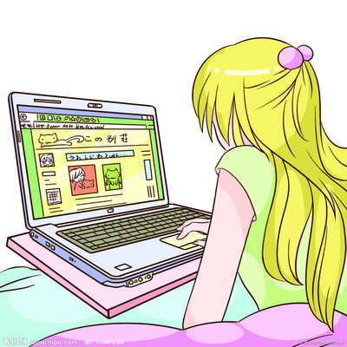
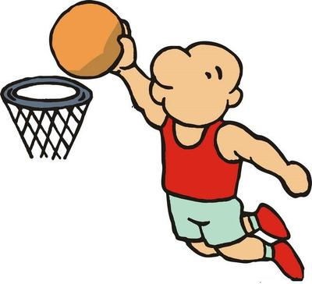
A: What do you want to be when you grow up ?
B: I want to be a basketball player .
A: How are you going to do that ?
B: I’m going to practice basketball every day.

Slide 13
Revision

Slide 14
Exercises
用 be going to 填空
1. He ____________(go) hiking on his field
trip next Sunday.
2. They ______________(watch) a football
match tomorrow afternoon.
3. Lin Tao _____________(study) Japanese
next term.
4. ____ you __________(have) dinner
together ?
5. When ___the children _________(meet) at
the school gate ?
6.What ___ you _______(do) next Friday ?
is going to go
are going to watch
is going to study
Are going to have
are going to meet
are going to do

Slide 15
1. I’m going to call him up when he _____(come)
here tomorrow.
2. The old man wants _______(go) to Hainan
for a vacation this winter.
3. Do you enjoy ______(play) soccer in the park?
4.Yesterday our school _____(have) a sports
meeting on the playground.
5.Every girl in our university wants to exercise
and keep _____(fit).
Exercises
适当形式填空
comes
to go
playing
had
fit

Slide 16
1.are , going , to , grow, up , be ,what , when, you , you
______________________________________
2. I’m , get, going , to , good, grades
______________________________________
3. piano, brother, take , and, to ,going , I ,my ,lessons,
are _________________________________
4.some , readers, are , going to , more, eat, vegetables
_______________________________________
Exercises
连词成句
What are you going to be when you grow up ?
I’m going to get good grades.
My brother and I are going to take piano lessons.
Some readers are going to eat more vegetables.

Slide 17
1.What are you going to be when you grow up ?
---I ___ an actor.
A. am B. was C. be D. am going to be
2. Her father is an ____ in a big factory.
A. star B. engineer C. actor D. player
3. We are going to work ___this year than last year.
A. hard B. harder C. hardest D. much hard
4.___ are you going to do that ?---I’m going to practice
football every day ? A. What B. How C. Why D. When
Exercises
单项选择

Slide 18
5. What is your New Year’s ____ ?
---I am going to study harder.
A. resolution B. question C. job D. subject
6.Mr. Black ___ up early every morning.
A. gets B. is getting C. is going to get D. got
7. He ____ to save his pocket money for later use, but
he spent it on a toy soon.
A. refused B. persuaded C. promised
Exercises
单项选择

Slide 19
Lead in

Slide 20
What will your life be like in
the future?
I will … .
将要

Slide 21
Grammar
一般将来时

Slide 22
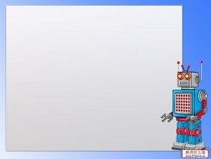
Simple Future Tense
定义：
表示将要发生的动作或情况。
be going to +动原
be doing+将来的时间
will/shall+动原
结构：
将要，打算，计划，做某事

Slide 23
标志性时间状语
明天和后天
in+段时间
今天下午和今晚
下周，下月和明年
当我长大，在未来
还有soon记心间。
tomorrow
the day after tomorrow
在…以后
this afternoon
this evening/tonight
next week, next month
next year
when I grow up
in the future

Slide 24
will+动原
will='ll
I
You
She
He
We
They
I will=I'll
he will=he'll
she will=she'll
will+动原
we will=we'll
they will=they'll
you will=you'll
名词之后不缩写 Bob will

Slide 25
People will have robots in their homes.
I shall visit the Summer Palace.
肯定式: 主语+will/shall+动原
Note : shall只能用在第一人称
will/shall 填空
1.She _________(go) to English class.
2.I___________(am) a good student.
3.They_________(have) lunch with us.
4.We___________(study) English.
will go
will/shall be
will have
will/shall study

Slide 26
People won’t use money .
We shan’t go back to shool next Sunday.
will not=won’t
shall not=shan’t
否定式: 主语+won’t/shan’t+动原
Note : shall只能用在第一人称
will/shall 改写否定句
1.She _________( not go) to English class.
2.I___________(not am) a good student.
3.They_________(not have) lunch with us.
4.We___________(not study) English.
won’t go
won’t/shan’t be
won’t have
won’t/shan’t study

Slide 27
Will the students watch the match ?
Shall we go to the zoo ?
一般疑问句: Will/Shall+主语+动原?
Note : shall只能用在第一人称
will/shall 一般疑问句
1._____ you _____(go) to Shanghai tomorrow?
2.____people ____(use) money in 100 years?
3.____we go to the movies next week ?
4.____ they ____(have) robots?
Will go
Will use
Shall
Will have

Slide 28
What will kids do next Sunday ?
Where shall we go ?
特殊疑问句: 特殊疑问词+will/shall+主语+动原?
Note : shall只能用在第一人称
eg. They will watch a basketball match next Sunday.
____ ____ they ____ next Sunday ?
What will do

Slide 29
辨析 will/shall+动原与be going to +动原
①will/shall +动原 表示单纯意义“将来要……，没有计划性。
②be going to +动原 表示“将要发生……”,
“打算，计划，决定要…… ”。
eg. They will go with us.
eg. What are you going to do next Sunday ?

Slide 30
There be 句型的一般将来时
肯定式: There will be +主语+其他。
eg. There will be fewer trees.
将会有更少的树。
否定式: There won’t be +主语+其他。
eg. There won’t be more free time.
将不会有更多的空闲时间。
一般疑问句: Will there be +主语+其他 ？
eg. Will there be a nice basketball match ?
Yes , there will. No, there won’t .

Slide 31
一般将来时口诀
一般将来时,形式有三变：
be +doing表计划，be going to +动原
还有一种更简单，will,shall 加动原
变疑问 be 提前，
will,shall 也提前，
否定be后加not,
will否定变won’t,shall否定变shan’t,
切记there be存在句
将来时是there will be.

Slide 32
Exercises
1.Traveling to space is no longer just a dream. Russia
___ the first hotel in space in the near future.
A. builds B. will build C. built D. has built
2.There ___a football match on CCTV-5 at nine
tomorrow evening.
A. will have B. is going to be C. is having
3.In 50 years there ___more robots in people’s homes.
A. were B. will have C. will be D. have
4.Will people live to be 300 years old ?--___.
A. No, they won’t B. No ,they aren’t C. No, they don’t

Slide 33
Exercises
5.I hope your dream ___ true one day.
A. come B. comes C. will come D. came
6.They ___ any classes next week.
A. will have B. won’t have C . have D. had
7.What ___the students ___ tomorrow ?
--They will clean the classroom.
A. do ; do B. did; do C. will ; do D. is ; doing
8.There ___a meeting tomorrow afternoon.
A. will have B. have C. will be D. will

Slide 34
Exercises
句型转换
1.There will be fewer people in our country.(否定句)
_____ ______ _____ more people in our country.
2.I will live in Beijing in ten yeas.(一般,并肯否回答)
____ ____live in Beijing in ten years?
Yes, ____ _____. No, _____ ______.
3.Bob will play soccer next Sunday. (划线提问)
_____ _____Bob _____ next Sunday ?
4.The students will study in the library. (划线提问)
_____ _____ the students _____ ?
There won’t be
Will you
I will
I won’t
What will do
Where will study

Slide 35
Section A

Slide 36
Do you think there
will be robots in
people’s homes?
Yes, there will.
I think every home
will have a robot.
Will kids go to
school ?
Kids won’t go
to school. They’ll
study at home on
computers.

Slide 37
Notes
1.Do you think there will be robots in people’s homes ?
你认为人们家里将会有机器人吗?
本句是一个含有宾语从句的主从复合句
Do you think 是主句,there will be … 是宾语从句
如果do you think 放在句中,则为插入语, 常放在疑问词之后.
结构为： 疑问词+do you think +主语+谓语+其他成分 ？
eg. What time do you think the train will arrive here ?
你认为火车什么时间到达这里？
宾语从句要用陈述语气。

Slide 38
Notes
A
eg.1. Do you know ____to buy some pears ?
----Sure, there’s a supermarket next to the post office.
Where I can go B. who will help me
What I should take D. when is the right time
2.Excuse me . Could you wake me up when my friend
___ here ? ---Of course. But we still don’t know
when your friend ____here.
A. comes; will come B. comes; comes
C. will come; comes D. will come; will come
A

Slide 39
Notes
2. I think every home will have a robot.
我认为每家都会有一个机器人。
本句是一个含有宾语从句的主从复合句
I think是主句,every home will have a robot是宾语从句
I think/suppose/believe 等后的宾语从句如果是否定句， 要把否定转移到主句的动词上，即“否定转移”。
eg. I don’t think he can swim.
我认为他不会游泳。
eg. I think you can go there by bus. (否定句)
I don’t think you can go there by bus.

Slide 40
Notes
3. 辨析 every 和 each
指三者或三者以上范围中的“每一个”
侧重总体，不能单独使用。
every
adj.
adj.
指两者或两者以上中的“每一个”，
侧重个体。
each
pron.
可作主语或宾语，其后可跟介词 of
eg. _____ teacher knows her .
There are lots of trees on ____side of the road.
____ of us has a dictionary.
Every
each
Each

Slide 41
Chant
every 用来表整体 ,each 用来表个体.
each 最低需是两, every最低需是三.
every做主用单数, each可单也可复 .
作主,定用单数 , 其他情况用复数 .

Slide 42
1a
How will the world be different 100 years from now? Read these predictions. Check(✓) A for agree or D for disagree.
✓
__A __D 1.People will have robots in their homes.
__A __D 2.People won’t use money . Everything
will be free.
__A __D 3.Books will only be on computers, not
on paper.
__A __D 4.Kids won’t go to school. They’ll study at
home on computers.
__A __D 5.There will be only one country.
__A __D 6.People will live to be 200 years old.
✓
免费的
✓
/PeIPE/ n. 纸,纸张
✓
在家通过电脑学习
✓
✓

Slide 43
Notes
4. Books will only be on computers , not on paper.
书只会在电脑上出现，而不会在纸上。
① paper 不可数名词 ，纸，纸张
② a piece of paper 一张纸
③ two pieces of paper 两张纸
A
eg. Please pick up the ___.Don’t keep it
on the floor.
A. paper B. boxes C. books D. bottles

Slide 44
Notes
5. People will live to be 20o years old.
人们将会活到200岁。
① live to be +基数词+year(s) old 活到……岁
② live v. 居住，生活
③ live in +地点 居住在……
④ live with +sb. 和某人住在一起
ive
eg. In the story, people will l____ to be
500 years old.
I l_____ in Beijing.
ive

Slide 45
Notes
⑤ live v. -----lives (单三)
/lIvz/
life n. 生命
-----lives (复数)
/laIvz/
eg. The doctor lives in a village.
He saved many lives.
/lIvz/
/laIvz/

Slide 46
1b
Listen and circle the predictions you hear in 1a.
1.People will have robots in their homes.
2.People won’t use money . Everything will be free.
3.Books will only be on computers, not on paper.
4.Kids won’t go to school. They’ll study at home on computers.
5.There will be only one country.
6.People will live to be 200 years old.

Slide 47
1c
Ask and answer questions about the predictions in 1a.
A:Will people use money in
100 years?
A : Yes, they will.
B: No, they won’t .Everything
will be free . Will people live to be
200 years old?

Slide 48
Notes
6. Will people use money in 100 years ?
100 年以后人们还使用钱吗 ？
① in 1oo years 在100年以后
② in +时间段 在……之后 用于一般将来时
③ in +时间段 how soon来提问
辨析 in 和 after
用来表示以现在为起点的将来某一段时间之后，后接时间段
in
将来时
既可接时间点有可接时间段
将来时或
过去时
after

Slide 49
Notes
eg. He will be back _____ two days.
He will be back ______ three o’clock.
He started on Sunday and arrived in Beijing _____ three days. A. in B . after
A
B
B
eg. My mother will finish cooking dinner in an hour.
____ _____ ____ your mother finish cooking
dinner ?
How soon will

Slide 50
2a
Listen and circle the words you hear.
1.There will be (more/less/fewer)people.
2.There will be (more/less/fewer free time.
3.There will be (more/less/fewer) cars.
4.There will be (more/less/fewer) pollution.
5.Ther will be (more/less/fewer) trees.
/PElu:Sn/n.污染

Slide 51
2b
Listen again .Check (✓) the predictions you hear.
__1.There will be fewer people.
__2.There will be less free time.
__3.People will use the subways less.
__4.There will be more pollution.
__5.Cities will be very big and crowded.
✓
✓

Slide 52
Notes
7. There will be (more/less /fewer) people.
many
① more 是_____和 _____的比较级,更多的
much
little
② less 是____ 的比较级，较少的,更少的
③ fewer 是______的比较级，较少的,更少的
few
more +可名复/不可名
less + 不可名
fewer + 可名复

Slide 53
Notes
eg. Ms. Smith wanted to get _____money.
(more / fewer)
There is _____ water in that glass.
(fewer/less)
I have _____ friends in that school.
(fewer/less)
more
less
fewer

Slide 54
Notes
8. There will be (more/less /fewer) pollution.
① pollution 不可数名词 “污染,污染物”
② pollute v. 污染,弄脏-polluted-polluting
③ air pollution 空气污染
noise pollution 噪音污染
eg. All these waste products are _______
(pollute) the river.
polluting

Slide 55
2c
Make conversations about the predictions in 2a and
2b.
/PrIdIKSn/n.预言,预测
A: What’s your prediction
about the future?
/fju:tSE/n.
将来,未来
A : Really ? I don’t think
so. But I think there will
be fewer trees.
B: I think there will be more
pollution.

Slide 56
Notes
9. What’s your prediction about the future ?
关于未来你的预言是什么?
① prediction 可数名词 复数+s
② predict v. 预测-predicted-predicting
③ future n. 将来,未来
in the future在将来,以后,特指将来的
某一时刻.
in future 从今以后的全部将来.
=from now on

Slide 57
Notes
10. I don’t think so . 我不这样认为.
① 表示否定对方的意见或观点
② 肯定形式 : I think so.
I hope so. 我希望是这样的.
I hope not. 我希望不是这样.
I’m afraid so. 恐怕如此.
I’m afraid not. 恐怕不是.

Slide 58
Exercises
1.Please pass me two ____ .
A. pieces of paper B. pieces of papers
C. pieces paper D. piece papers
2.Where is your brother ?
--He has gone to Beijing. He ___back in three days.
A. will come B. comes C. has come D. came
3.Some people ride bikes to work instead of driving in
order to reduce ____ pollution.
A. water B. air C. soil D. white

Slide 59
Exercises
4. I think English is ____ French.
---I don’t agree with you .
A. less popular than B. the most popular
C. so popular as D. as more popular as
5.He went to have a meeting on May 5th,2013 in
Shenzhen .He ___ back in 3 days.
A. is B. was C. is being D. will be
6.I hear there ____ a meeting tomorrow afternoon.
A. will have B. have C will be D. will

Slide 60
Exercises
句型转换
1.They clean the classroom every day.
(用tomorrow代替every day)
They _____ ____ the classroom tomorrow.
2.Will the flowers come out soon ? (肯定回答)
_____ , _____ _____.
3.We’ll go out for a walk with you .(否定句)
We ____ _____ out for a walk with you .
4.Nanjing will have a fine day. (一般疑问句)
____ Nanjing ____ a fine day ?
5.The students will work in the supermarket .(划线提问)
_____ ____ the students ______ ?
will clean
Yes they will
won’t go
Will have
Where will work

Slide 61
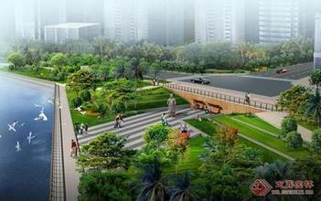
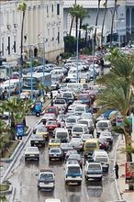
Look at two cities.
Which one do you like ?
Why ?

Slide 62
2d
Listen to the conversation and answer the
questions.
1.What will the future be like ?
①
②
③
Cities will be more crowded and polluted.
There will be fewer trees .
/InvaIrEnmEnt/n.环境
The environment will be in
great danger.

Slide 63
Listen and repeat !
Nick: What are you reading , Jill ?
Jill: It’s a book about the future.
Nick : Sounds cool. So what will the future be like ?
Jill: Well , cities will be more crowded and polluted . There will be fewer trees and the environment will be in
great danger.
Nick: That sounds bad ! Will we have to move to other planets ?
Jill: Maybe. But I want to live on the earth.
Nick : Me, too .Then what can we do ?
Jill : We can use less water and plant more trees.
Everyone should play a part in saving the earth.
planet /plQnIt/n.行星
/3:(R)T/n.地球
/PLA:nt/v.种植 n.植物
/PA:t/ n.参加,部分

Slide 64
Role –play the conversation.
Nick: What are you reading , Jill ?
Jill: It’s a book about the future.
Nick : Sounds cool. So what will the future be like ?
Jill: Well , cities will be more crowded and polluted . There will be fewer trees and the environment will be in
great danger.
Nick: That sounds bad ! Will we have to move to other planets ?
Jill: Maybe. But I want to live on the earth.
Nick : Me, too .Then what can we do ?
Jill : We can use less water and plant more trees.
Everyone should play a part in saving the earth.

Slide 65
Notes
It’s a book about the future.
它是关于未来方面的一本书。
① about prep. 关于,对于,有关
辨析 about 和 on (关于)
about
常用在口语中,表示的内容较普通,
不太正式。
常用在书面语中,表示严肃的或学术性的
问题。
on
eg. She has a lot of books on the history of
China.

Slide 66
Notes
2. So what will the future be like ?
那么,未来将会是什么样子？
① What’s … like ? ……怎么样 ？
② What’s sb. like ? 某人怎么样 ？
常用来询问某人的相貌,性格,品质
eg. 天气怎么样 ？
Tom 怎么样？--他滑稽有趣。
你的父亲长得怎么样 ？.
What’s the weather like ?
What’s Tom like ?—He is funny.
What’s your father like ?

Slide 67
Notes
3. There will be fewer trees and the environment
will be in great danger.
将会有更少的树,环境将会处于极度危险之中。
① in danger 处于险境,在危险中
② 反义短语：out of danger 脱险
③ danger n.---dangerous adj. 危险的
eg. It’s ________(danger) to play on
the road.
He is in great ________(dangerous).
dangerous
danger

Slide 68
Notes
4. Will we have to move to other planets ?
我们将不得不搬到其他星球上吗？
不得不have to 单三 has to
过去 had to 后面加动原
疑问否定别忘do , does,did来帮忙
eg. Mary ____(have) to do the laundry herself.
____ Mary ____(have) to do the laundry
herself?
Mary __________(have ) to do the laundry
herself.
has
Does
have
doesn’t have

Slide 69
Notes
辨析 have to 和 must
①主观必须must 客观不得不have to
② have to 有人称,数和时态变化,疑问否定
要用do , does, did.
must 情态动词 没有人称数变化
must 问,肯定回答must
否定回答needn’t.
eg. My mother has to get up early .(否定句)
My mother ____ ____ ____get up early.
Must you go now ? (肯定/否定回答)
Yes, I _____. / No , I _____.
doesn’t have to
must
needn’t

Slide 70
Notes
5. But I want to live on the earth.
但是我想住在地球上。
辨析 on the earth 和 on earth
地点状语
位于句首或句末
在地球上
on the earth
究竟,到底
用于疑问词后,加强语气
on earth
eg. What on earth do you mean ?
你究竟什么意思？

Slide 71
Notes
6. We can use less water and plant more trees.
我们可以少用水,多栽树。
辨析 plant和 grow
“种植”,一般指栽入土中,强调种植动作.
plant
“种植”,包括种下及以后培育过程,
强调种植过程 .
grow
eg. Don’t ____ the flowers before mid-April.
My uncle’s job is to ____ flowers.
plant
grow

Slide 72
Notes
7. Everyone should play a part in saving the earth.
每个人都应该参与到拯救地球的行列当中去。
①play a part in +n./pron./doing
参与某事; 在……方面起作用
eg. Let’s play a part ____ the room.
---That sounds great !
A. clean B. cleaning
C. to clean D. in cleaning
D

Slide 73
Practice the conversation.
Nick: What are you reading , Jill ?
Jill: It’s a book about the future.
Nick : Sounds cool. So what will the future be like ?
Jill: Well , cities will be more crowded and polluted . There will be fewer trees and the environment will be in
great danger.
Nick: That sounds bad ! Will we have to move to other planets ?
Jill: Maybe. But I want to live on the earth.
Nick : Me, too .Then what can we do ?
Jill : We can use less water and plant more trees.
Everyone should play a part in saving the earth.

Slide 74
Grammar
Focus
more polluted
Cities will be ____________
(polluted).And there will be
______(few) trees.
What
like
____ will the future be ____?
fewer
use
won’t
Will people _____(use) money
In 100 years ?
No, they _____. Everything
will be free.
Will there be world peace ?
Yes, I hope so.
study
won’t
Kids will ______(study) at
home on computers.
They _______(will not) go to
school.
Peace /pi:s/n.和平
peaceful adj.和平的

Slide 75
Grammar
Focus
Countable nouns
Uncountable nouns
There will be more people.
There will be more pollution.
There will be fewer trees.
There will be less free time.
ˊll=will
won’t = will not

Slide 76
3a
Fill in the blanks with more, less or fewer.
less
In the future , there will be ______ fresh water because
there will be ______ pollution in the sea.
2. In 100 years, there will be _____ cars because there will
be ______ people in the cities.
There will be _____ jobs for people because _____ robots
will do the same jobs as people.
I think there will be _____ cities because people will build
_____ buildings in the country.
In 50 years , people will have ______ free time because
there will be ______ things to do .
more
/si:/n.海洋,海
more
more
fewer
more
more
more
less
more

Slide 77
Notes
8. There will be fewer jobs for people because more
robots will do the same jobs as people.
对人们来说将会有更少的工作,因为更多的机器
人将会像人们一样做工作。
①the same…as 和……一样
②be different from 和……不同
eg. Is William’s lifestyle ___ David’s ?
A. the same B. same as
C. same to D. the same as
D

Slide 78
3b
Complete the predictions with what you think
will happen.
sky /skaI/ n.天空,可数名词
sky-skies
Kids study at school now.
In 100 years, ______________________________.
I sometimes see blue skies in my city , but in the future
________________________________________ .
People now usually live to be about 70 –80 years old ,but
in the future _______________________________
________________________________________ .
Families usually spend time together on weekends , but
maybe in 200 years _________________________
________________________________________ .

Slide 79
Notes
9. Families usually spend time together on weekends.
周末，全家人通常在一起度过时光。
①spend +time/ money (in) doing sth .
②spend +time /money on sth .
eg. She spends the whole morning
_______(help) her mother clean
the house.
helping

Slide 80
3c
Draw a picture of what you think a city in
the future will be like . Then describe it to
the class.
I think there will be more tall buildings, and there will be fewer
cars and more buses.

Slide 81
Exercises
根据句意及首字母提示,补全单词
1.Look at the s_____. Can you see any kites ?
2.Take out a piece of p_____ and write down your
dreams on it .
3.Can you show me how to u____ the computer ?
4.We can see there is much p_______ around us.
Our environment is getting worse and worse.
5. In the f_______ , there will be more buildings and
fewer trees.
ky
aper
se
ollution
uture

Slide 82
Exercises
用所给词的适当形式填空
1.I think there will be ______(few) trees in the future.
2.There will be more tall buildings on the ____(earth).
3.Tom was surprised by all the ________(pollute) on
the beach.
4. I think the kids in the future will study at home on
________(computer).
5. I think there will be more _____(plant) in the future.
fewer
earth
pollution
computers
plants

Slide 83
Exercises
单项选择
1. It’s ___ for them to swim in the river. They should
leave at home.
A. safe B. dangerous C. simple D. happy
2.We can see many stars in the ___. It will be a sunny
day tomorrow.
A. earth B. river C. sky D. hole
3.Mr.Green went to see his family in Shanghai. He ___
back in six days.
A. is B. was C. is being D. will be
4.Let’s play a part ____the housework.
A. to do B. doing C. do D. in doing

Slide 84
Section B

Slide 85
1a
Write each word in the correct column below.
/QstrEnO:t/ n.宇航员
/EpA:tmEnt/ n.公寓套房
astronaut house apartment train
rocket space station computer programmer
/RXkIt/ n.
火箭
/speIs/ n.太空,空间
Jobs
Transportation
Places to live
astronaut
computer
programmer
house
apartment
space station
train
rocket
1b
Think of other words and write them in the chart in 1a.

Slide 86
1c
Listen to Alexis and Joe. Number the pictures
[1---3] .
2
3
1

Slide 87
Listen again. Fill in the blanks with the correct
verbs in the box.
1d
I ______ in an apartment across the street from here.
I ______ near here.
I ______ a computer programmer.
We ________ in a house in the country.
I _______ the train to school.
I _______ an astronaut.
I ____________ rockets to the moon.
I __________ on a space station.
live
work
am live work lived took
will be
will live
will fly
am
lived
took
will be
will fly
will live

Slide 88
1e
Student A is Alexis and Student B is Joe. Talk about
Joe’s life now , 10 years ago and 10 years from now.
A: Where do you live ?
B: I live in an apartment.

Slide 89
Exercises
句型转换
There will be more people in our country.(否定句)
____ ____ ____ more people in our country.
I will live in Shanghai in ten years.(划线提问)
_____ ____ you live in ten years ?
Sally played football yesterday. (改为一般将来时)
Sally ______ _____ ______ tomorrow.
连词成句
less, in ,will, years, there, pollution , be, 100
______________________________.
won’t , be, any , there, money, paper
_______________________________.
There won’t be
Where will
will play football
There will be less pollution in 100 years
There won’t be any paper money

Slide 90
Exercises
单项选择
1.We are glad to hear that the Greens ___ to a new flat
next week.
A. move B. moved C. will move D. have moved
2. Have you washed the clothes ?
--Not yet. But I ___ them in half an hour.
A. washed B. have washed C. will wash D. wash
3.Simon is happy that he __in a big apartment in 2013.
A. live B. lives C. will live D. will living
4.The plane will take off ___three hours. I must get to
the airport right now.
A. in B. for C. on D. on

Slide 92
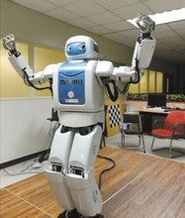
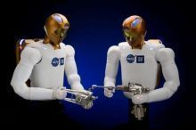
2a
What do the robots look like?
Tell your partner what you know about robots.
What do they look like
and what can they do ?
humans
They look like _________.
human /hju:mEn/ adj. 人的 n. 人

Slide 93
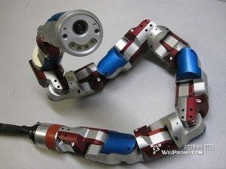
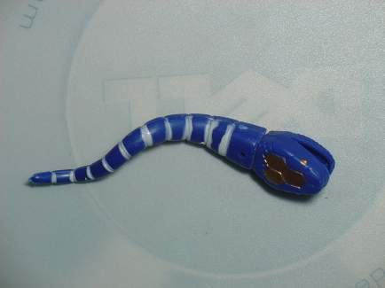
What do the robots look like?
snakes
They look like _________.

Slide 94
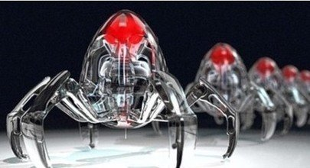
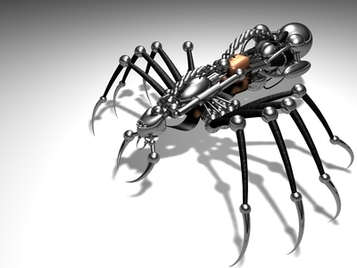
What do the robots look like?
spiders
They look like _________.

Slide 95
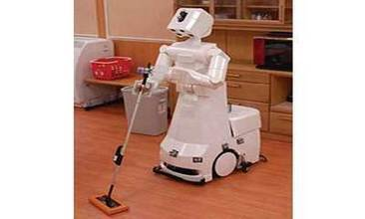
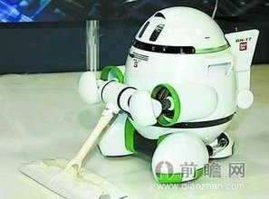
What can the robots do ?
They can ________________.
do the housework

Slide 96
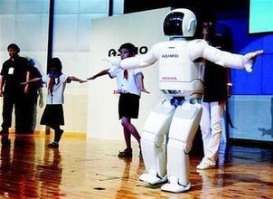
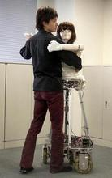
What can the robots do ?
dance
They can __________.

Slide 97
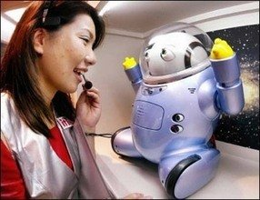
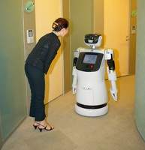
What can the robots do ?
talk
They can __________.

Slide 98
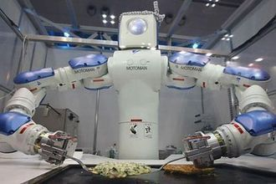
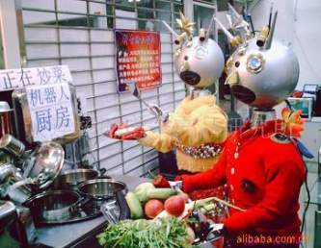
What can the robots do ?
cook
They can __________.

Slide 99
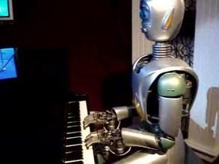
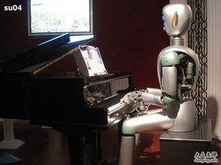
What can the robots do ?
play the piano
They can _____________.

Slide 100
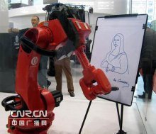
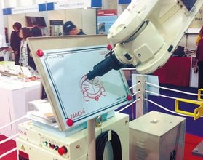
What can the robots do ?
draw
They can _____________.

Slide 101
2b
Listen to the article and match each paragraph with
the question it discusses.
Paragraph 1 Will robots think like humans in the future ?
Paragraph 2 What will robots be like in the future ?
Paragraph 3 What can robots do today ?
Paragraph 4 What are robots like in movies?

Slide 102
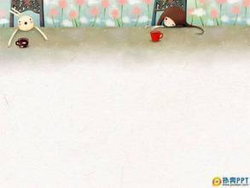
Do You Think You Will Have Your Own Robot ?
1. When we watch movies about the future, we
sometimes see robots. They are usually like
human servants. They help with the housework
and do jobs like working in dirty or dangerous
places.
/s3:vEnt/ n. 仆人
帮助做家务
/deIndZErEs/
adj. 危险的

Slide 103
Notes
1. They are usually like human servants.
它们通常就像人类的仆人一样。
辨析 human, person, person 和 man
指包括男人,女人,孩子的“人,人类”
human
无性别之分,常用于数目不大而且数目
比较精确的场合，可数名词
person
泛指“人们”集合名词 表示复数
people
a man 可指一个人,也可指一个男人
复数men
man

Slide 104
Do You Think You Will Have Your Own Robot ?
/O:LRedi/ adv. 已经,早已
2. Today there are already robots working in
factories . Some can help to build cars, and
they do simple jobs over and over again .Fewer
people will do such jobs in the future because
they are boring,but robots will never get bored.
多次,反复地
做简单工作
such +n. 如此……
factory /fQktri/ n. 工厂
感到厌倦

Slide 105
Notes
2. Today there are already robots working in factories.
今天，已经有机器人在工厂工作了。
①already adv. 早已，已经
多用于肯定句句中，否定疑问要变yet,放句末
eg. He has _____ left.
Has he finished the work ____ ?
already
yet
②There be + n. +doing sth.
有某人/某物正在做某事
eg. There are some girls ______(sing).
singing

Slide 106
Notes
3. Some can help to build cars , and they do simple
jobs over and over again .
有些可以帮助制造小汽车,它们可以反复地做一些
简单的工作。
①simple adj. 简单的,简易的
同义词 easy
反义词 hard / difficult
②over and over again
反复地, 一遍又一遍地
=again and again
eg. Li Na practices singing again and again.
=
over and over again
Li Na practices singing ___ ___ ___ ____.

Slide 107
believe /bIli:v/ v. 相信
disagree /dIsEgri:/
v. 不同意
even /i:vn/ adv. 甚至
Do You Think You Will Have Your Own Robot ?
3. Scientists are now trying to make robots look like
humans and do the same things as we do .Some robots
in Japan can walk and dance. They are fun to watch.
However, some scientists believe that although we can
make robots move like people, it will be difficult to
make them really think like a human. For example ,
scientist James White thinks that robots will never be
able to wake up and know where they are. But many
scientists disagree with Mr.White . They think that
robots will even be able to talk like humans in 25 to 50
years.

Slide 108
Notes
4. Scientists are now trying to make robots look like
humans and do the same things as we do.
科学家现在正尽力制造一些看上去像人类一样，
并且能像我们一样做事情的机器人。
①try to do sth. 尽力做某事
eg. I try ________(speak) English.
to speak
②look like 看起来像
③do the same things as…
像……一样做事情

Slide 109
Notes
5. They are fun to watch.
他们看着很有趣。
①be fun to do sth. 做某事有趣
eg. The boys are fun ______(play).
to play
6. However, some scientists believe that
although we can make robots move like
people. 然而,一些科学家认为虽然我们
能使机器人像人们一样移动。
① make sb. do sth. 使某人做某事
make sb. +adj. 使某人……

Slide 110
Notes
7. However, some scientists believe that
although we can make robots move like
people. 然而,一些科学家认为虽然我们
能使机器人像人们一样移动。
① believe v. 相信 , 认为
(和think用法一样)
② believe sb. 相信某人 (所说的话是真的)
③ believe in sb. 信任某人
eg. I believe him, but I can’t believe in him.
我相信他说的话是真的,但我不能信任他。

Slide 111
Notes
8. It will be difficult to make them really think
like a human.
使它们真正像人类一样 思考将是困难的。
① It is +adj. (for sb.) + to do sth.
做某事对某人来说……的。
C
eg. It will be difficult for a robot ___ the
same things ___ a person.
A. doing ; like B. do ; from
C. to do ; as D. does ; as

Slide 112
Notes
9. For example, scientist James White thinks
that robots will never be able to wake up
and know where they are.
例如,科学家詹姆斯怀特认为机器人将永远
不能醒来并知道它们在哪里。
① wake up 醒来
wake sb. up 把某人唤醒, 代词放中间。
eg. His mother often wakes ____(he)
up at 5:00 in the morning.
him

Slide 113
Notes
辨析 be able to 和 can
可用多种时态,表示经
过努力而有能力做成
某事
有人称和
数的变化
be able to
只有现在时(can)和过去时
(could),can 可以表示请求,
允许,推测,be able to 没有此
用法。
can
没有人称
和数的变化
eg. He ___(be) able to do great things.
Mary can’t ____(be) in Paris.
is
be

Slide 114
Notes
10. But many scientists disagree with Mr.White.
但是许多科学家不同意怀特先生。
① disagree v. 不同意
反义词：agree
② agree/disagree with sb.
同意/不同意某人
eg. I think people here are friendly.
Do you agree ___ me ?
A. with B. to C. on D. from
A

Slide 115
Notes
11. They think that robots will even be able to
talk like humans in 25 to 50 years.
他们认为在25到50年之后机器人甚至能
像人类一样进行交谈。
① even adv. 甚至,更 ,
用来加强语气,也修饰比较级。
②in 25 to 50 years 在25到50年之后

Slide 116
shape /SeIP / n. 形状
inside /InsaId /
prep./adv. 在……里面
Do You Think You Will Have Your Own Robot ?
4. Some scientists believe that there will be more robots
in the future. However, they agree it may take
hundreds of years. These new robots will have many
different shapes. Some will look like humans, and
others might look like animals. In India, for example,
scientists made robots that look like snakes. If
buildings fall down with people inside, these snake
robots can help look for people under the buildings.
This was not possible 20 years ago,but computers and
rockets also seemed impossible 100 years ago. We
never know what will happen in the future !

Slide 117
Notes
10. However, they agree it may take hundreds
of years.
然而,他们一致认为这可能要花费数百年的时间。
① hundreds of 数以百计的
② hundred (百)/thousand(千)
million(百万)/billion(十亿)
有数字，无s ;无数字，有s,+of
B
eg. Our school is so famous that ___
people come and visit it every term.
A. hundred B. hundreds
C. hundred of D. hundreds of

Slide 118
Notes
11.Some will look like humans , and others
might look like animals.
有些看上去像人类，其他一些可能看上去像动物。
① look like 看起来像…… 强调外表
② look the same 看起来一样
主语通常是两个或两个以上的人或事物
其后不可以再接其他的词。
eg. Both of them look the same.
他们两个看上去一样。
③ look the same as … 看起来和……一样
④ some…others… 一些……另一些……

Slide 119
Notes
12.If buildings fall down with people inside,
these snake robots can help look for people
under the buildings.
如果建筑物倒塌了,里面有人,这些蛇形机器人能
帮助寻找建筑物下的人。
① fall down 突然倒下,倒塌
fall-fell
② look for 寻找,强调寻找的动作。
find 找到，强调找的结果。
looking for
eg. We are ________ Millie, but we can’t
_____ her. (look for , find )
find

Slide 120
Notes
13.This was not possible 20 years ago, but
computers and rockets also seemed
impossible 100 years ago.
20年前这是不可能的，但是在100年以前,电脑
和火箭似乎也是不可能的。
① possible /pXsEbl/ adj.可能的
② impossible 不可能的
③ as +adj./adv.原级 as possible
尽可能地……
④ if possible 如果可能的话

Slide 121
Notes
eg. We’ll start as _____ as possible. (earlier)
early
⑤ as soon as possible
as fast as possible
as quickly as possible
as early as possible
尽可能快(指时间)
尽可能快(指速度)
尽可能快(指动作)
尽可能早(指时间)

Slide 122
Notes
14.This was not possible 20 years ago, but
computers and rockets also seemed
impossible 100 years ago.
20年前这是不可能的，但是在100年以前,电脑
和火箭似乎也是不可能的。
① seem +adj. = seem to be +adj.
eg. He seems very angry.
=
He seems to be very angry.
② seem + n.
eg. He seems a nice man.

Slide 123
Notes
③ seem like … 好像,似乎……
eg. It seemed like a good idea at the time.
④ seem to do sth. 好像/似乎做某事
eg. I seem to have left my book at home.
⑤ It seems/seemed that … 看起来好像……
eg. It seemed that he was very happy.

Slide 124
Read the article again quickly . Complete the sentences about what robots can do now.
2c
1. Robots can build ________ in factories.
2. They can do ________ jobs many times and
never get bored.
3. Some can _________ and __________.
4. Some can help __________ people under ___________.
cars
simple
walk
dance
look for
the buildings

Slide 125
Fill in the blanks in this paragraph with words from the article.
2d
Some robots are very human-like . They can walk
and ______ like people. Some scientists think that
in the future they will ______ robots more like
humans. This may not _____in the near future,
but at some point , robots will even be able to ___
like people. However, some scientists _______.
James White believes that robots will not be able to
do the ______things as we can. For example, he
thinks that robots will ______ be able to wake up
and know where they are. Which side do you ____
with ?
dance
make
happen
do
disagree
same
not
agree
side /saId/ n.一方(的意见,态度,立场)
at some point 在某些方面

Slide 126
What kinds of animals might robots look like in the
future ? What do you think these robots will be able
to do ? Write your ideas and discuss them with your
partner.
2e
I think some future robots might look like
_________________________. They will
__________________________________
__________________________________
__________________________________.

Slide 127
Exercises
单项选择
1.____volunteers will give out leaflets to ask people
to protect the wetland.
A. Two hundreds B. Hundreds of
C. Two hundred of D. Hundred of
2.____ , Tom ! It’s time to get up and go to school.
A. Wake up B. Make up C. Grow up D. Look up
3.What are you doing ?---I’m ___my book.
A. looking B. looking for C. looking after
4.The 3D Titanic is a moving film. My parents have
seen it twice ____.
A. yet B. already C. never D. almost
5. What’s the ____of the red ball ? ---It’s round.
A. name B. shape C. color D. size

Slide 128
Exercises
单项选择
6.Japanese companies have already made robots ___.
A. to walk and dance B. walking and dancing
C. walk and dance D. walked and danced
7. What are you doing in the room ?
--I’m ___ my pens.
A. looking after B. looking out
C. looking for D. looking up
8.She often helps her mother ___ the housework, but
she never gets ____.
A. with ; bored B. do ;boring
C. on ;bored D. to do; boring
9.Mr.White thinks that robots won’t __walk to people.
A. can B. able to C. be able to D. are able to

Slide 129
Exercises
补全对话
A: Hi, Mary. There will be an exciting movie next Sunday evening . __1___
B: Sure . What is it about ? A: __2___
B: Is it interesting?
A: Yes. People can visit planets like Mars by spaceship.
B: __3___
A:Yes. There are houses, hospitals and cities on Mars
in the movie.
B: How exciting ! ___4___
A: Do you think man can live on Mars one day?
B: ___I hope I can live there one day.
B
E
A
D
C
Can we live on Mars? B. Would you like to see it ?
I think so. D. I can’t wait.
E. It’s about life on Mars.

Slide 130
3a
Read Jill’s answer to the question “ What will your
life be like in the future ? ’’ Fill in the blanks with
the words in the box.
meet work live look keep wear more less fewer take
In 20 years, I think I’ll be a newspaper
reporter. I’ll ______In Shanghai, because
there will be ______jobs in that city.
As a reporter ,I think I will _____ lots of
interesting people,so I’ll have more friends.
I’ll have ________pets ,though, because
I’ll have _____free time.
live
more
meet
fewer
less

Slide 131
3a
Read Jill’s answer to the question “ What will your
life be like in the future ? ’’ Fill in the blanks with
the words in the box.
meet work live look keep wear more less fewer take
And my apartment will be no good for pets because it’ll be too
small . So I’ll probably just _______a bird. During the week ,
I’ll _____ smart clothes. On the weekend, I’ll _______less
smart but I’ll be more comfortable . In the future, people will
______more so they’ll probably have fewer vacations, but
I think I’ll _______a holiday in Hong Kong when possible.
One day I’ll even go to Australia.
like
wear
look
work
take
holiday /hXlEdeI/ n .假期
probably /prXBEbli/ adv.很可能,大概
during /djʊErIN/ prep .在……期间

Slide 132
Notes
1.So I’ll probably just like a bird.
因此,我可能就像一只鸟.
辨析 probably ,maybe 和 perhaps
① probably 常用于句中,可能性大.
② maybe=perhaps 常用于句首,可能性
小于probably.
eg. He will ______ come tomorrow.
___________you are right.
probably
Maybe/Perhaps
probably adv.- probable adj.

Slide 133
Notes
2.During the week, I’ll wear smart clothes.
在工作日期间,我将穿干练的衣服.
辨析 during , for 和 in
① 某事是在某一段时间之间发生的用during
② 某事持续多久则用for
③ 某事具体发生的时间用in

Slide 134
Notes
3.holiday /hXlEdeI/ n .假期 可数名词
=vacation
① take a holiday 度假
② on holiday 在休假中
③ the school holidays 学校的假期
④ the summer holidays 暑假
D
eg. Everyone wants to ___to the moon
for__.
A. walk ; vacations B. run; vacations
C. swim; holidays D. fly ; holidays

Slide 135
3b
Complete the chart about your life 20 years from
now. You can add more items.
What will your … be like ?
job
home
free time activities
neighborhood

Slide 136
3c
Write about your life 20 years from now. Use 3a and
3b to help you .

Slide 137
4
Discuss how you think a robot will help students with
schoolwork in the future .Write down your group’s
ideas and draw a picture of your robot.
1. I think students won’t need dictionaries because a robot
will tell them the meanings of the words.
2.
3.
4.
5.
word /W3:d/ n.单词

Slide 138
Self Check
1. Put the words in the correct columns in the chart.
job people pollution robot fresh water
paper planet car clean air city free time building money tree
more/fewer
more/less
job, people , robot, planet, car , city, building , tree
pollution, fresh water
paper , clean air,
free time, money

Slide 139
Self Check
fly up into the sky 飞向天空
2. Free in the blanks in the conversation.
be
Girl : Mom, what will the future _______ like ?
Mom: Well, no one knows what the future will be
______.
Girl : But ______I be beautiful like you ? _____
I be a pilot ? I want to fly up into the sky.
Mom: You’re already beautiful. And you should study
hard. Then you _____ be a pilot.
Girl : OK , I must study harder then.
Mom: But you should also remember that ____will
_____both good and bad things in life.
Girl: Oh, but I’m not scared, Mom ,because you
___help me !
like
will
Will
will
there
be
will

Slide 140
Exercises
适当形式填空
1.There is a tall ________(build) in front of the bank.
2.I think there will be _____(little) pollution in the
future.
3.I think ______(human) will have more free time in
the future.
4.______(Which) place do you want to go ?
--China Pavilion. (中国馆)
5.I _______(be) able to climb the tree last year, but
now I can’t .
6.It will ________(probable) rain. Let’s take the bus
to Shenzhen.
7.He ______(fall) down a tall tree. Luckily he didn’t
hurt badly.
building
less
humans
Which
was
probably
fell

Slide 141
Exercises
根据句意及首字母提示,补全单词.
1.Please give me a piece of p______. Thanks.
2.I want to travel in s______.
--Me , too. This is our dream about the future.
3.It will p______ rain. You have to take an umbrella.
4.New bags will have many different s______. But I
like round ones best.
5.We plant more trees, and our e___________ will be better and better.
aper
pace
robably
hapes
nvironment

Slide 142
Exercises
单项选择
1.The next time you see Nick, he ___sixteen years old .
A. will be B. is C. was D. will
2.In ten years, John ___ as astronaut.
A. is B. will be C. was D. will
3.They want to fly ___ the sky. But it’s too difficult.
A. up in B. in up C. up into D. into up
4.Our school is so famous that ___people come and
visit it every term.
hundred B. hundreds C. hundred of D. hundreds of
5.Traveling to space is no longer just a dream. Russia
____ the first hotel in space in the near future.
A. builds B. will build C. build D. has build

Slide 143
Exercises
单项选择
6.This term ___over. The summer vacation is coming
in two weeks.
A. is B. was C. has been D. will be
7.Mom, when can I go out to play football ?
--Finish your homework first , or I ___ let you go out.
A. don’t B. didn’t C. won’t D. haven’t
8.In A.D.2050, what will the world population(人口)be?
-- I think cities will be really big and crowded because
there will be a lot ___people.
A. much B. more C. many D. less
9.The computer is broken. ___ it ____ today?
A. Will ; repair B. Has; repaired
C. Will ; be repaired D. Has; been repaired

Slide 144
Exercises
句型转换
Kids will go to school in 100 years. (否定句)
Kids _____ _____ to school in 100 years.
She’ll read books this afternoon. (一般)
_____ she _____ books this afternoon ?
He’ll work as a reporter when he’ s older. (同义句)
He’ll work as a reporter when he ____ _____.
His bag looks like a big box. (划线提问)
_____ _____ his bag look like ?
They agree with what I said. (反义句)
They _____ _____ what I said.
won’t go
Will read
grows up
What does
disagree with

Slide 145
Thank you!

