Slide 1
Unit 6 Go with Transportation
Lesson 36：Clean Cars?
Preparation:
Stationery
Textbook
Paper

Slide 2
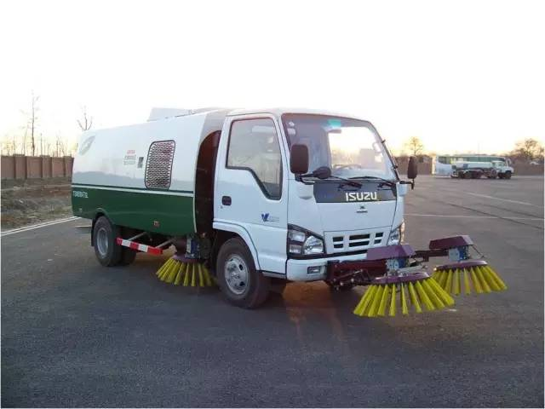
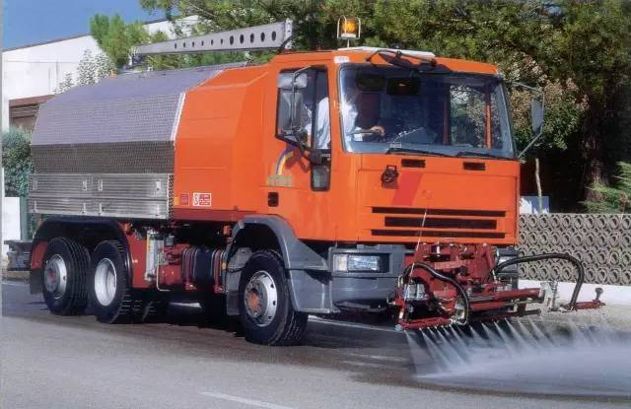
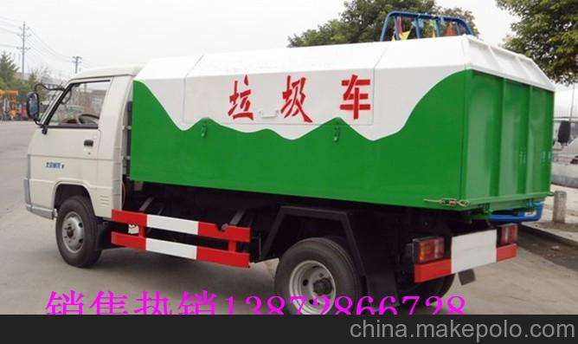
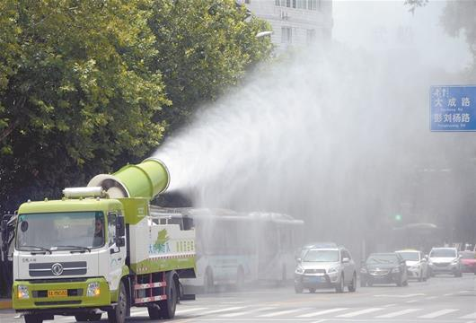
What do you think of “a clean car”?
We can call them the cleaning trucks.
street sweeper
watering lorry
garbage truck
spraying truck

Slide 3
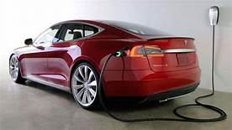
It is a clean car.
CLEAN here means it does not create so much pollution.
What different kinds of fuel may be
used to create clean cars in the future?
Maybe we can use electricity, water, wind, sun power as fuel in the future.

Slide 4


Task 1
Listen and tick the correct answers.
1. Jenny and Li Ming talked about different types of transportation over the next ________ years.
A one hundred B one thousand
C one million
2. Jenny would like to invent a ________.
A hoverboard B clean car C backpack
3. Li Ming travelled across the city by ___.
A bus B bike C train

Slide 5
Task 2
Read two emails and answer the questions.
1. What did Jenny's class do this week in school?
They discussed transportation.
They learned about trains, planes, bicycles, cars and rockets.
2. What did the teacher ask the class to do?
The teacher asked them to think about the future of transportation.
3. What does Li Ming think of Jenny’s idea of inventing a clean car?
He thinks it sounds like a fun project. Jenny is right about cars.

Slide 6
Task 2
4. What does Li Ming think of cars?
They are very bad for our environment.
5. How did Li Ming travel around the city?
He rode across the city. /By bike.
6. How long did Li Ming pedal?
For more than an hour!
7. What will cars use to power them in the future?
Water or sun energy.

Slide 7
1Read the two e-mails by youself.
2. Read the two emails to your partner, correct your wrong pronunciation.

Slide 8
Task 3
Read the lesson and fill in the blanks.
transportation
This week，Jenny’s class discussed_______________(交通).They ________(learn) about trains，planes，rockets and more. The teacher asked them to think ______ the future of transportation. They had to think of ___ invention and present it ____ the class. Danny ______(give) a very interesting ____________ (present). He put _____ an old backpack. He _____(get) on a chair and ________ (jump) down. He wanted to fly. Li Ming thinks that cars are bad _____our environment. When people walk or ride bicycles more often, our air would be a lot _______(clean). He _________(pedal) for more than an hour! In the future, cars will __________(probable) use water or sun energy to power them.
learned
about
an
to
gave
presentation
on
got
jumped
for
cleaner
pedalled
probably

Slide 9
Task 4
What are the advantages and disadvantages of different types of transportation? Talk with your partner and fill in the table.
Transportation | car | bus | bicycle | plane | train | ship | walking
Advantages
Disadvantages

Slide 10
fast /slow expensive /cheap, comfortable, clean, easy to carry / drive / park , convenient, exciting, hold more people,
be good for health / environment , environmental, save time, ...

Slide 11
I think a car is a good type of transportation. It is faster than a bus.People could drive it at anytime or and stop it anywhere. What's more , people feel comfortable in the car. It is convenient for people.
But it can't carry many people .Besides ,not all of cars are clean cars, some are bad for the environment . More importantly, there are more and more cars now. Parking cars is not easy for people, especially in the city.

Slide 12
Show time

Slide 13
Language Points

Slide 14
1. What different kinds of fuel may be used in the future?
be used 被用
be used to do 被用来做某事
① Wood is used to make paper.
木材可以用来造纸。
② A dictionary can be used to check the words.
字典可以用来查单词。

Slide 15
ask sb. to do sth. 叫（要求）某人做某事
类似用法的动词：tell, want, allow, wish, teach, advise, encourage
My mother wanted me to visit Beijing with her.
我母亲想要我和她一起参观北京。
I wish you to have a good journey.
我祝你旅途愉快。
【注意】
否定结构：在不定式to符号前加not。
My mother told me not to play on the road. It’s dangerous.
妈妈告诉我不要在马路上玩耍，很危险。
2. The teacher asked us to think about the future of
transportation.

Slide 16
用方框中词和短语的正确形式填空。
exercise
present sound clean
go well think of be bad for
cleaner
1. The air in the mountains is much _______ than it is in the cities.
2. He _________ a good idea to solve the problem.
3. Everything _________ last week. The newcomer got on well with the others.
4. Danny stood in front of the class and gave his ____________on his new form of transportation.
5. Eating too much junk food _________ our health.
6. Your idea ________ fun.
thought of
went well
presentation
is bad for
sounds

