Slide 1
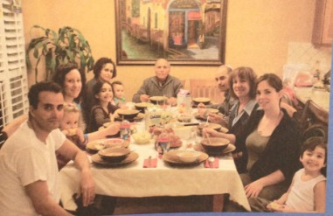
Unit 3 Families Celebrate Together

Slide 2
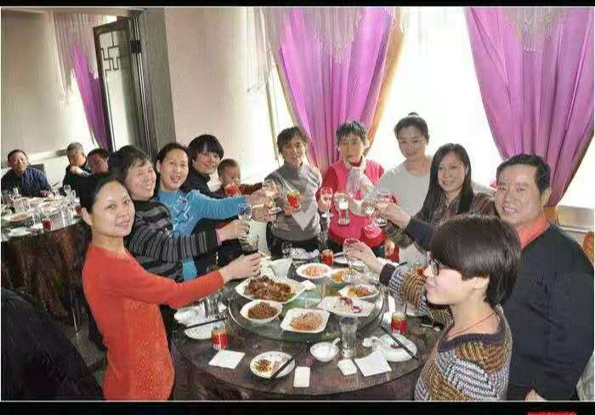
People celebrate Mid-Autumn Festival together.
[ˈselɪbreɪt] 庆贺; 庆祝

Slide 3
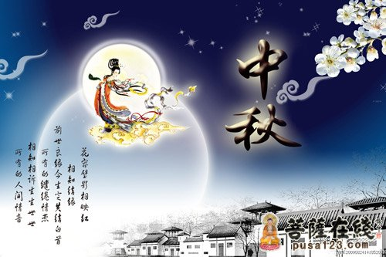
When is Mid-Autumn Festival?
In the lunar calendar, it's on August 15.
[ˈluːnə(r)] 农历/阴历的

Slide 4
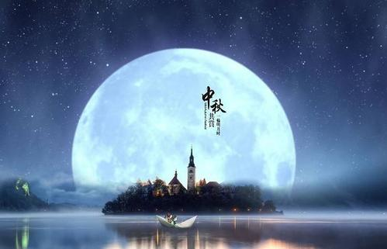
How does the moon look like ?
The moon is round and bright.
[raʊnd] 圆的

Slide 5
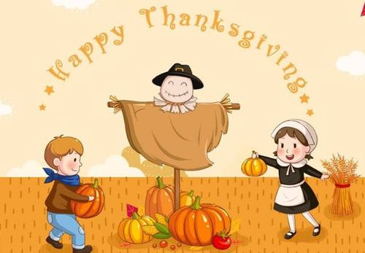
However, in the U.S. they celebrate Thanksgiving on the fourth Thursday of November.
[ˌθæŋksˈɡɪvɪŋ] 感恩节

Slide 6
New words and phrases
celebrate [ˈselɪbreɪt] v. 庆贺; 庆祝
lunar [ˈluːnə(r)] adj. 月球/农历/阴历的；
round [raʊnd] adj. 圆的 adv. 周而复始的
however [haʊˈevə(r)] adv. 然而、不过
wonder [ˈwʌndə(r)] v. 好奇、想知道
celebration [ˌselɪˈbreɪʃn] n. 庆贺; 庆祝
mid- [mɪd] 居中，在中间
Thanksgiving [ˌθæŋksˈɡɪvɪŋ] n. 感恩节

Slide 7


No.2 Listen to the dialogues and tick the correct answers or pictures.
1. When did the girl visit her grandparents?
On National Day.
On Mid-Autumn Day.
On Thanksgiving Day.
2. What do people usually eat on that day?

Slide 8
3. What do people usually do that evening?

Slide 9
Task 1:Listen to the first e-mail and answer the questions.
1.What will Li Ming’s family do this week?
2.When is Mid-Autumn Festival?
3.What will Li Ming’s family do on Mid-Autumn Festival?
They will celebrate Mid-Autumn Festival this week.
In the lunar calendar, it's on August 15.
They will watch the moon and look for Chang'e.

Slide 10
4.When is National Day?
5. How old is Li Ming now?
It's on October 1.
He is twelve years old now.

Slide 11
Task 2:Listen to the second e-mail and answer the questions.
1.When is Thanksgiving day in Canada?
2.What will Jenny and her family do in autumn?
3.When is Thanksgiving day in the U.S.?
It's on the second Monday of October.
Jenny will go to her grandparents' home and they will have a blg dinner.
It's on the fourth Thursday of November.

Slide 12
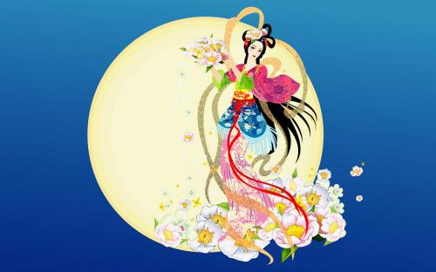
Exploration
Do you know Mid-Autumn Festival ? What season is it in?
What do we often do on Mid-Autumn Festival ？
Chang’e
families get-together
eat mooncakes
watch the moon
look for Chang’e

Slide 13
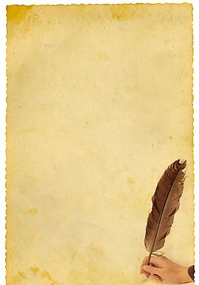
Discussion
1. Check the answers above.
2. Retell the story of Chang'e in groups.
3. Introduce the custom on Mid-Autumn Day.
the Queen Wangmu王母娘娘
shoot down 射下来
magic pill 仙丹
Act Out！

Slide 14
Self-Check
In China, Mid-Autumn Festival is very important. Families get together to 1._______（庆祝）it. At night, we sit in the open air to watch the 2.r_____ moon. 3. _____（在...期间) the festival we eat moon cakes. They're very 4. _______（美味的）. I 5. _______（想知道） if you like this festival.
celebrate
ound
During
delicious
wonder

