Slide 1
Get ready for the test!

Slide 2
1-5BCAAD
6-10CBBCD
11-15DBABC
16-20ADCCB
21-23BAC
24-26DBA
27-30BCAD
31-35DCDBA

Slide 3
36. three hundred 37. before 38. A hundred years ago. 39. The British Museum is one on the biggest museums in the world.
40. 这个图书馆发展得越来越快。
41. young 42. fed 43. giving 44. hand 45. what 46. wrong 47.grows 48.comfortably 49. used 50. happiness
51. Is Lily good at math
52. How many players are there in the team
53. We must try to save energy.
54. How fast Peter is running
55. Bring me some flowers if you can

Slide 4
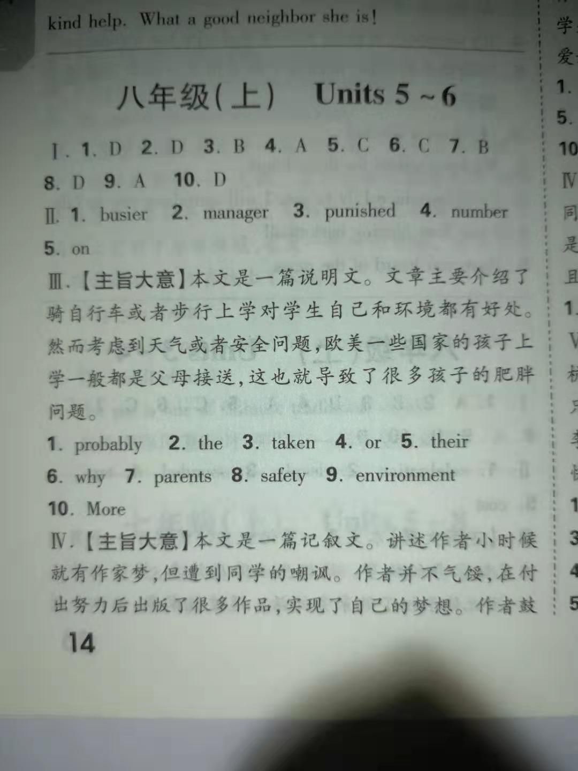

Slide 5
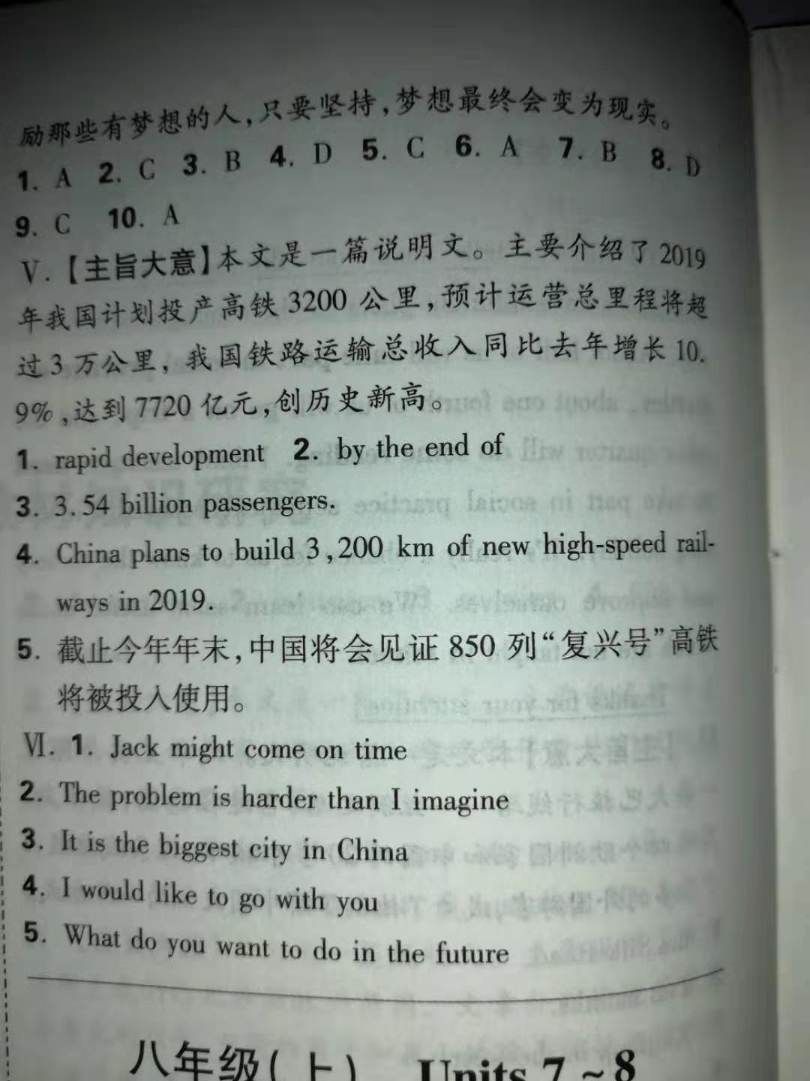

Slide 6
Composition
寒假就要到了，你有什么计划？去旅游，还是待在家里？帮妈妈做家务，还是与同学玩耍？请以“My Plan for the Winter Holiday”为题写一篇80词左右的英语短文。

Slide 7
One possible version:
My Plan for the Winter Holiday
The winter holiday is coming. We will have three weeks' holiday. The Spring Festival is coming, too. It will be fun to spend the Spring Festival in my hometown. As usual, my parents and I will come to my grandma's house and celebrate the Spring Festival together. I will help my grandma with the housework. We will have a lot of delicious food to eat. And I will play games with my local friends, too. I'm sure we will have a good time there.

