Slide 1
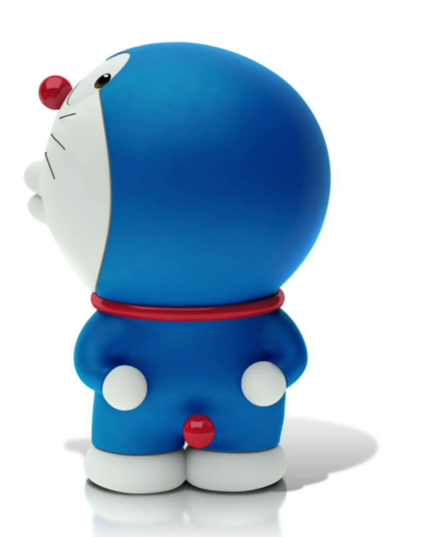
Lesson 39
Danny’s Hobby Hobby
单击此处添加标题

Slide 2
Words and expressions
Rex [reks] 雷克斯（男子名）
giant ['dʒaiənt] n. 巨人；伟人
adj. 巨大的
huge [hju:dʒ] adj. 极大的；巨大的
African ['æfrikən] adj. 非洲（人）的
hen [hen] n. 母鸡
anymore ['enimɔ:] adv. 再也(不)；不(再)

Slide 3
Rex [reks] 雷克斯（男子名）
giant ['dʒaiənt] n. 巨人；伟人
adj. 巨大的
huge [hju:dʒ] adj. 极大的；巨大的
African ['æfrikən] adj. 非洲（人）的
hen [hen] n. 母鸡
anymore ['enimɔ:] adv. 再也(不)；不(再)

Slide 4
Introduce one of your family members.
Free talk

Slide 5
Read the lesson again and answer questions.
1. What’s Danny’s hobby ?
2. Why does he like it?
3. What’s the nickname (别名) of Danny’s Great Great Grandpa?
His hobby is collecting facts about his family.
It’s fun and it makes him feel proud.
Grandpa Giant.

Slide 6
4. Does Danny's grandpa keep cows and chickens now?
5. What does Danny need to do for his report?
6. What’s Danny’s idea?
Yes, he does.
He needs to show and talk about his hobby.
He plans to trade photos. /He wants his grandma to keep his photo and send him a photo of Rex.

Slide 7
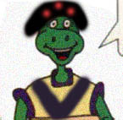
Read the text and fill in blanks.
Facts about Danny’s Great Great grandpa
His name
Appearance (外貌)
Place of learning English?
Style of house
Way to get eggs and milk?
Rex
Very tall and strong
In Canada.
African-style
From his own hens and cows.

Slide 8
This is Danny’s great great grandpa. He was very _____and ______.He comes from _______, and learned English in _________. He ______his own __________ house. He got his _____and ______from his own chickens and cows.
tall
strong
Africa
Canada
built
African-style
eggs
milk

Slide 9
Exercises
Danny’s grandma is telling him more facts about Grandpa Giant. Listen to the dialogue and circle for correct and for false.
He enjoyed playing basketball.
He didn’t like gardening.
He enjoyed eating donuts.
He liked collecting stamps.
He was not interested in painting.

Slide 10
Introduce one of your family members. You can talk about his/her basic facts and his/her hobbies. Then try to retell.
Facts: name, appearance, personality, others…
Hobbies: what
why
how

Slide 11
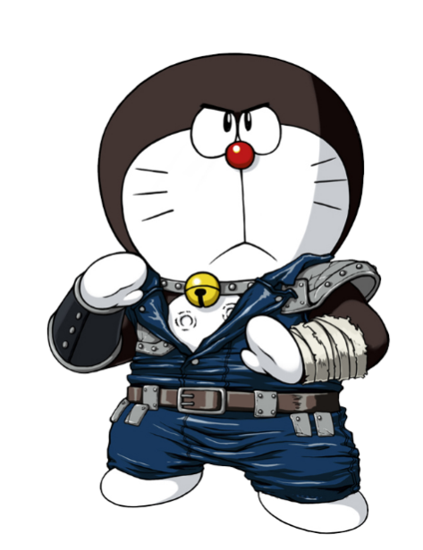
1. It’s fun and it makes me feel proud. .
(1)feel/be proud of :为…感到骄傲
eg: They are very proud of their son.
be proud of = take pride in
(2) be /feel proud to do sth. 为做某事很自豪
I am/feel proud to have a friend like you.
(3) be/feel proud +that 从句
I'm proud that I am Chinese.
She felt proud that she won first place.

Slide 12
2. Most people don’t have cows or chickens anymore.
你不能再喝了。
You can drink no more. = You can’t drink any more. 你不能再住在这了。
He no longer lives here. = He doesn't live here any longer.
no more
no longer
不再
not … any more/anymore
not … any longer

Slide 13
3. He built his own Afican-style house.
(1) own adj.自己的 用于形容词性物主代词或名词所有格后面，强调个人所有或某事物的特性。
It was my own idea.
This is Danny's own money.
拓展① own v.拥有，同义词是have
This house is mine. I own it.
② on one's own 独自
of one's own 属于某人自己的
He finished the work on his own.
He has a room of his own.

Slide 14
Complete the passage with the phrases in the box.
send a letter do a report feel proud collect facts trade photos
Shirley is a journalist. She travels around the world and interviews many people. Her job requires her to ask people questions and __________ about them. Right now she is ____________ about Africa. She is there to write about the lives of the poor. She likes to take photos with them and they like to ___________ with one another. Shirley never forgets to stay in touch with her family. She ___________ to them once a week and always includes a photo. Shirley’s family and friends _________ of her.
collect facts
doing a report
trade photos
sends a letter
feel proud

Slide 15
THANK YOU

